Slide 1
APLS Recertificatiecursus
Notes:
Read the notes under the slides

Slide 2
RCC Leerdoelen
het opfrissen van de kennis voor de opvang en stabilisatie van kinderen met levensbedreigende aandoeningen
het inoefenen van de praktische procedures die hierbij nodig zijn
deze kennis en vaardigheden worden continu geëvalueerd

Slide 3
RCC: Inhoud
Theorie | Boek en VLE
Praktijk | Simulatietrainingen inclusief vaardigheden
Beoordeling | Pre-cursus: VLE
 | Tijdens cursus: continue evaluatie
Opbouw | Introductie BLS/ALS Ernstig ziek/zwaargewond kind

Slide 4
RCC: jouw rol
Je zou:
het boek moeten gelezen hebben!
de VLE met al zijn vragen achter de rug moeten hebben
alle sessies moeten bijwonen
je medekandidaten en faculty enthousiast ondersteunen
maar vooral: veel plezier moeten hebben!

Slide 5
RCC : voorstellen faculty

Slide 6
RCC: ondersteuning
Mentor
Feedback
Notes:
This would be a nice time to introduce (SHORT!) the faculty and they can each mention whose mentor and group they are.
Feedback here relates to that which candidates receive during the course

Slide 7
RCC: na de cursus
4 j toegang tot de site/VLE:
Referenties, BestBETs, Richtlijnen
Updates
Online e-scenario’s
Feedback: Post-cursus vragenlijst invullen op de VLE
Notes:
INSTRUCTOR NOTES
eScenarios for CPD are available on the ALSG web-site. Successful completion of five of these is awarded one CPD point from the RCPCH. Past e-scenarios continue to be available and instructors are encouraged to contribute to the development of new ones.

Slide 8
Hoe jezelf als instructeur nomineren?
Mail richard@gokin.be
Doe dit binnen de twee weken na de cursus
Met volgende informatie
Een paragraaf waarom je graag instructeur wil worden
Een paragraaf over wat jij kan bijbrengen aan onze groep van instructeurs
Je huidige werkplaats en rol
De naam van de course director
Notes:
Candidates are encouraged to self nominate to be an instructor from the APLS recertification course to ensure that experienced candidates accessing this course rather than a 2 day course are not disadvantaged.
In order to do this they need to send an email within 2 weeks of the course to ALSG’s director of education kdenning@alsg.org
This email needs to include: a paragraph about why they want to become an APLS instructor, a paragraph about what they would bring to the community of APLS instructors, their current role/place of work and the email address of the course director
Kate Denning will contact the CD to find out whether they have any reason why the person shouldn’t become an instructor

Slide 9
Advanced Paediatric Life Support
Recertificatie Cursus
De krijtlijnen

Slide 10
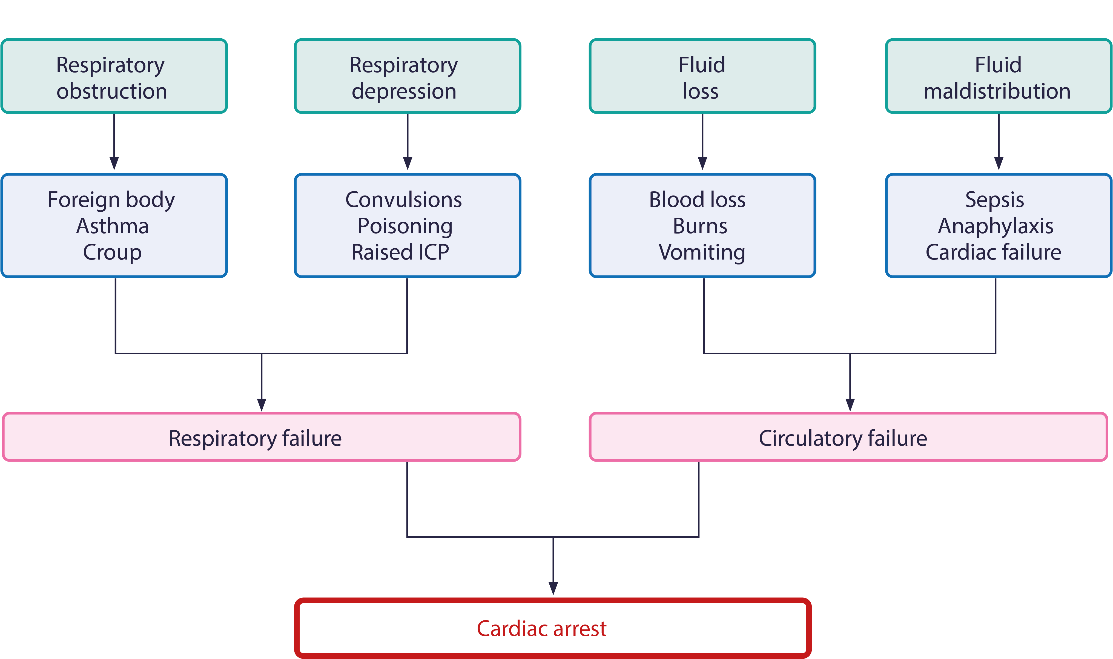
Oorzaken van hartstilstand bij kinderen
Notes:
Structured approach is needed in the simulations
The rapid clinical assessment should take less than 60s (excl BP) – it follows the same order as treatment should be provided
Re-assessment using the same structure should be undertaken after any treatment
It is used as a communication tool between staff and for record keeping in the critically ill or injured child
Examples of respiratory distress, eg croup, asthma, bronchiolitis
Examples of respiratory depression, eg post-ictal, meningitis, poisoning
Examples of fluid loss, eg gastroenteritis, femoral / pelvic fractures
Examples of fluid maldistribution, eg meningococcal shock, anaphylaxis

Slide 11
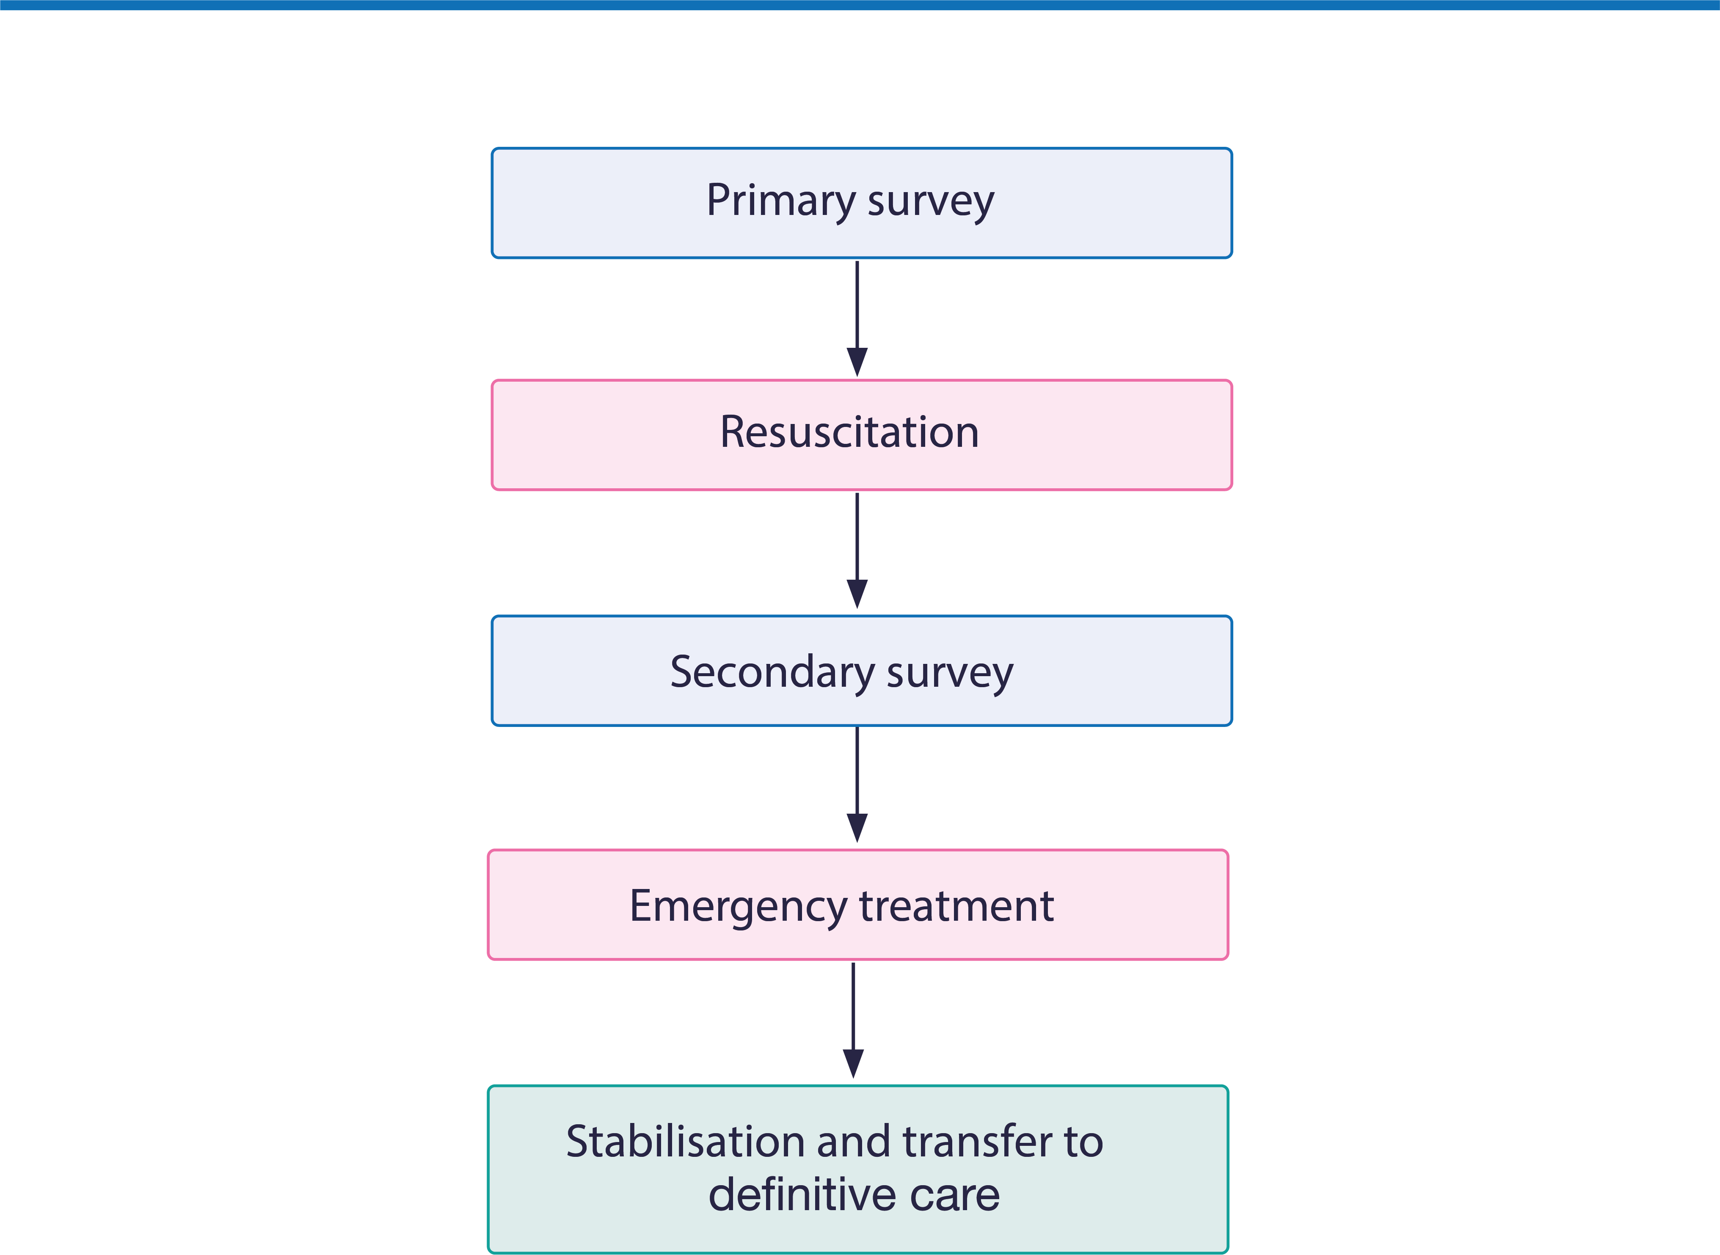
APLS: Systematische aanpak
A | B | C | D | E
Notes:
Stress the structured approach – reinforce:
the need to treat in order of the structured approach
the role of repeat assessments using the same structure and in particular after any treatment
the value of using this in record keeping and in communications between staff.
Structured approach is needed in the simulations
The rapid clinical assessment should take less than 60s (excl BP) – it follows the same order as treatment should be provided

Slide 12
APLS Recertificatie cursus
De krijtlijnen

