Slide 1
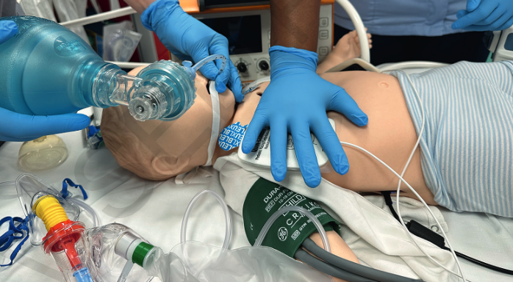

Advanced Paediatric Life Support
Aanpak van hartstilstand
Notes:
DON’T FORGET TO READ THE NOTES UNDER THE SLIDES!
Remember the lectures are here to refresh the content for the candidates rather than teach it.
Don’t spend too long on the first 9 slides (BLS).
The cardiac demo simulation follows this lecture.
The lecturer is responsible for leading into this at the end of the lecture and for facilitating the ‘partner discussion’ at the end of the sim demo.
Please use the slide provided at the end of the lecture (after the questions and summary slides) to show the candidates the questions they need to discuss.

Slide 2
Hartstilstand: leerdoelen
Inzicht verwerven in de gestructureerde aanpak van hartstilstand
Opfrissing van de verschillende protocollen gebruikt bij hartstilstand
Overgang BLS naar ALS
Belang van team approach
Verschillen met NLS aangeven

Slide 3
BLS protocol
SAFETY
Denk aan veiligheid
STIMULEER
Alles OK?
Geen reactie
SHOUT
Roep om hulp
Open airway (luchtweg)
Ademt niet normaal
Geen tekenen van leven
5 rescue breaths
Nog steeds geen tekenen van leven
Start CPR
15 compressies: 2 beademingen
Leg aan monitor / defibrillator / AED
(als beschikbaar)
Continu CPR tot tekenen van leven of normaal ademen

Slide 4
BLS protocol
SAFETY
Denk aan veiligheid
STIMULEER
Alles OK?
Geen reactie
Alleen: roep hard.
Met twee: iemand belt 112/2222 en haalt materiaal, iemand start BLS
SHOUT
Roep om hulp
Open airway (luchtweg)
Ademt niet normaal
Geen tekenen van leven
5 rescue breaths
Alleen mét gsm: bel 112/2222
Nog steeds geen tekenen van leven
Start CPR
15 compressies: 2 beademingen
Leg aan monitor / defibrillator / AED
(als beschikbaar)
Alleen zonder gsm: haal hulp na 1 minuut CPR.
Continu CPR tot tekenen van leven of normaal ademen
Notes:
Leg de drie momenten van activatie uit

Slide 5
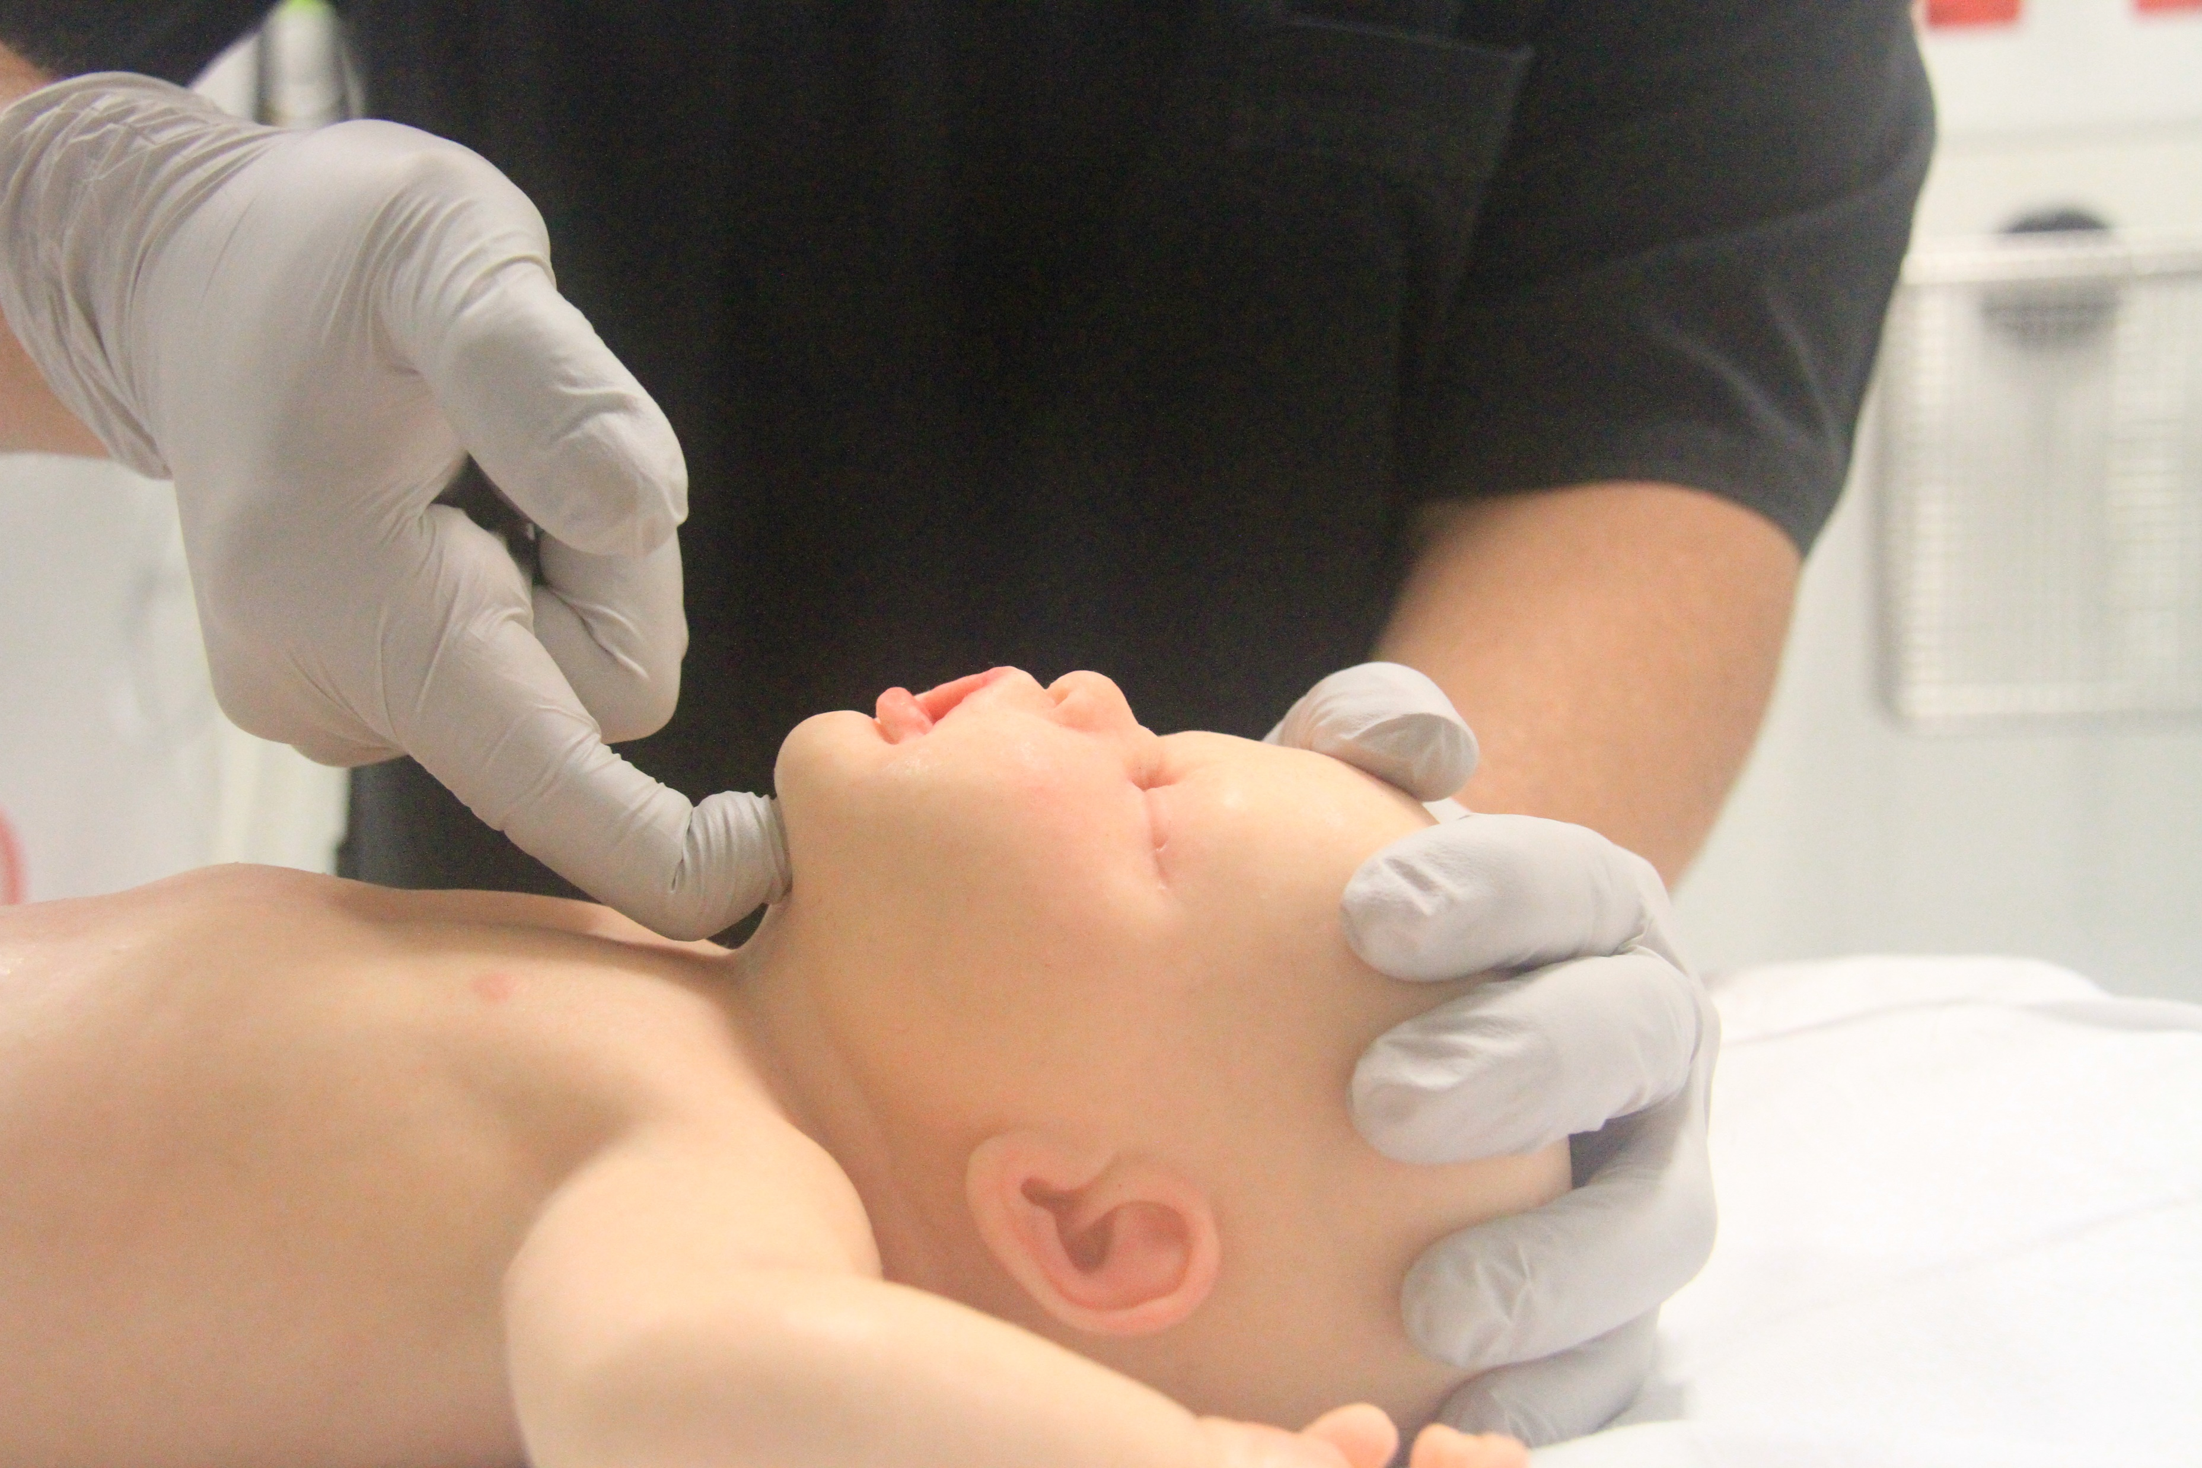
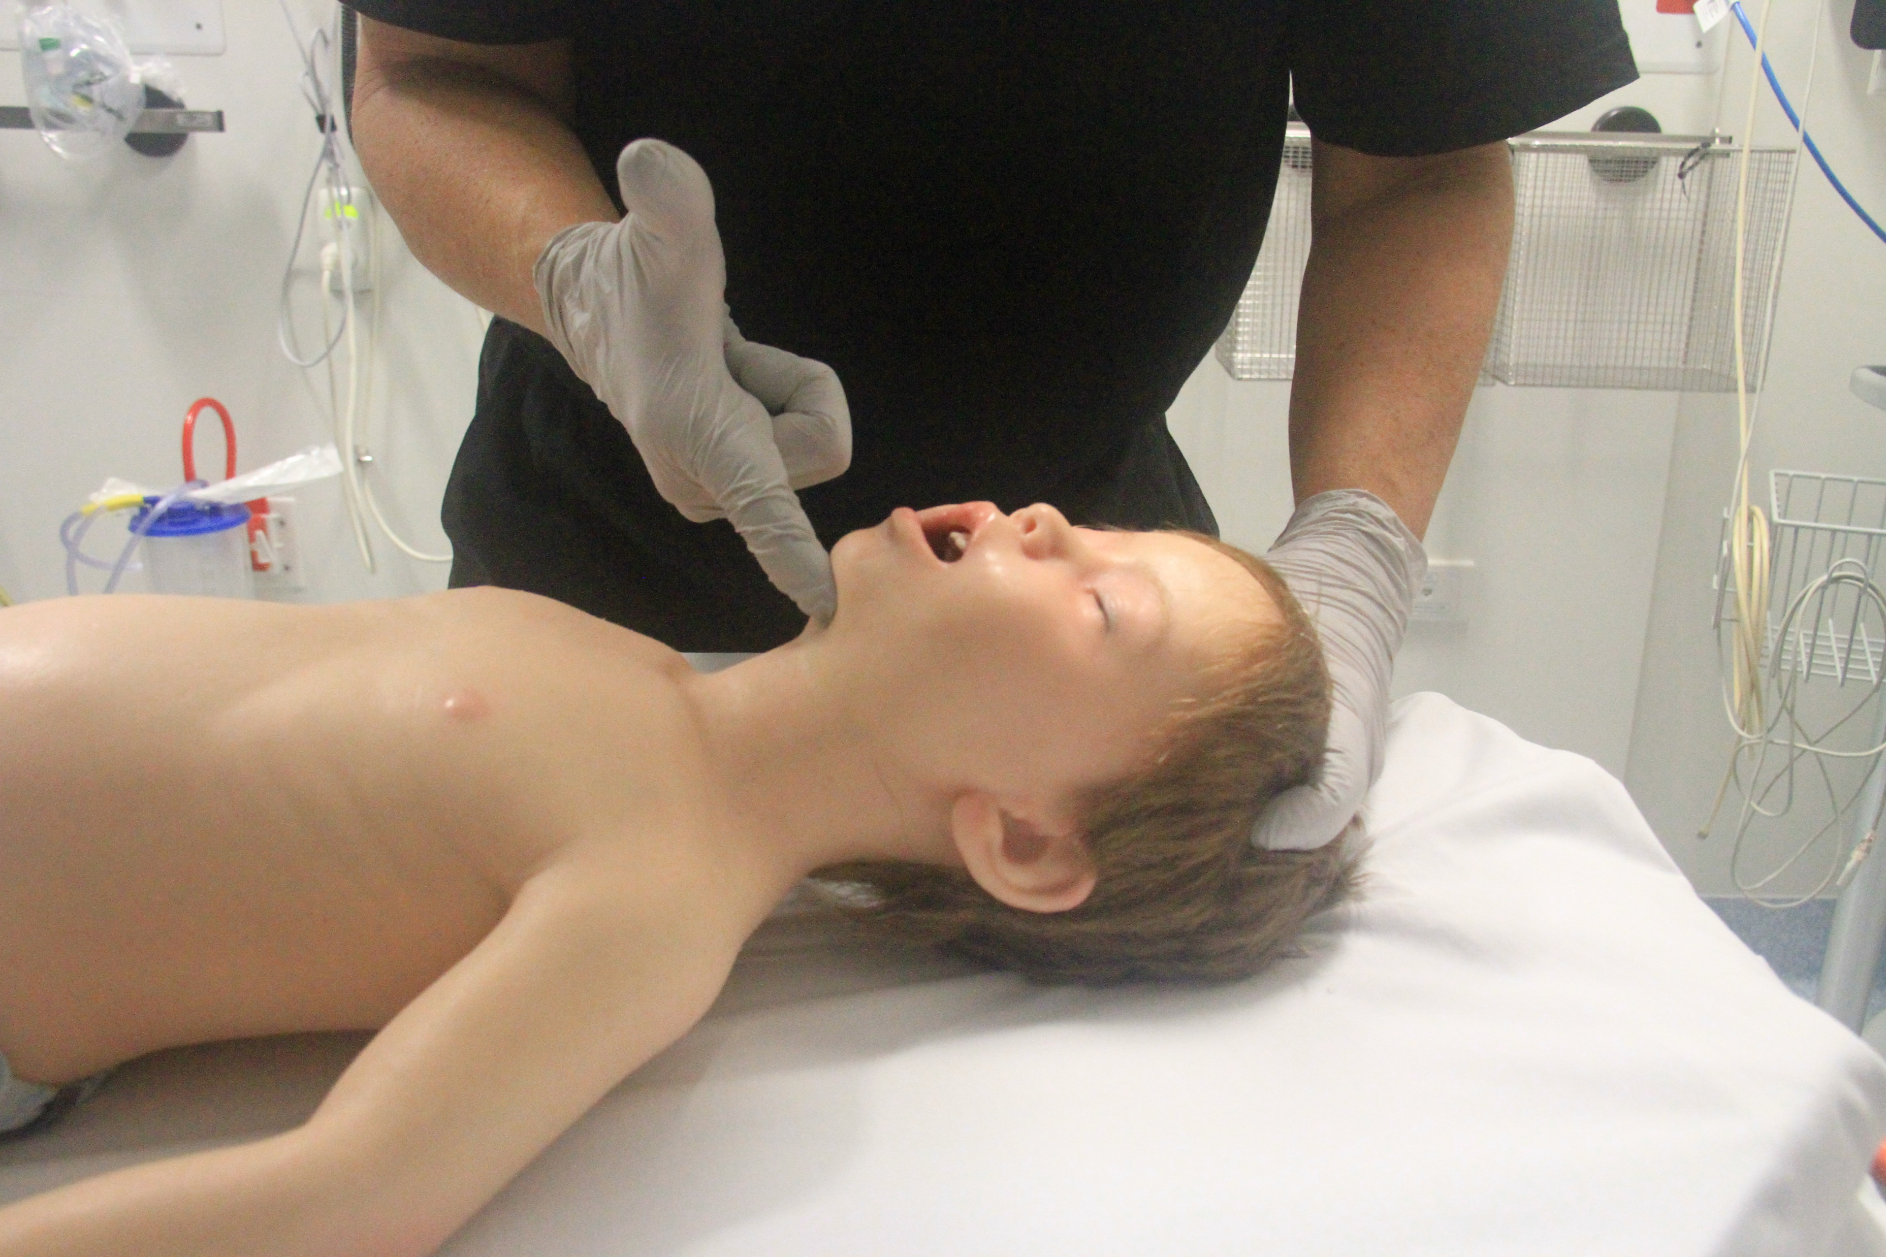
Airway openen
Notes:
INFANT - Neutral, with chin lift
CHILD – Sniffing, with chin lift
Bij trauma jaw trust

Slide 6
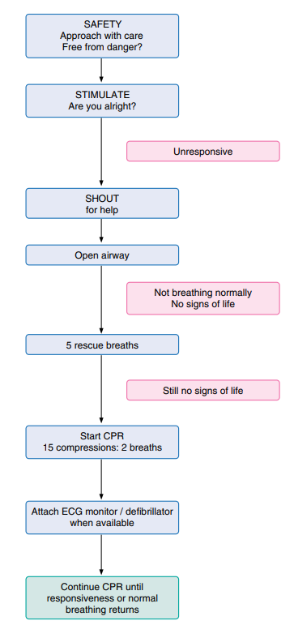

Cardiac arrest algorithm
Open airway
Ademt niet normal. Geen tekenen van leven
5 rescue breaths
Mond op mond of met hulpmiddelen
Nog steeds geen tekenen van leven
Start CPR
15 compressies: 2 beademingen

Slide 7
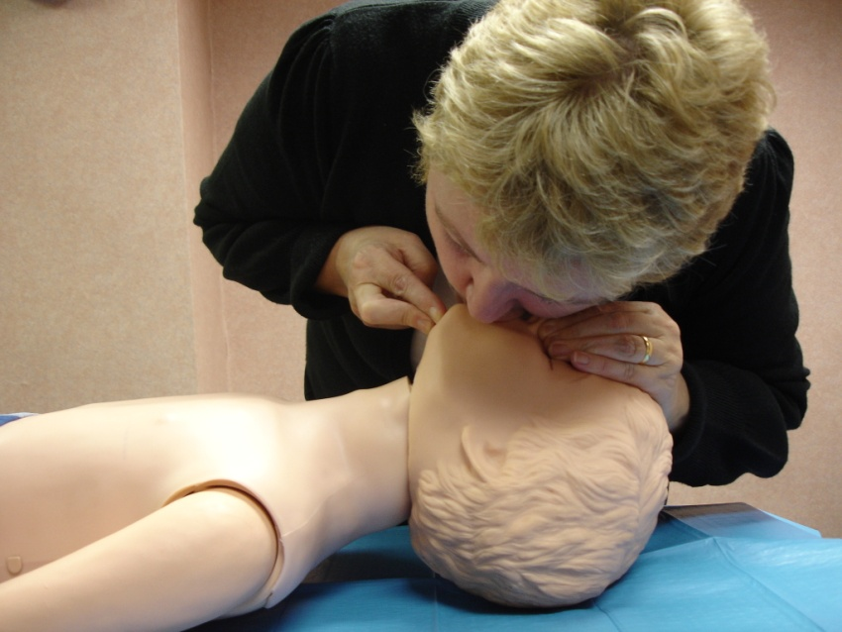
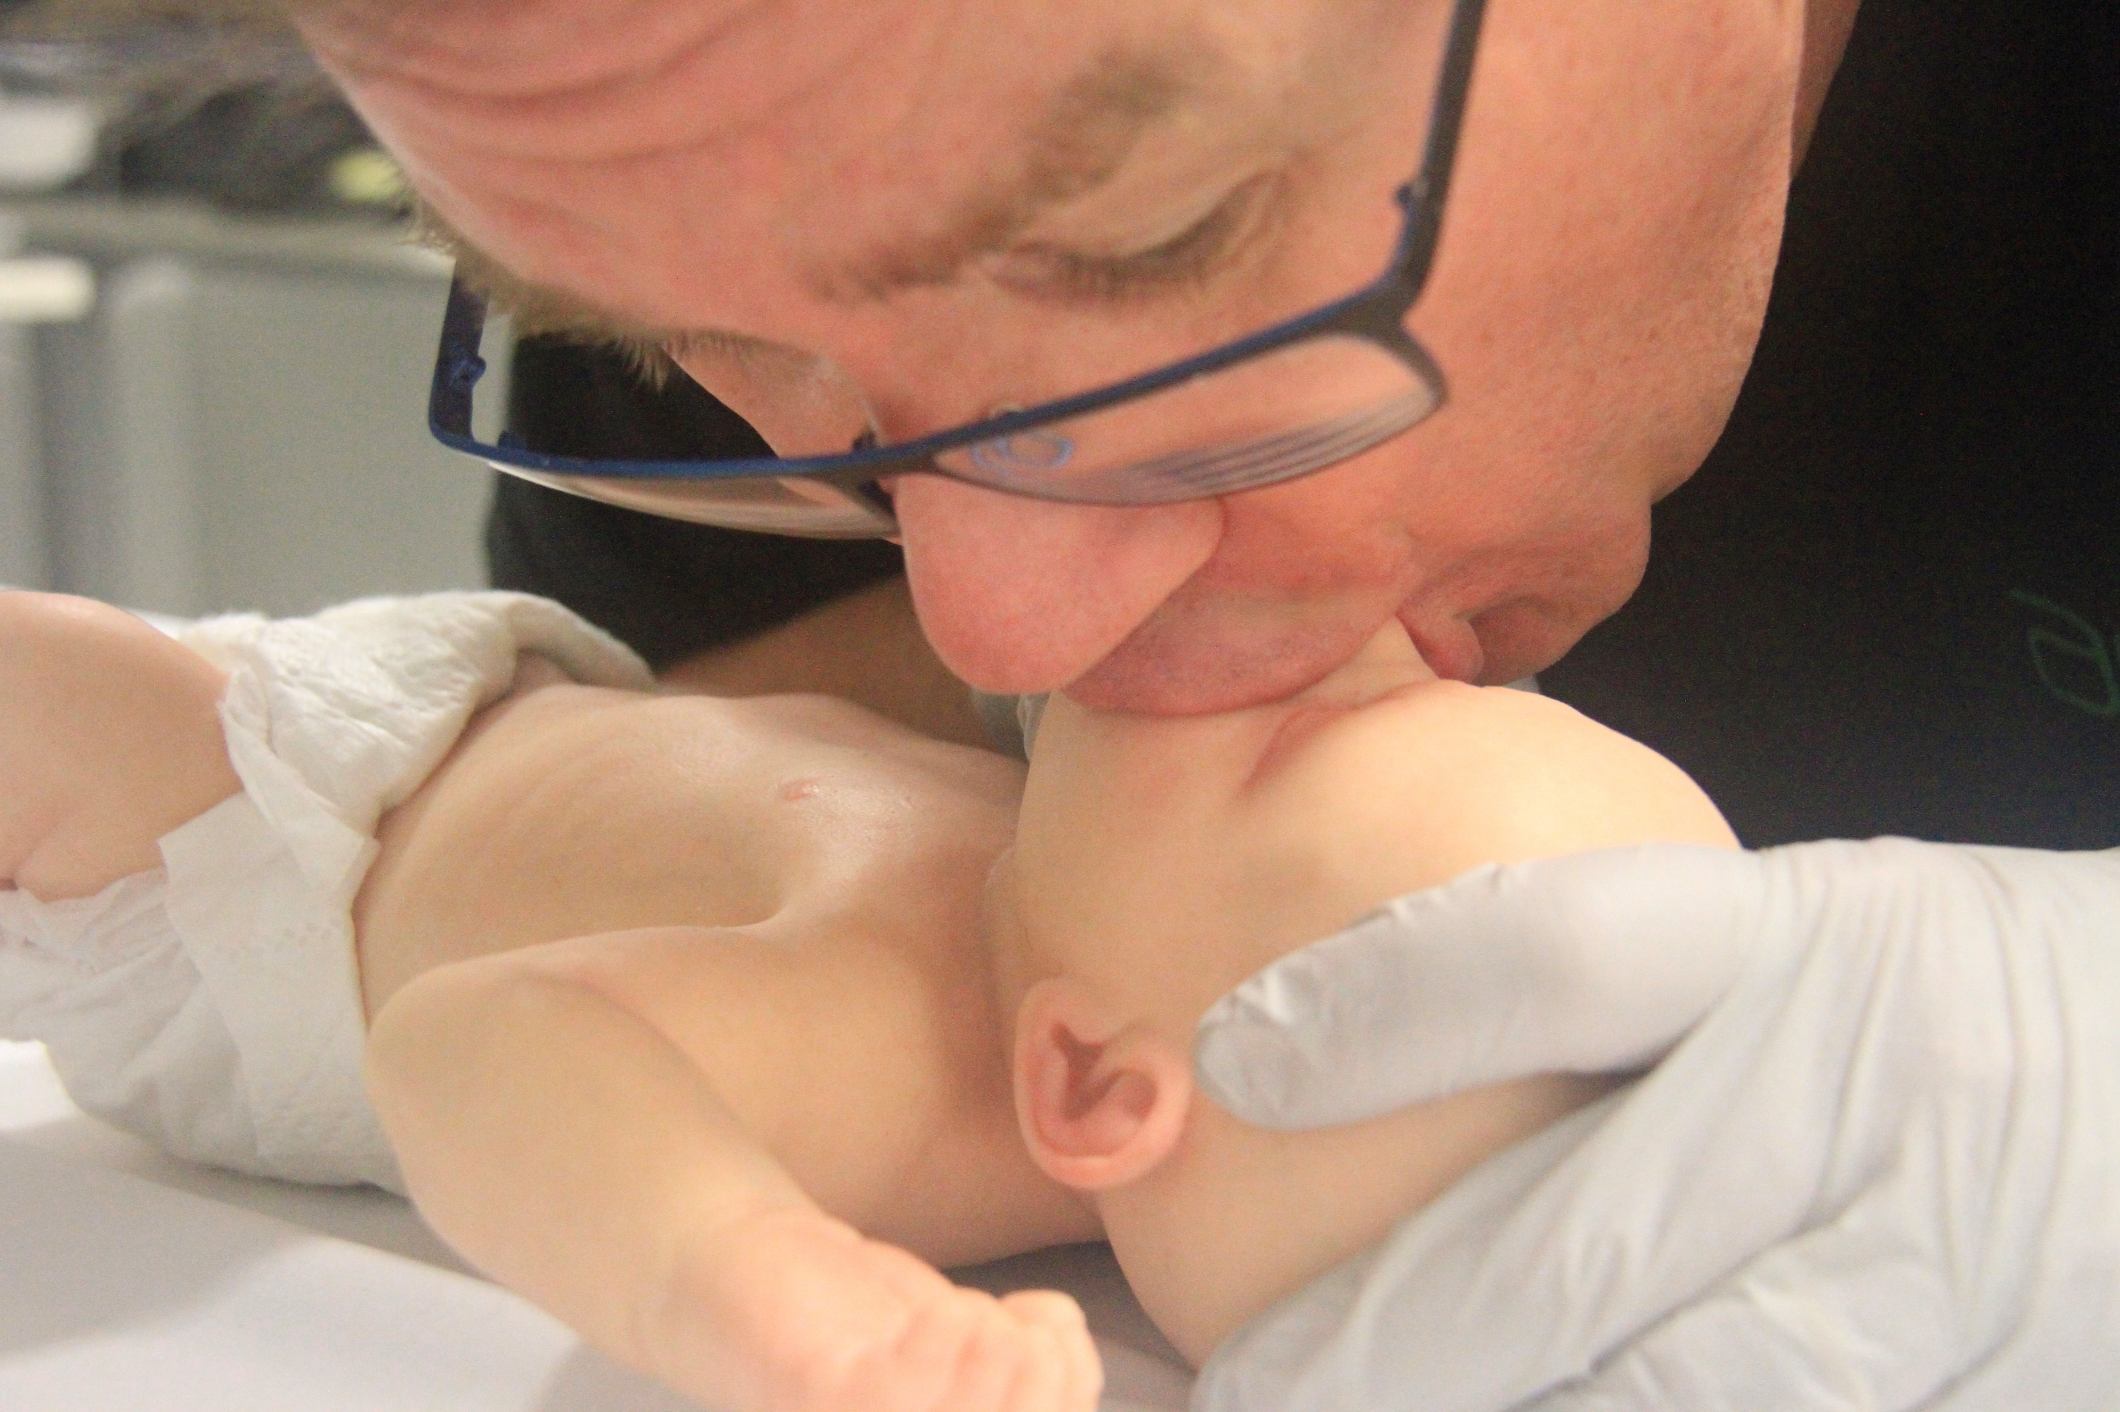
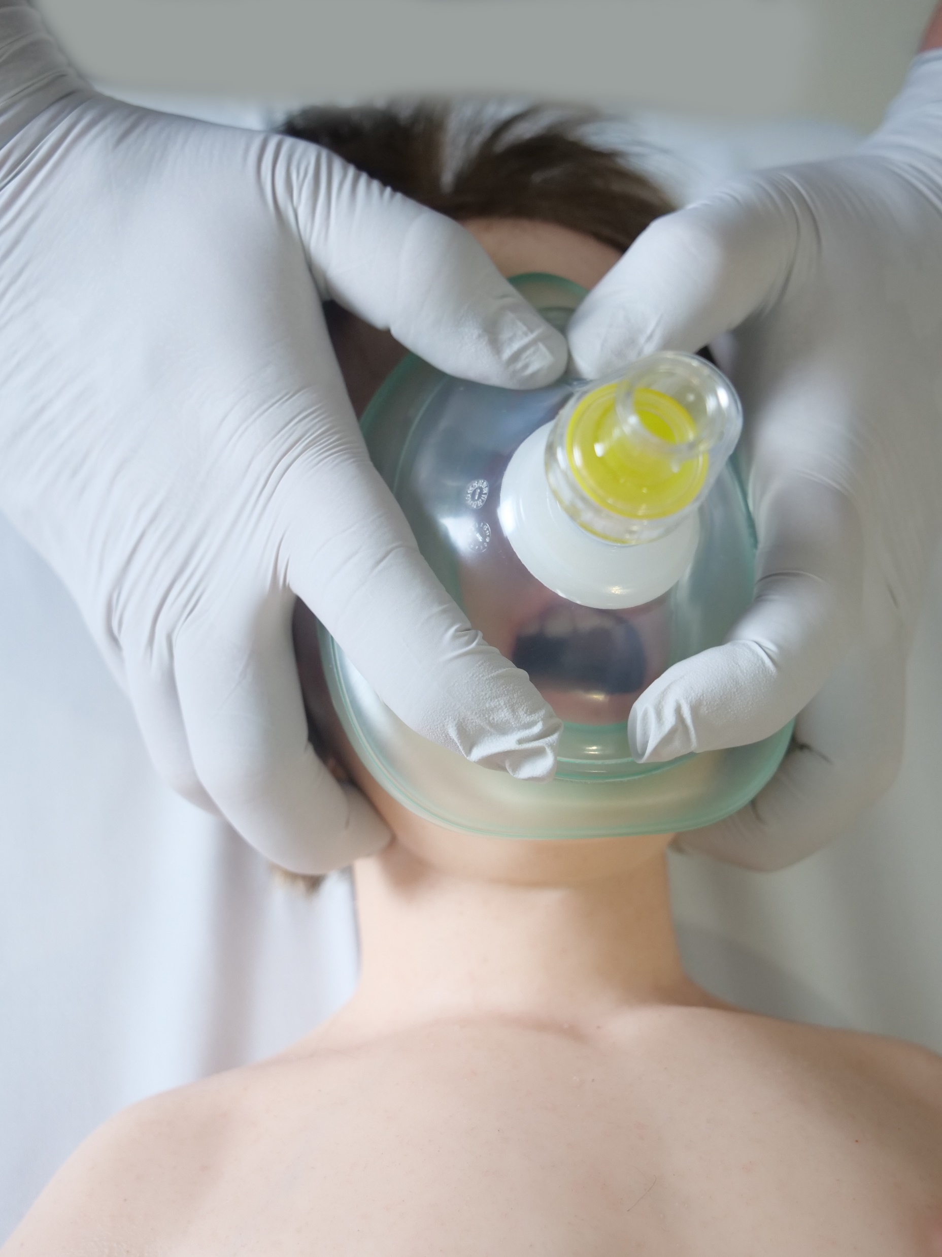
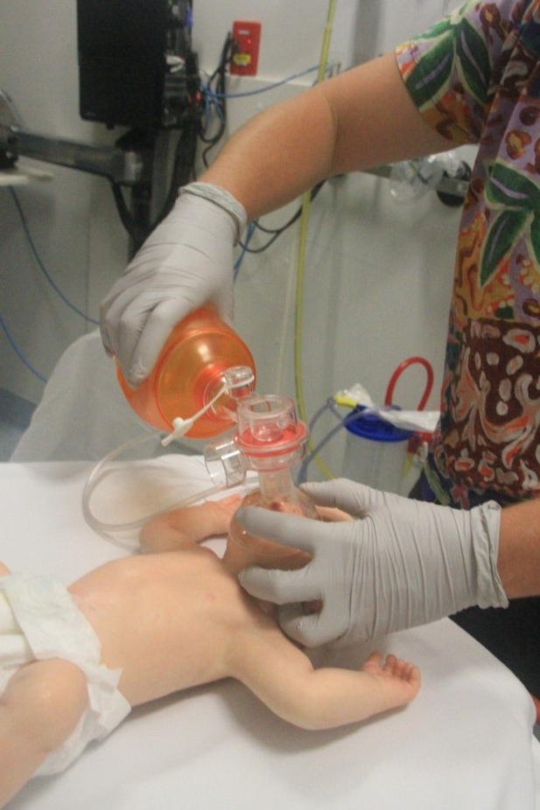
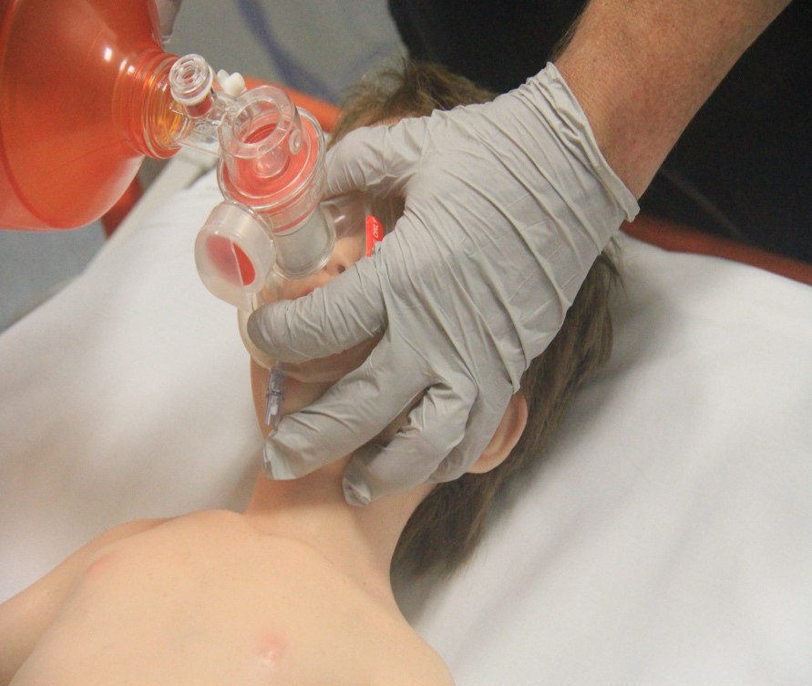
5 rescue breaths
Notes:
Give 5 rescue breaths
Mouth to mouth with nose pinched for over ones
Mouth to mouth and nose for under ones
If the nose and mouth cannot be covered in the older infant, the rescuer may attempt to seal only the infants’ nose with his mouth (and close the lips to prevent air escape)
Slow breaths –about one second
Lowest pressure, so as not to inflate stomach
Assess by seeing chest movement
While doing the rescue breaths, note whether there is any gag/cough as part of the “signs of life” assessment
Note that delaying mouth to mouth in favour of waiting for a bag valve mask may allow the child to fully arrest

Slide 8
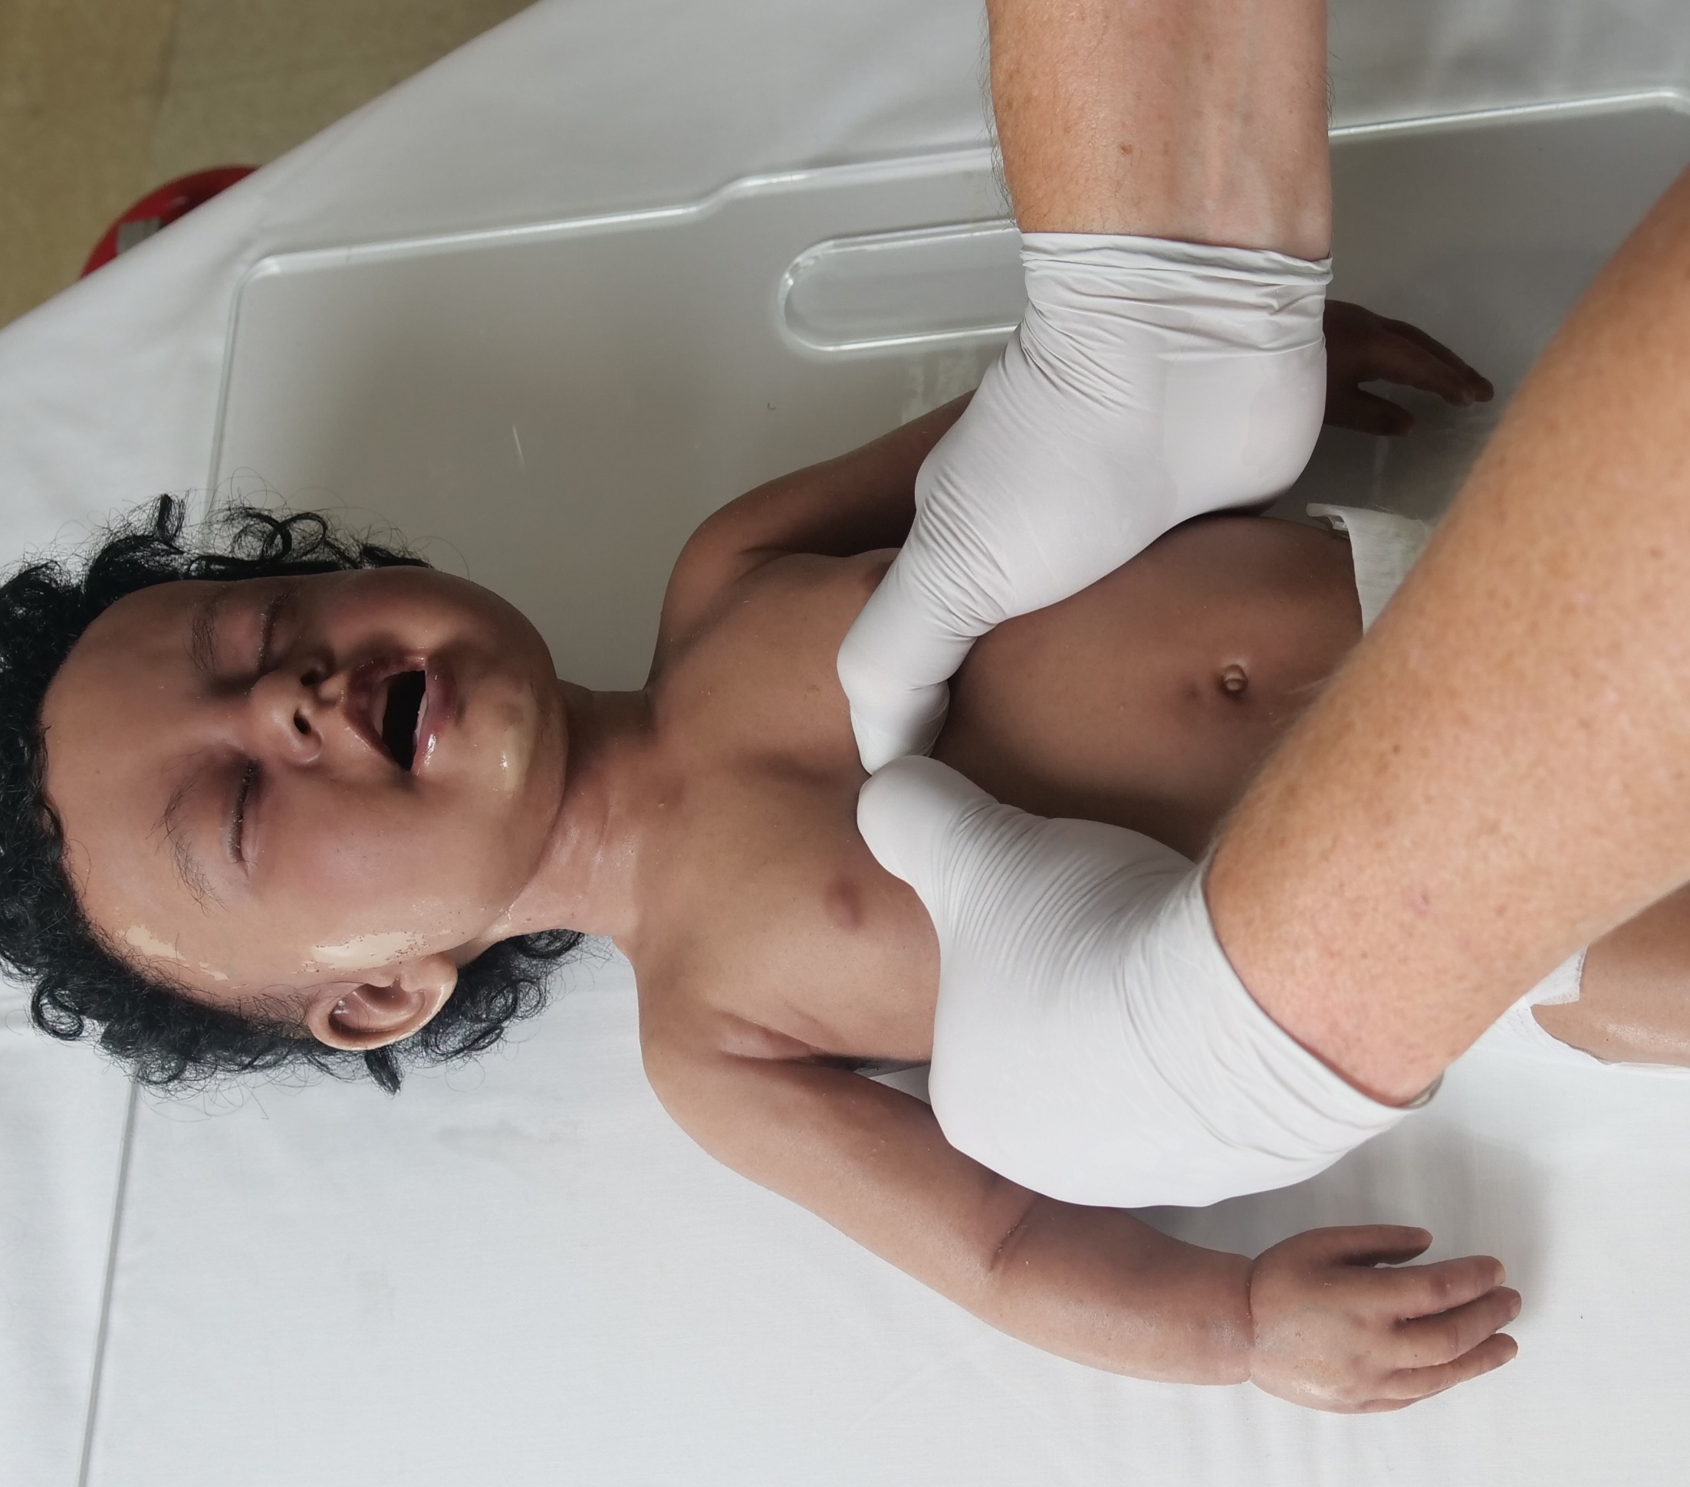
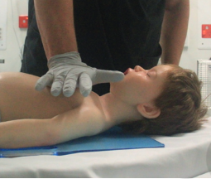
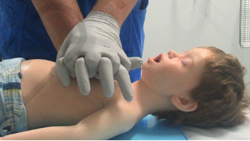
EFFECTIEVE BLS REDT LEVENS
15:2
100-120 per minuut
Duw hard, één derde diep
Notes:
If still no signs of life observed during the previous steps, then start chest compressions.
Signs of life
• breathing or abnormal breathing (agonal breathing)
• movement
• cough/gag in response to breaths
Compress the lower half of the sternum at least one third of the depth of the child’s/infant’s chest.
Infant - Using two-thumb encircling technique over the lower half of the sternum – at least 4cm
Child - Using the heel of one hand (or two) over the lower half of the sternum – at least 5 cm
Thanks to Children’s Health Queensland for images

Slide 9
Van basic naar advanced life support
Nog steeds geen tekenen van leven
Start CPR
15 compressies: 2 beademingen
Effectieve BLS is essentieel
leg ECG monitor / defibrillator aan (als beschikbaar)

Slide 10
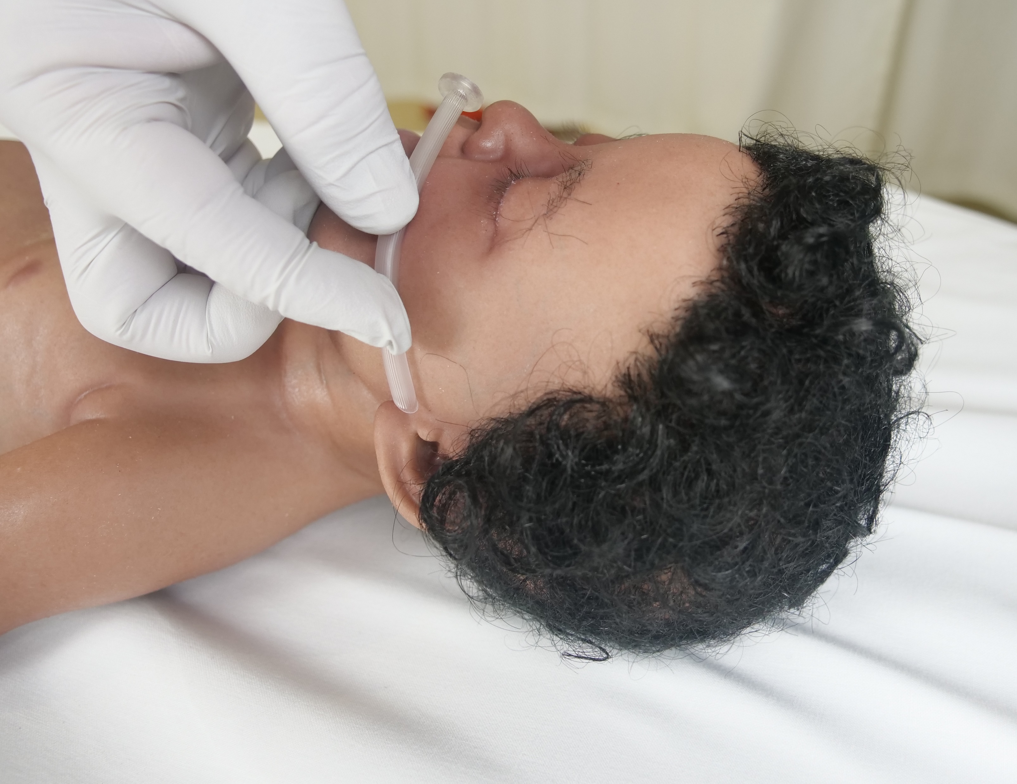
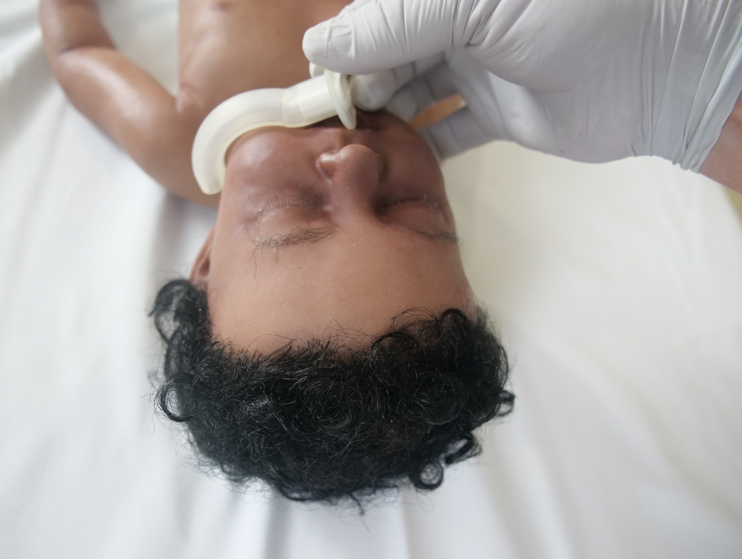
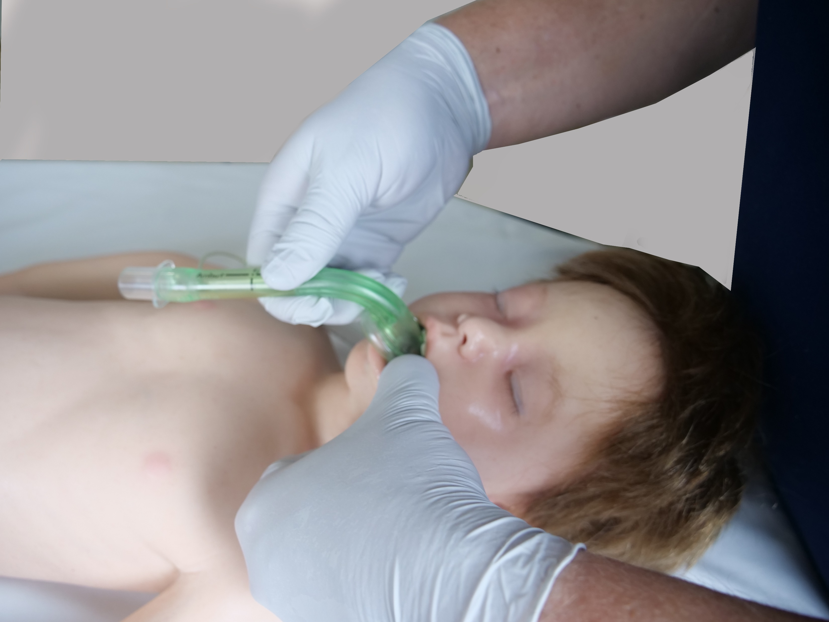
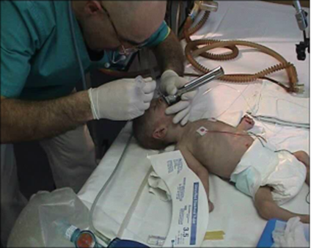
Airway hulpmiddelen
Notes:
Use airway adjuncts as appropriate and in a timely fashion

Slide 11
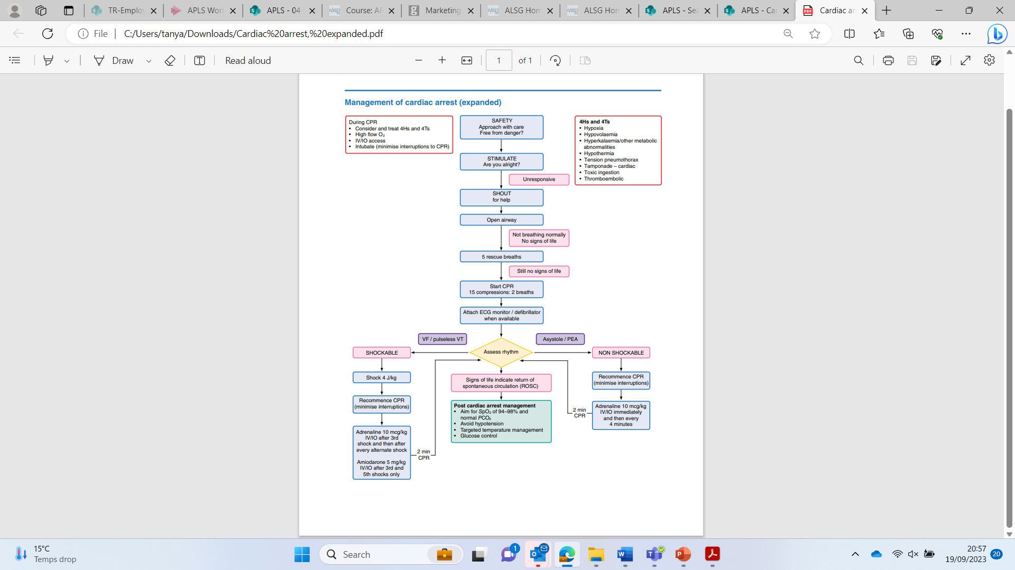
Advanced life support C
Leg aan monitor / defibrillator / AED
(als beschikbaar)
VF / pulsloze VT
Asystolie / PEA
Beoordeel ritme
SHOCK NODIG
GEEN SHOCK NODIG

Slide 12
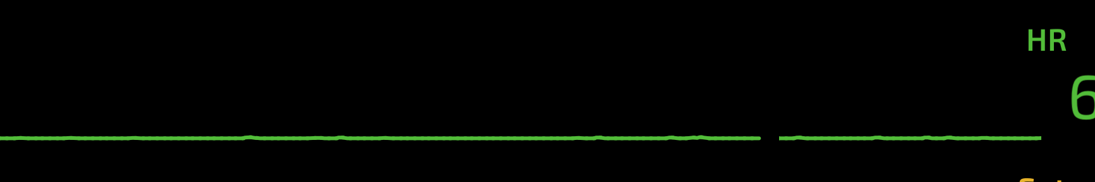
Asystolie
Notes:
Mention checking leads and turning up ECG gain

Slide 13
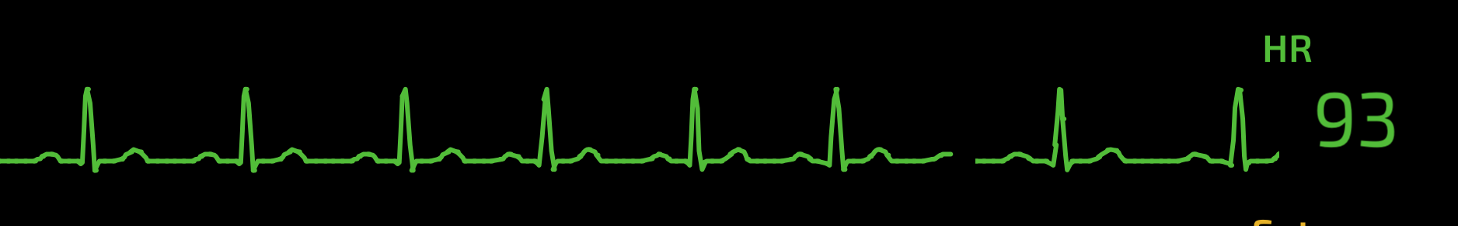
Pulsloze Electrische Activiteit
Notes:
Pulseless Electrical Activity is the absence of a palpable pulse in the presence of an electrical rhythm that should produce a pulse in an unconscious patient
Electro-Mechanical Dis-association is a particular type of PEA usually seen in adults with severe coronary disease and therefore not relevant to children. The two names are sometimes used interchangeably

Slide 14
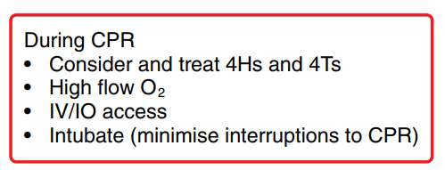
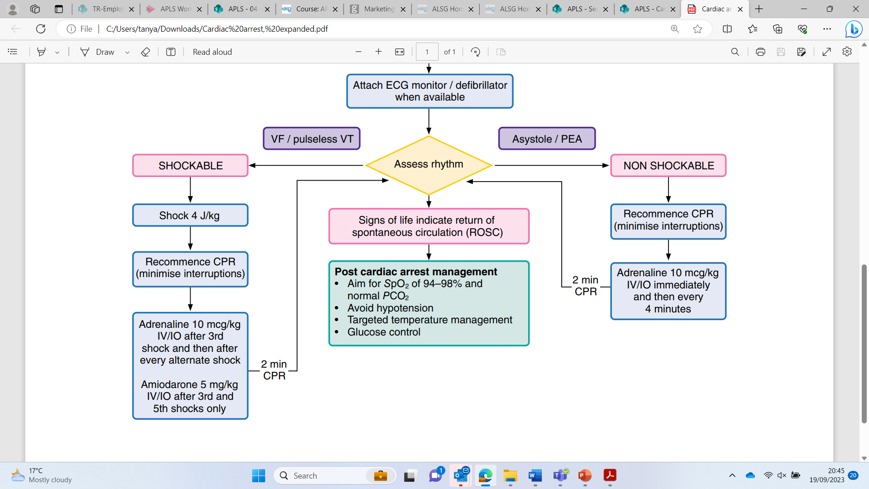
Algoritme “geen shock nodig”

Slide 15
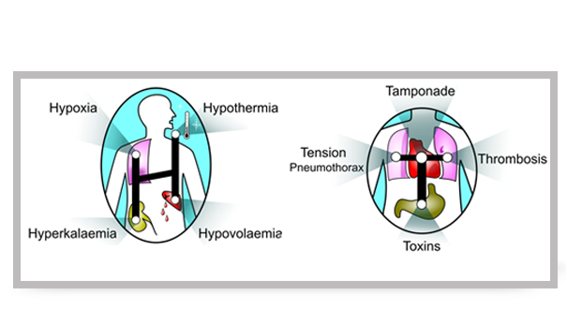
4 H’s en 4 T’s
Hypoxie
Hypovolemie
Hyper-, hypokaliëmie (en andere metabole oorzaken)
Hypothermie
Tensie pneumothorax
HartTamponade
InToxicatie
Thrombo-embolisme
Notes:
Instructor notes
Ask the candidates to shout out the 4 Hs and then click to project these; then ask for the 4 Ts and then click to project these.

Slide 16
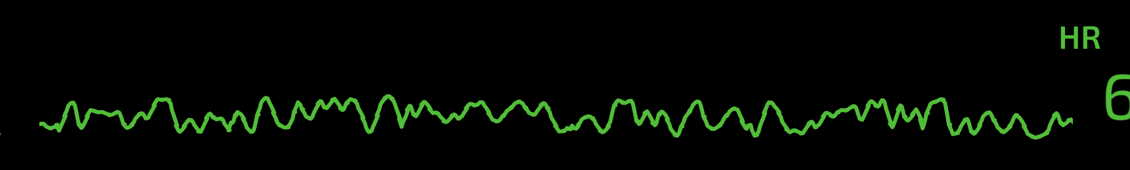
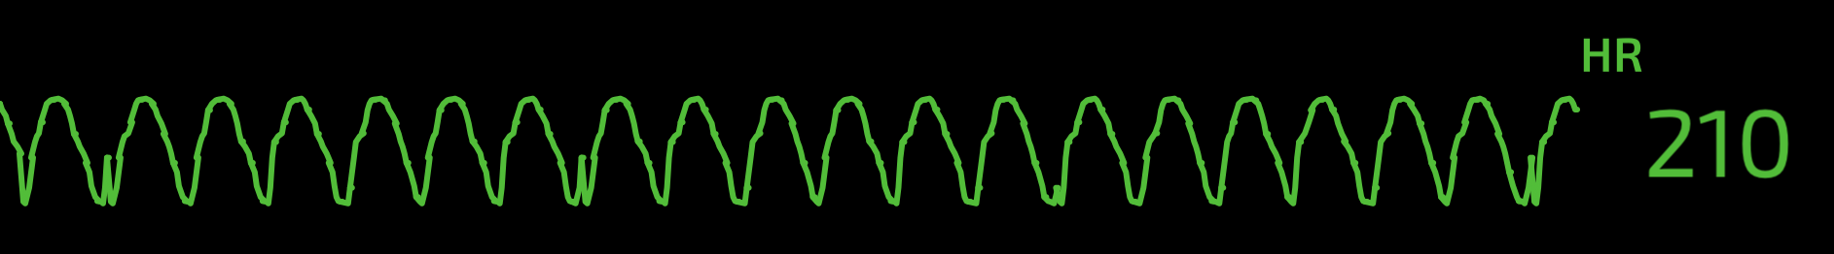
Ventrikelfibrillatie
Ventrikeltachycardie

Slide 17
Algoritme “shock nodig”

Slide 18
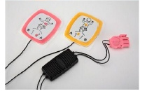
Defibrillatie
Eén shock:
4J/kg - manuele defibrillator -> alle lft
AED aangepast aan kinderen -> 1-8 jaar
AED volwassenen -> >8 jaar
Geen resultaat na 5 x shock:
  Verdubbel dosis tot 8 J/kg *
  Als paddles, ga over naar pads
* Resuscitation 161 (2021) page 338 - European Resuscitation Council Guidelines 2021: Paediatric Life Support
Notes:
For the infant of less than one year a manual defibrillator which can adjusted to give the correct shock is recommended. However, if an AED is the only defibrillator available, it use should be considered, preferably with paediatric attenuation pads. The order of decreasing preference for defibrillation in the under ones is as follows:
Manual defibrillator
AED with dose attenuator
AED without dose attenuator
From Resuscitation 161 (2021) page 338 - European Resuscitation Council Guidelines 2021: Paediatric Life Support :
“Use 4 J/kg as the standard energy dose for shocks. It seems reasonable not to use doses above those suggested for adults (120-200 J, depending on the type of defibrillator). Consider escalating doses -stepwise increasing up to 8 J/Kg and max. 360 J- for refractory VF/pVT (i.e. more than 5 shocks neede

Slide 19
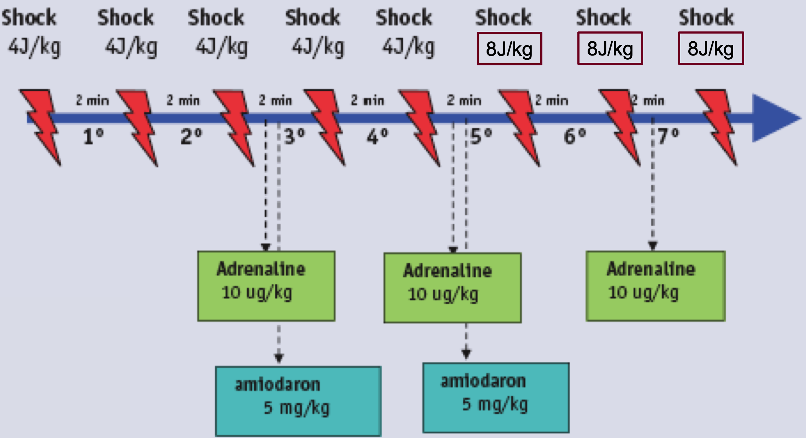
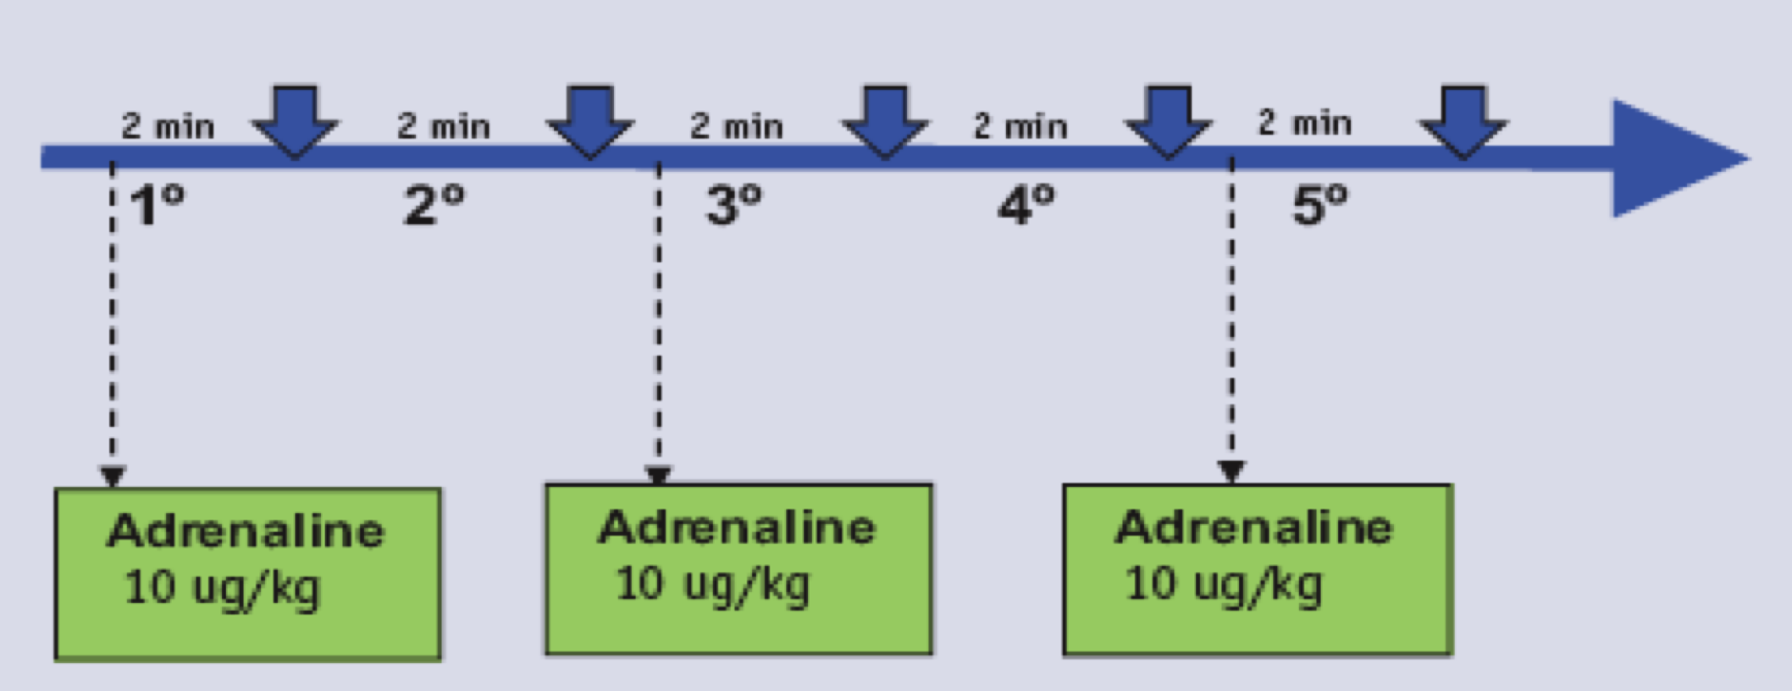
Notes:
In summary: This is the complete cardiac arrest algorithm as you have seen in your book (p 257)
Follow the appropriate arm of the algorithm depending on the rhythm on the monitor, get early IV/IO access and consider the 4 Hs and 4 Ts.

Slide 20
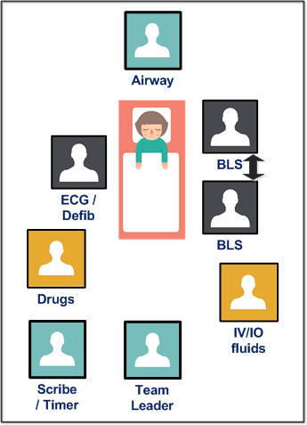
Team aanpak
Notes:
Discuss the roles and what they involve – how the team may have to double up where less staff are available – see colours on diagram
Discuss communication via team leader
Pre allocation of roles where possible
Discuss when it is expedient to use advanced airway skills

Slide 21
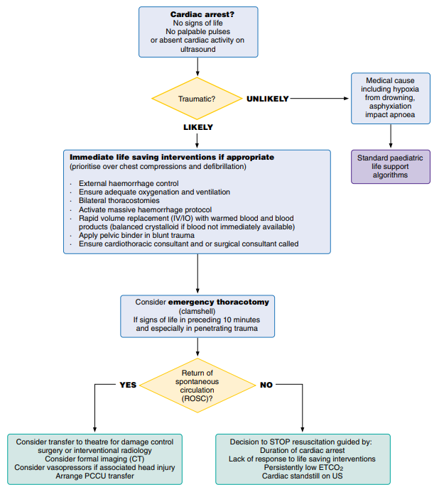
Paediatrische traumatische hartstilstand
Notes:
Why do we do this differently? Aimed at managing the causes likely in traumatic injury particularly haemorrhagic hypovolaemia.
When do we do this? Talk through indications and timings penetrating injury; and limited evidence in blunt injury.
How do we do this differently? (next slide)

Slide 22
HOTT-principes
= Interventies die onmiddellijk levensreddend zijn.
Hypovolemie: stop externe bloedingen (vóór start compressies)
Oxygenatie en ventilatie
Bilaterale Thoracostomie
Tamponade
Tevens:
  activeren van massief transfusie protocol
  Snelle volume toediening
  Plaatsen bekkensling bij stomp trauma
  Snel cardio/thoracale/abdominale chirurg
Notes:
Immediate life saving interventions if appropriate – name HOTT principles (stands for hypovolaemia; oxygenation; tension pneumothorax/tamponade. = 2 of the H and 2 of the T in cardiac arrest)
· External haemorrhage control (prioritise over chest compressions and defibrillation)
· Ensure adequate oxygenation and ventilation
· Bilateral thoracostomies
· Activate massive haemorrhage protocol
· Rapid volume replacement (IV/IO) with warmed blood and blood products (balanced crystalloid if blood not immediately available)
· Apply pelvic binder in blunt trauma
· Ensure cardiothoracic consultant and or surgical consultant called

Slide 23
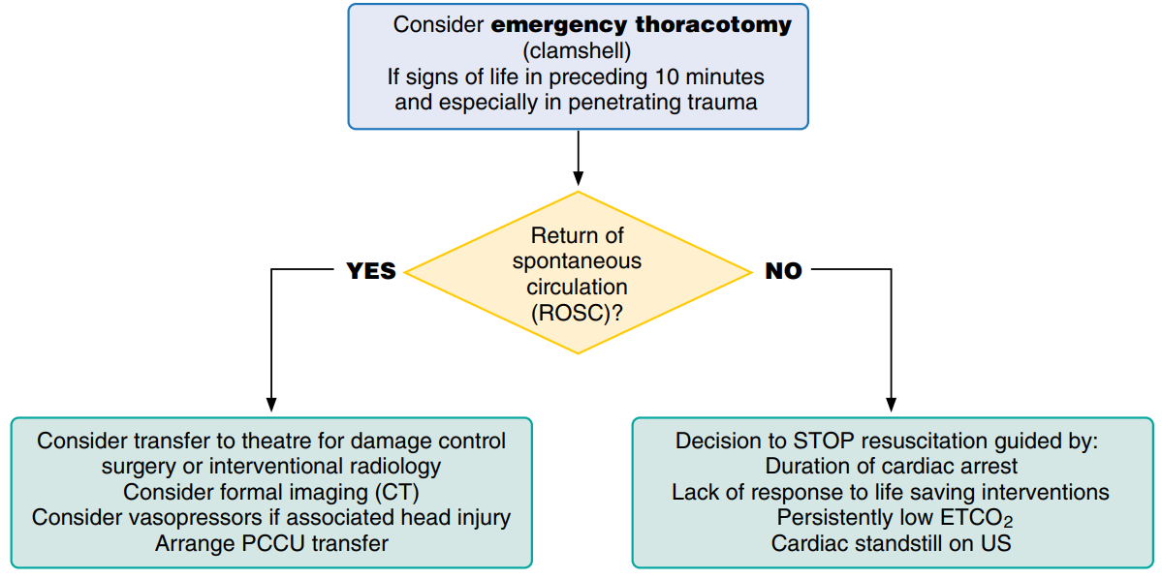
Pediatrisch traumatisch arrest
Notes:
Briefly talk through the bottom half of the algorithm
The 2nd T in HOTT: Emergency thoracotomy – clamshell – when you would do this – who would do this
Then:
Post ROSC – imaging, surgery, transfer
When to stop………………..
Questions?

Slide 24
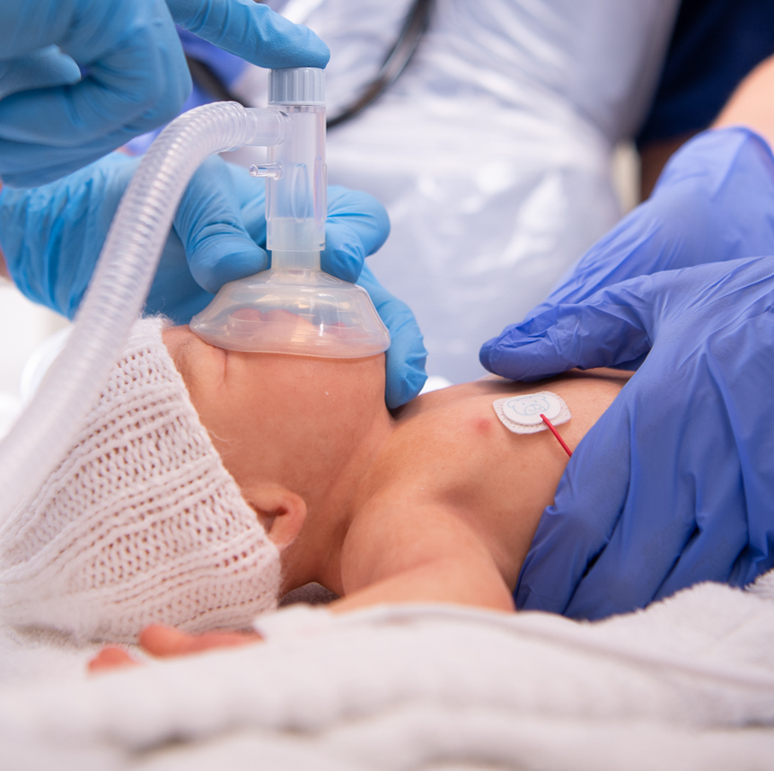
Neonatale resuscitatie
Notes:
Make it clear that this is immediate post-delivery resuscitation (in ED, on a general ward or in the labour room) rather than every neonate and that otherwise follow usual APLS guidance.
Why does Newborn resuscitation need a different approach to paediatric resuscitation?
In most cases they have a hypoxic event in utero and the lungs have not yet been inflated

Slide 25
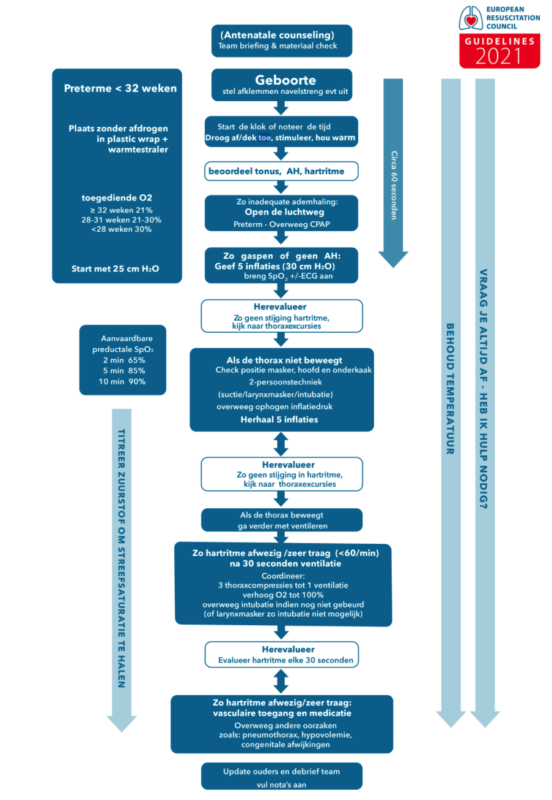
Notes:
Newborn resuscitation needs a different approach to paediatric resuscitation because in most cases they have a hypoxic event in utero and the lungs have not yet been inflated.
Most infants adapt well to extra-uterine life but some require help with stabilisation, or resuscitation. Up to 85% breathe spontaneously without intervention; a further 10% respond after drying, stimulation and airway opening manoeuvres; approximately 5% receive positive pressure ventilation. Intubation rates vary between 0.4 and 2%. Fewer than 0.3% of infants receive chest compressions and only 0.05% receive adrenaline
This algorithm clearly describes the sequence of actions needed to resuscitation a newborn.

Slide 26
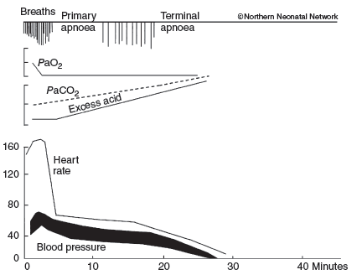
Figure G.3 Response of a mammalian fetus to total, sustained asphyxia starting at time 0
Reproduced with permission from Northern Neonatal Network
Notes:
In the 1950’s some important research was carried out on mammals. They were delivered into a bag of saline, to mimic a hypoxic event and then released from the bag at different points.
This graph demonstrates the time following hypoxia and the physiological sequence of events.
The arrows are the point at which the animals were ‘delivered’ out of the saline bag and resuscitated.
At the bottom is a timeline and on the vertical graph you can see the heart rate, blood pressure and acid balance. The top line shows the respiratory effort of an infant following a hypoxic event.
Delivery at the first point (note the baby has been hypoxic for approx. 8-9 minutes) would mean the baby has gone into primary apnoea, and management would be to inflate the lungs with 5 inflation breaths. This would allow the heart rate to increase, acid base to normalise. The baby would most likely self-resuscitate by gasping if nothing was done at this point.
Treatment: Dry the baby: 5 inflation breaths, check for chest movement, if chest rises, then continue with ventilation breaths until the baby breathes for themselves. Wrap and hand to mother.
At approximately 12 minutes following hypoxia a baby will start gasping, these are irregular ‘spinal’ breaths and if nothing was done, they would inflate the lungs and the baby would self-ventilate.
If delivery happens at this point: dry the baby, 5 inflation breaths followed by ventilations if successful chest rise.
Once the baby breathes, wrap and hand to the mother.
Delivery during the secondary apnoeic event will require 5 inflation breaths ánd ventilations. If the heart rate does not increase, this needs to be followed by 3:1 compressions until the heart rate improves. Check the baby every 30 seconds for tone, colour, breathing and heart rate.
If no increase of heart rate or asystole, consideration should be given to adrenaline and intubation and further resuscitation.

Slide 27
Notes:
Briefly talk through this algorithm, mention acceptable pre-ductal saturations.

Slide 28

Neonatale resuscitatie – inflatie
Met dank aan dr H Blom

Slide 29
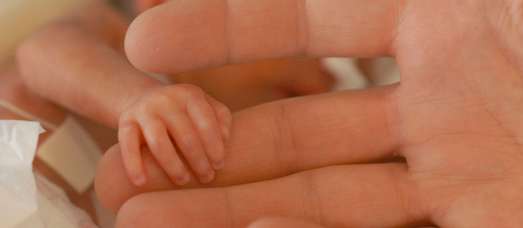
Pre-terme babies
Wat doen we anders?

Slide 31
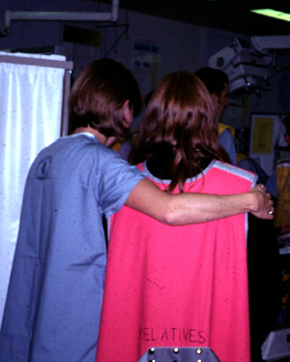
Aanwezigheid van familie tijdens reanimatie
Familie moet de gelegenheid geboden worden aanwezig te zijn tijdens de reanimatie van hun kind
Stel (zo mogelijk) iemand aan om de ouders te begeleiden

Slide 32

Advanced Paediatric Life Support
Aanpak van hartstilstand

Slide 33
Notes:
In summary: This is the complete cardiac arrest algorithm as you have seen in your book (p 257)
Follow the appropriate arm of the algorithm depending on the rhythm on the monitor, get early IV/IO access and consider the 4 Hs and 4 Ts.

Slide 34
Demonstratie kind met arrest
Vragen die kandidaten in duo moeten bespreken na de demonstratie:
Herhaal (verbaal) alle stappen van een veilige defibrillatie.
Hoe heeft de teamleider de niet-technische elementen tijdens de simulatie aangepakt?
Tracht alle vragen die bij je opkomen onderling op te lossen alvorens de sessie weer opengetrokken wordt naar de hele groep.

