Slide 1

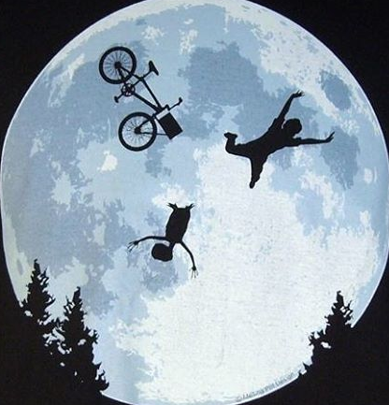
Advanced Paediatric Life Support
Gestructureerde aanpak van het ernstig gewonde kind
Notes:
DON’T FORGET TO READ THE NOTES UNDER THE SLIDES!
Remember the lectures are here to refresh the content for the candidates rather than teach it.
Candidates get more values from discussing the cases in small groups than Q&A with the lecturer.
Don’t spend too long on the first 11 slides – you should be moving onto the case studies (slide 12 onwards) by 14:00.
The trauma demo simulation follows this lecture.
The lecturer is responsible for leading into this at the end of the lecture and for facilitating the ‘partner discussion’ at the end of the sim demo.
Please use the slide provided at the end of the lecture (after the questions and summary slides) to show the candidates the questions they need to discuss.
Session to learn more about the structured approach to the seriously injured child, building on the knowledge you have gained through the manual and VLE.
Highlight importance:
death following injury is still one of the leading causes of childhood mortality worldwide.
an injured child may be brought into any emergency unit and having

Slide 2
Leerdoelen
Inzicht verwerven in
de gestructureerde aanpak van het ernstig gewonde kind
het snel herkennen van levensbedreigende letsels bij het kind
Notes:
Session approach: knowledge reinforcement and case-based discussion
How to manage a child in a structured and systematic way to identify, prioritise and treat serious injuries and the problems they cause.
Introduce “damage control resuscitation” concept – an approach which aims to prevent any further deterioration

Slide 3
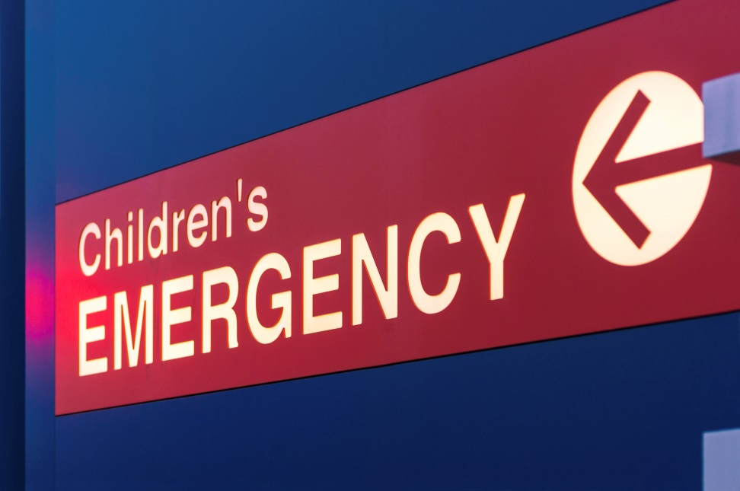
Focus op “doing the basics well”
Primaire opvang met _{c}A_{c}BC resuscitatie zijn je prioriteiten
Aansturen en controle van het team zijn van groot belang
Secundaire aanpak met voorkomen van verdere achteruitgang
cAcBCDE
Notes:
Systematic primary survey looking for catastrophic bleeding or haemorrhage, airway and breathing problems, problems with circulation such as shock, disability (neurological dysfunction)
To identify essential things that need to be done to start to reverse the effects of injury and prevent further deterioration or secondary injury to brain, heart and other vital organs because these contribute to later death or disability from organ failure.
Highlight importance of team with clear leadership and members who understand and can carry out their roles.

Slide 4
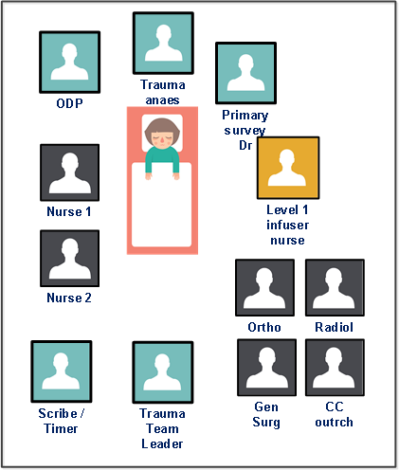
Trauma team
Verschillen:
Level 1 traumacentrum (+ PICU)
Tertiair centrum
Regionaal ziekenhuis
…
Afhankelijk van de lokale setting kan het team wisselen maar de basisprincipes blijven dezelfde.
Notes:
Team composition may vary by setting but fundamentals are the same:
Conduct a primary survey and carry out any immediate life- or limb- saving interventions to stabilise the patient so that they can get safely to definitive care.
Skills needed in team:
advanced airway skills
be able to carry out chest procedures
manage haemorrhage and shock
assess neurological function
assess pain
be able to give emergency room treatment.
A trauma team leader who is able to stand back and have situational awareness so that they can direct the team with clear instructions towards a clear goal is a really important part of a well-functioning trauma team.

Slide 5
Voor aankomst
Team toewijzing
Informatie overdracht
Rol toewijzen
Formuleer een plan gebaseerd op informatie en leeftijd
Zorg voor leeftijdsadequaat ABC materiaal inclusief voor controle bloeding
Communiceer en plan je volgende stappen:
Waar gaat kind heen? Hoe?
Kind komt toe: 5 seconds look
+ gestructureerde SBAR overdracht
Notes:
Discuss team preparation – interaction opportunity – learner conversation – ask what team member would need to know:
Each member needs to know
what’s expected: what patient with what injuries
the job that is expected of them and
who is in charge because this is the person they should be giving information to and who they should be taking direction from.
This then helps with formulating a plan A: based on the information we have
what sort of things are we expecting to find?,
what sort of things are we expecting to need to do? and
how do we think this is going to go? – let’s get ready for that.
Discuss anticipating changing clinical scenario – having a Plan B
Mention:
TTL 5 second review
Structured handover to entire team

Slide 6
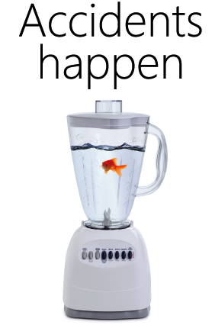
Systematische aanpak
Primaire opvang Behandel de problemen als je ze tegenkomt
Resuscitatie Levensreddende (damage control) acties nodig?
Secundaire opvang en spoedbehandeling
Alle letsels identificeren en plan maken
Definitieve zorg Wat is je eindplan?
Notes:
Systematic approach:
It starts with a primary survey to identify any immediate threat to life.
Complete secondary survey in the trauma room if stable patient and time
Plan and move to where they can get definitive care for their injuries with the right specialist teams.

Slide 7
Initiële beoordeling en aanpak
<c>ontrole massieve bloedingen
Airway - met (cervicale) wervelkolom bescherming
Breathing
Circulatie
Disability (neurologie)
Exposure inclusief extremiteiten/omgeving
Notes:
Reinforce Primary Survey structured approach:
Emphasise the first <c>.
<c>
Mention haemorrhage control – direct pressure, splints and tourniquets
A (+CS)
Identify at risk airway (e.g. low GCS or inhalational burns) and what level of intervention is needed immediately
Remember if risk of spinal injury to protect spine with immobilisation and restriction of movement.
B
Breathing assessment includes inspection of the chest for signs of injury and paradoxical movement, listening to the percussion note and listening for breath sounds and air entry as well as measuring oxygen saturations. This might suggest pneumothorax, haemothorax or a flail chest.
C
Not all traumatic bleeding is obvious. Look for signs of shock such as tachycardia, prolonged capillary refill, reduced consciousness.
Low blood pressure or absent pulses in a child are very late signs of shock and require immediate fluid resuscitation.
Think about where blood may be lost “blood on the floor and five more” - chest, abdomen, pelvis, long bones such as femur. In small infants with open head sutures a significant amount of blood can also be lost into the scalp and skull.
Mention activating massive haemorrhage protocol if significant bleeding suspected.
D
AVPU/GCS, pupils and posture. This is often best done by the person managing the airway as they can talk to the patient and look in the eyes.
E
The patient should be examined fully for signs of injury. This will include perineal examination to look for signs of pelvic injury.
The back should be examined especially in penetrating injury. The patient will need to be log-rolled for this if there is concern for spinal injury.
The patient’s extremities should be assessed for injury, especially for open fractures. Obvious deformities may need to be splinted or manipulated if there are signs of critical skin or poor perfusion distally.

Slide 8
Levensbedreigende letsels: herken en behandel ze
Airway obstructie
Tensie pneumothorax
Open pneumothorax
Massieve hemothorax
Fladderthorax
Cardiale tamponade
Dreigende inklemming
Shock (door bloeding of door andere oorzaak)
Notes:
Using this systematic approach, within a few short minutes of the patient arriving in our trauma room our primary survey will allow us to identify these conditions:
An ill-looking patient who is not responding normally, has irregular breathing is pale with an abnormal heart rate or blood pressure might have any of these life-threatening conditions.
Interaction opportunity:
work around room: ask candidate for signs of airway obstruction; ask next candidate for how to manage. Continue for each of life-threatening conditions.

Slide 9
Damage Control Resuscitatie
Gebalanceerde resuscitatie – “Don’t add insult to injury”
Vermijd de dodelijke trias (lethal triad)
Behandel en voorkom:
  bloedverlies
  hypoxie
  afkoeling
Doe alles om:
  bloedingen te stoppen
  adequate orgaanperfusie te voorzien
  verdere stress te vermijden
Activeer MTP
Notes:
Another important part of the structured approach is to prevent secondary damage to organs, either as a result of the initial injury or the things we might do to fix it.
Describe lethal triad and management.
Describe damage control resuscitation/damage control surgery sequence used in severe polytrauma. This is uncommon in children but may be necessary.

Slide 10
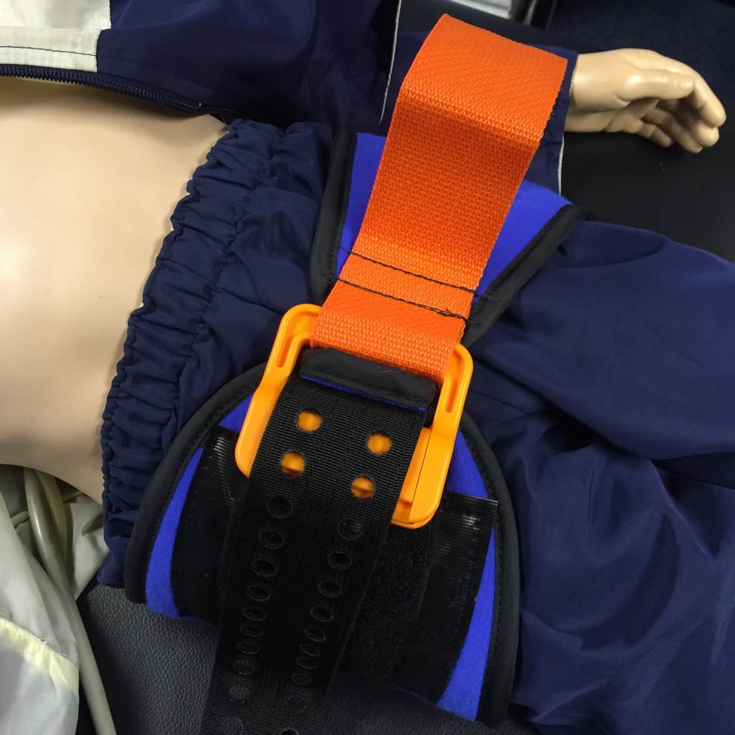
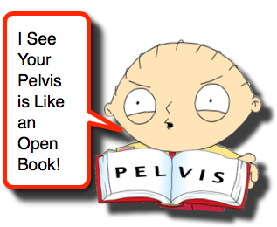
Controle van bloedingen
Tranexaminezuur
Directe druk
Bekkensling
Spalken
Tourniquets
Notes:
An essential part of DCR is preventing further blood loss through the use of tranexamic acid, splinting, packing, administering blood in preference to saline.

Slide 11
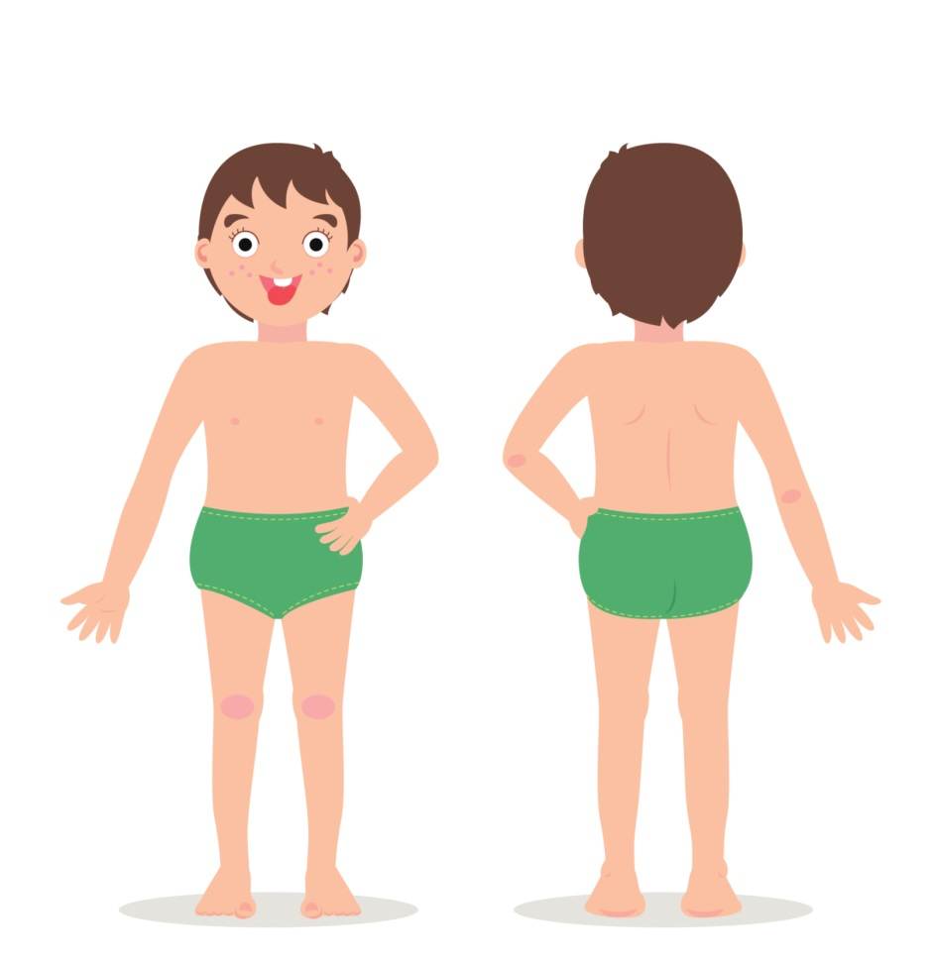
Tweede beoordeling
Hoofd tot teen
Voor en achter
Binnenstebuiten
door:
  Look
  Listen
  Feel
Dit is niet altijd volledig mogelijk: documenteer en draag zorgvuldig over wat wel en niet gedaan is.
Notes:
Secondary survey focused assessment to identify all significant injuries and plan definitive treatment.
This is done in a systematic fashion so as not to miss any injuries.
Don’t forget the eyes, back, perineum and digits.
Depending on patient condition, a full (or any) secondary survey may not be possible in the trauma room.
If it is not possible, then this should be documented and communicated so it may be done when the patient is out of theatre.
When the patient is awake, another tertiary survey should be completed to ensure there are no missed injuries.

Slide 12
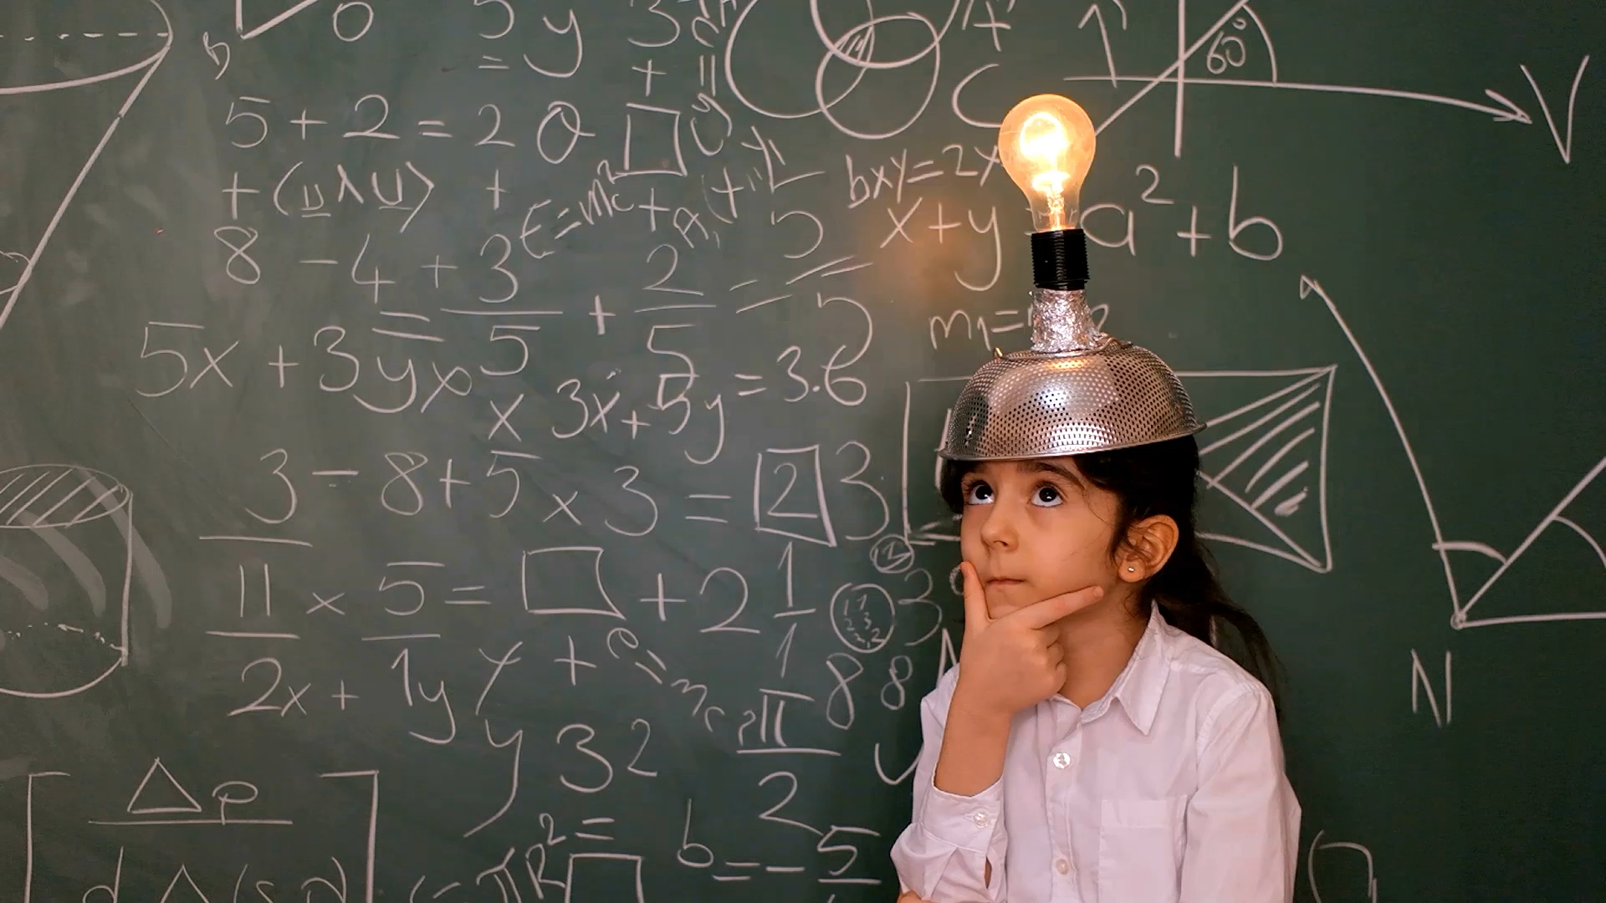
Cases
Interactieve discussie

Slide 13
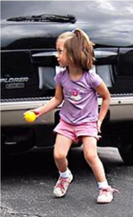
Nia werd aangereden door een auto
A 3 jaar
T 20 min geleden
M Aanrijding door auto (+- 50km/u)
I Hoofdletsel & bewusteloos sinds impact.
S Geen externe bloedingen; reutelende oppervlakkige ademhaling (32/min), HR 100/min; lokaliseert pijn; grote, zachte zwelling rechts occipitaal, bloed uit rechter oor.
T MILS en Mayo, hoge flow O₂
Notes:
Case 1 focuses on the management of traumatic brain injury in a child.
Ask candidates to use ATMIST information to develop a cABCDE primary assessment and plan.
Give the candidates time to think about this case (15-20 secs) – can be as a partner conversation.
specifically highlight airway and ventilatory support and discuss the importance of neuro-protective measures.

Slide 14
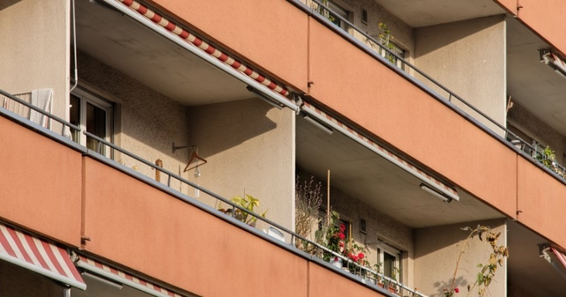
Trauma-oproep
A 15-jaar-oud meisje
T 40 min geleden
M Getuigen zagen haar vallen van balkon op 1e verdieping
I Klaagt dat alles pijn doet, kan niet rechtop komen
S Luchtweg open, AH 17/min; HR 100/min, RR 110/80mmHg;
GCS 15/15
T MILS & vacuüm-matras; hoge flow O₂
Notes:
Case 2 discusses the approach to managing the c-spine and the difficulties faced with the packaging of a trauma patient, especially a child
Work through primary survey:
<c> - nothing obvious
A – talking / complaining so patent
C-spine – significant mechanism, pain and unable to get up – keep immobilised
B – nothing obvious / immediate
C – HR and BP appear ok, and patient talking so perfusing brain
D – appears alert so no immediate concerns
Spinal injury is the main concern, but assessment complicated by distracting pain. Management aims to prevent further injury, reduce spinal movement, give analgesia and plan to re-assess further with clinical examination (20 degree tilt) and imaging.

Slide 15
Letsels aan de (cervicale) wervelkolom
Zeldzaam bij kinderen
Maar ernstige gevolgen als miskend
Denk aan SCIWORA
Ga bij ernstig trauma altijd uit van mogelijk WK letsel
Behoud spinale bescherming tot letsels uitgesloten werden
Notes:
Spinal injuries in children are uncommon
must be vigilant if the mechanism or patient’s symptoms suggest possible spinal injury.
Make sure candidates know what SCIWORA means
Shouldn’t clear spine in the trauma room unless you are able to adequately clinically assess the patient.
Also remember that injury in one part of the spine is very suggestive of injury elsewhere in the spine.

Slide 16
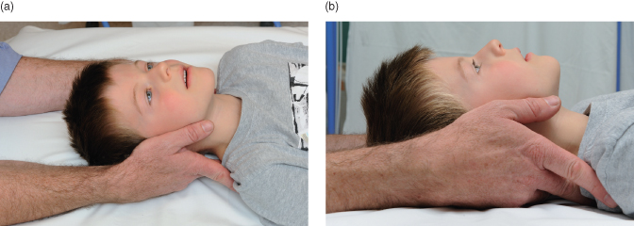
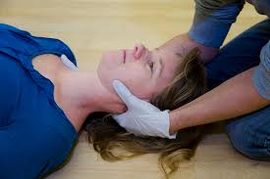
Spinale stabilisatie en bescherming
Manuele In-Line Stabilisatie (MILS)
Hoofdfixatie set (Blokken en tape)
Stevige matras (geen harde board)
Vacuümmatras
Bij onderzoek: Log-roll
Notes:
Part of good trauma management is not to make any existing injuries worse and to protect injured parts.
For the spine: restriction of spinal movement is essential if there is a chance of spinal injury. This should continue until the entire spine has been assessed and a decision made that there is no injury.
APLS approach is that it is mandatory to protect the cervical spine if there is potential for injury but you can do this perfectly well without a collar. Start with MILS at the same time as you manage Airway with oxygen. Use blocks and straps if you need to. When moving the patient, you need to do this as a coordinated team to minimise spinal movement whatever method you use. Make sure whoever you are handing over to knows that the spine is not cleared.
If there is concern about pelvic injury - mechanism, pain (don’t spring), signs of perineal injury - minimise movement using a binder (slows bleeding, reduces fracture and reduces pain), only log rolling to 20 degrees.
For limbs, splints such as traction splint or box splints can be used.
These are covered during the course.

Slide 17
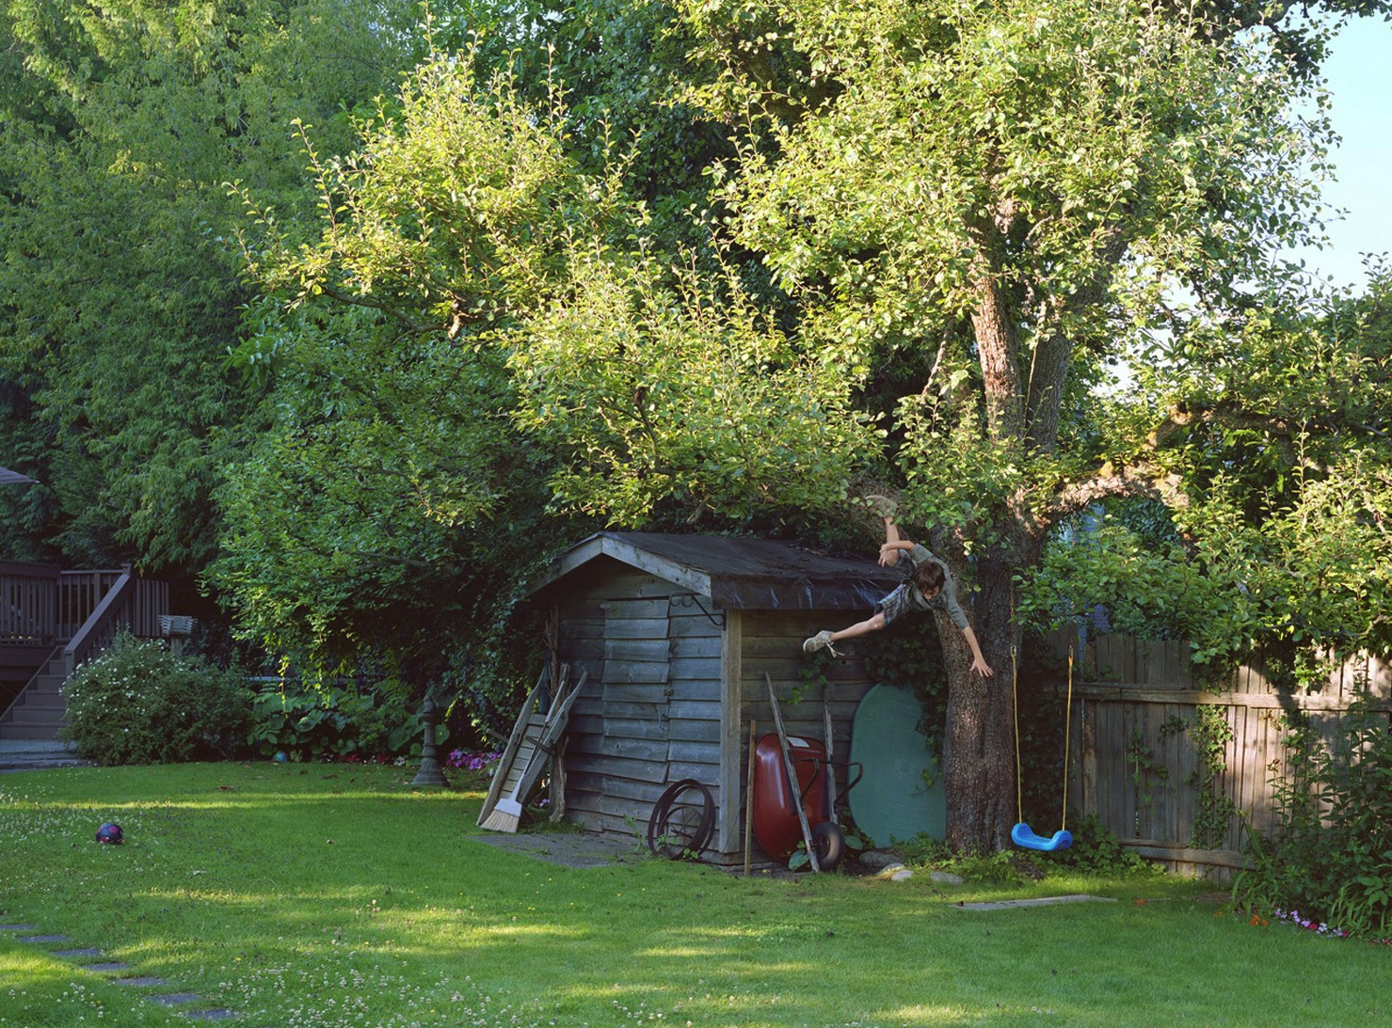
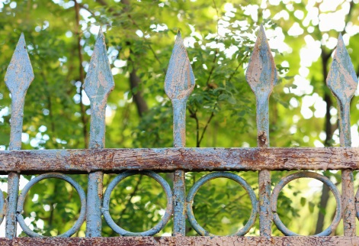
Lucas, 8j
A 8 jaar
T 30 min geleden
M Val uit boom op hek
I Penetrerend thoraxletsel?
S Bloed op shirt; praat maar hapt naar adem, AH 35/min, bleek, HR 140/min, CRT 3 sec.
T Drukverband rond thorax, hoge flow O₂
Notes:
Case 3 focuses on life threatening injuries; concentrating on early recognition and management of massive haemorrhage from chest trauma.
Give candidates 30 seconds to discuss how they would plan for.
How are they going to prepare? (Code Red, MHP, Chest drain)
Tranexamic acid should be given.

Slide 18
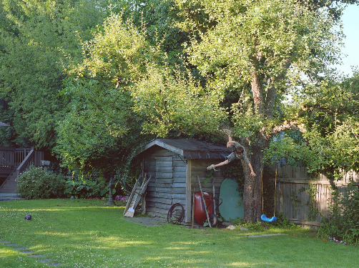
Bij aankomst in het ziekenhuis
Initieel praat hij nog en klaagt over pijn aan zijn borstkas. Je ziet daar linksonder een open wonde.
Ademhaling wordt echter steeds moeizamer (40/min) met toegenomen intrekkingen. Bij controle hoor je links geen ademgeruis meer.
Hij is perifeer koud, CRT > 5 sec, HR 150/min.
Notes:
On this assessment what is the problem?
Confirm plan into action: Vascular access, fluid, chest drain.
Activate massive hemorrhage, Tranexamic Acid bolus and start infusion.

Slide 19
Massief bloedverlies
Geef
  10ml/kg PC (initieel O neg tot kruisproef bekend) of (verwarmde) gebalanceerde kristalloïden
  tranexaminezuur 15mg/kg in bolus (als nog niet gegeven) gevolgd door infuus aan 2mg/kg/u
  zo nodig verder vochtbolussen van 10ml/kg
Activeer het massief transfusie protocol
Ga verder bloedverlies tegen (druk, tourniquet…)
Stuur bloed op voor kruisproef, stolling, BB, ..
Alterneer PC en plasma (1:1 ratio), voeg plaatjes of cryoprecipitaat toe afhankelijk van de bloedresultaten
Notes:
Note that for the volumes for the alternating doses of blood products in a 1:1 ratio vary between different protocols, usually either 5ml/kg or 10ml/kg per dose. The evidence for either dose in children is not available and candidates should check their local major haemorrhage protocol. Also note that platelets take longer to prepare by blood bank than either RBCs or FFP.
2 x IV access
Warmed fluids.

Slide 20
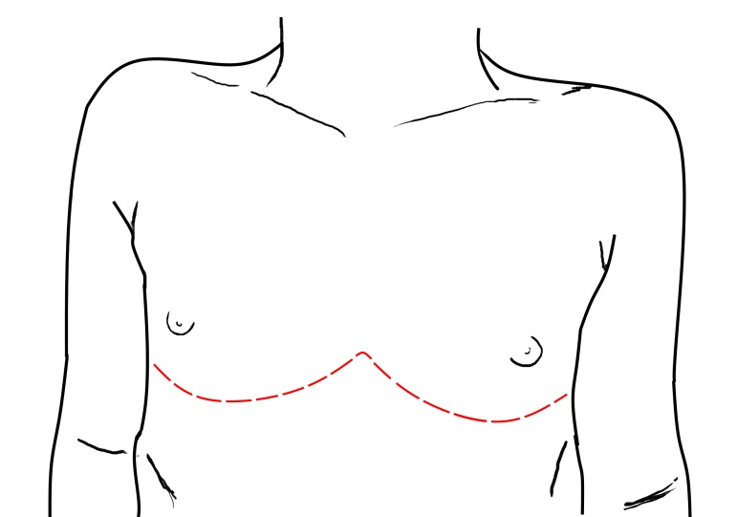
Hij wordt nu wel erg stil….
Ondanks adequate behandeling gaat hij verder achteruit.
Plots ontwikkelt hij een PEA ARREST.
Notes:
Work through through 4H and 4T with group.
Concern for cardiac tamponade.
How treat that?
Evidence continues to evolve as experience increases, but for children there can be good outcomes with witnessed traumatic cardiac arrest following penetrating injury within 10 minutes of arrest. The evidence is that emergency thoracotomy is unlikely to be successful if the injury is blunt trauma.

Slide 21
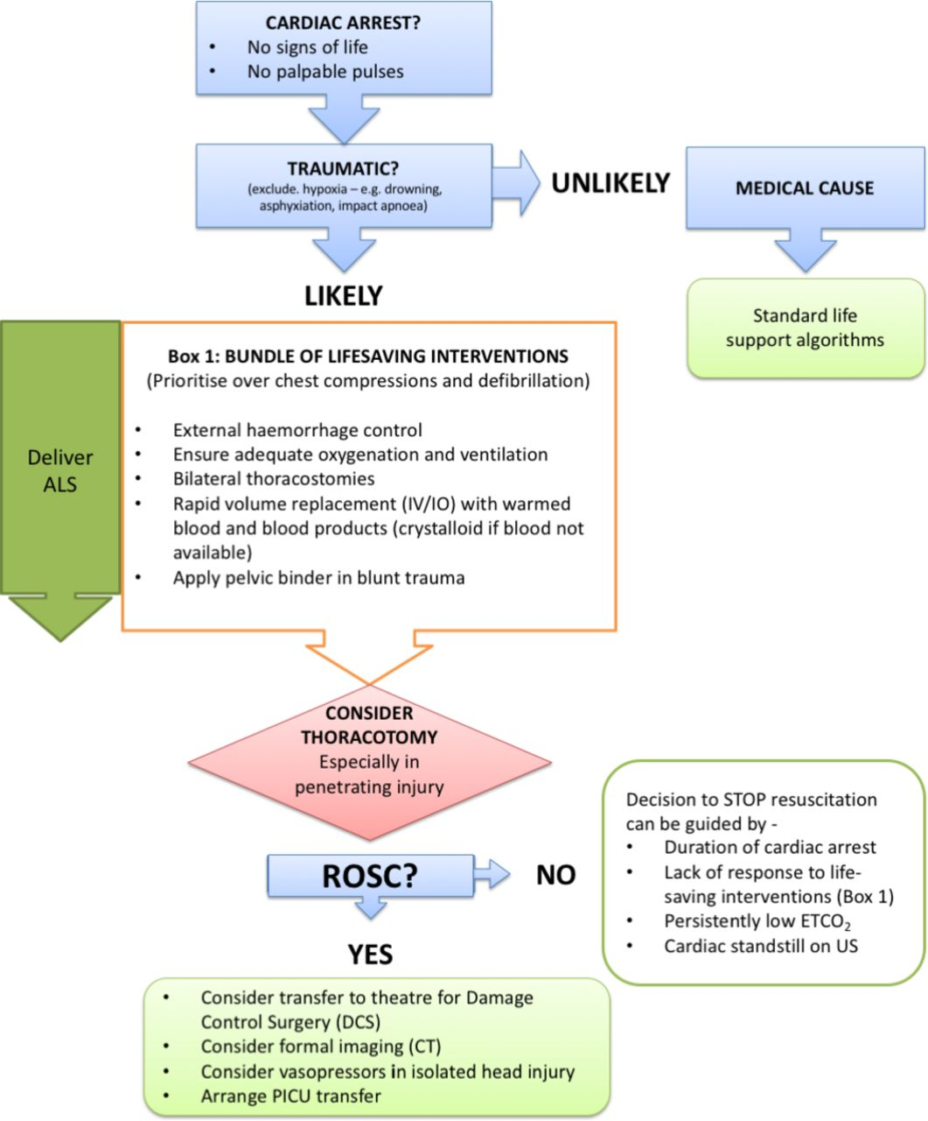

Pediatrisch Trauma Hartstilstand algoritme
James Vassallo et al. Emerg Med J 2018;35:669-674
Copyright © BMJ Publishing Group Ltd and the College of Emergency Medicine. All rights reserved.
Notes:
Introduce PTCA algorithm – discuss more in cardiac arrest lecture but highlight bundle of life-saving measures (to deal with hypovolaemia, hypoxia and tension pneumothorax). Must do these before any compressions start.
If not improving may need to go onto emergency resuscitative thoracotomy.
Discuss most difficult thing may be to make the decision.

Slide 22
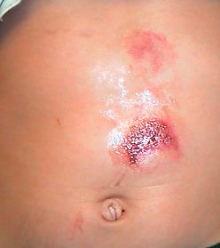
Komt een kind naar de spoed
A 14 jaar oude Jacob
T 1 u geleden
M Verloor controle op BMX en viel op stuur, droeg helm en beschermingsmateriaal. Initieel nog naar huis gefietst (enkele min).
I Buikpijn
S Geen externe bloedingen; AH 20/min; erg bleek, HR 145/min, CRT <3 sec; stil, reageert alleen op aanspreken.
T hoge flow O₂
Notes:
Case 4 looks at the careful management of a child with abdominal trauma focusing on the intricacies of hidden haemorrhage; focussing on blood on the floor and five more along with the importance of correct patient focused imaging / surgical intervention
Ask group to call out main problem: circulation/shock
Ask group to call out management:
IV access, TXA, pain relief, CT abdomen with contrast to find the extent of his injuries.
Discuss need for fluid – what sort and how much? Blood vs. saline
Discuss other information that may be helpful – BP, lactate.

Slide 23
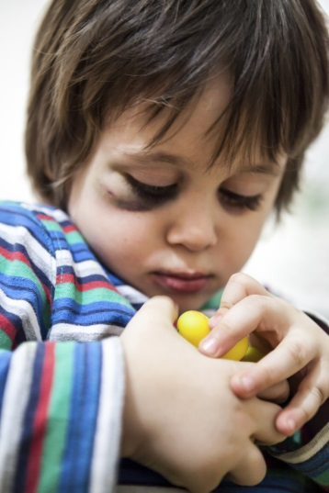
Lily
A 18 m oud
T 2 u geleden
M val van trap, van boven naar beneden
Ambulanciers vonden haar onderaan de trap.
12j oude zusje probeerde haar te troosten
I Gezwollen rechter bovenbeen in abnormale stand; blauwe plekken op voorhoofd en blauw oog.
S Geen externe bloedingen; AH 36/min; HR 155/min, CRT < 2 sec; ontroostbaar huilen; blauw oog rechts en bovenbeen in abnormale stand
T Spalk rechter bovenbeen
Notes:
Case 5 looks at a child with a common presentation taking into account her social history as well as her medical management
Primary survey actions:
Assess for head injury, manage what you find.
Analgesia and splint for the femoral fracture.
Check circulation and look for signs of shock because that might be a clue to injuries elsewhere.
Ask group if they have any other concerns after primary survey?
Discuss importance of secondary survey to identify other injuries and discussion with safeguarding services.

Slide 24

Advanced Paediatric Life Support
Gestructureerde aanpak van het ernstig gewonde kind
Notes:
Second set of questions / MCQ
The lecture should then be brought to a close but all the points raised may be discussed later in more detail in the subsequent workshops and scenarios

Slide 25
Samenvatting
Focus op “doing the basics well!”
Primaire opvang met _{c}A_{c}BC resuscitatie zijn je prioriteiten
Aansturen en controle van het team zijn van groot belang
Secundaire aanpak zo nodig
Notes:
Described the structured approach to the injured child through common scenarios.
Focus on doing the basics well
A systematic approach will help direct your priorities of care
Working together as a team is crucial to delivering that care well
And if you can, move beyond the primary survey; a head-to-toe secondary survey will help you find all significant injuries that you need to manage.

Slide 26
Demonstratie opvang van kind met ernstig trauma
Vragen die kandidaten in duo bespreken na de demonstratie:​
Bespreek:
Welke strategieën de teamleider gebruikte om het team te leiden
Wat je zag bij de andere teamleden en wat hun taak zou moeten wijn
Tracht alle vragen die bij je opkomen onderling op te lossen alvorens de sessie weer opengetrokken wordt naar de hele groep.​

