Slide 1


Advanced Paediatric Life Support
APLS pre course faculty meeting slide set
- please adapt as needed
Notes:
Please use the course director checklist with these slides as your notes

Slide 2
Introduce faculty
Record the meeting – for those who can’t make it

Slide 3
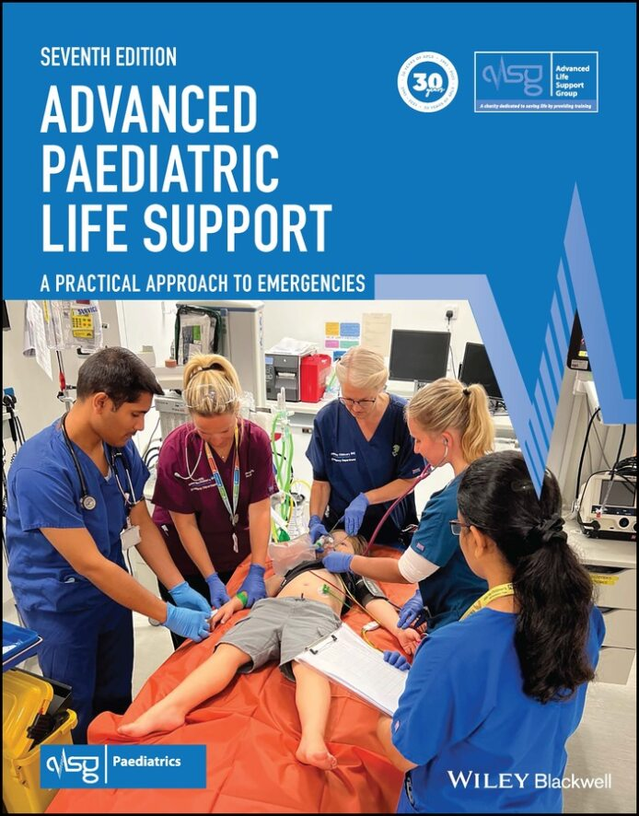
Content of slide set
Instructor preparation
Key changes to the programme
  Demos
  Faculty roles
  Embedded skills
  Case based discussion
  Final sims
Questions

Slide 4
Instructor preparation
  Read instructor guide
  New VLE/e-modules and skills videos
  New 7e manual
  Prepare your simulations
  Read the update skills guides – illness, trauma and cardiac
  Prepare your lecture or demo
  Demos should be practised by the team during the lecture

Slide 5
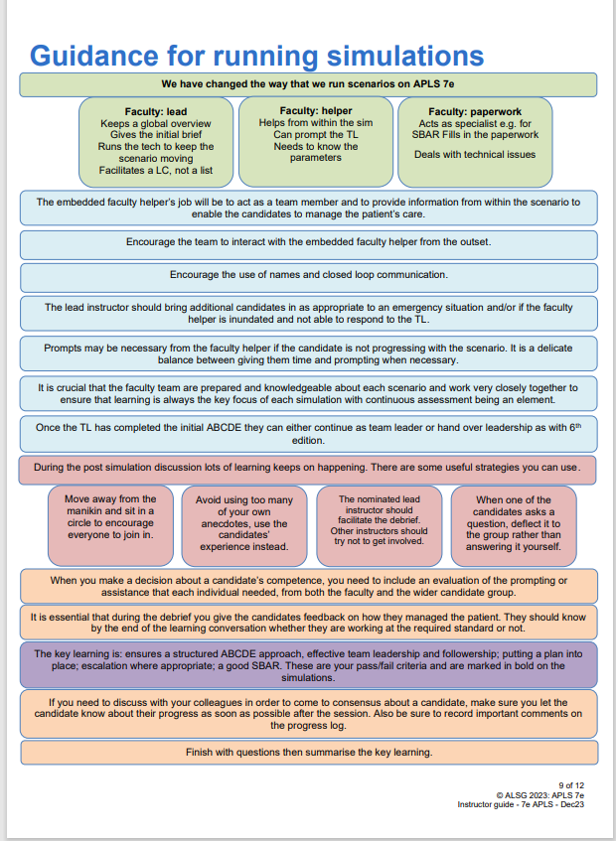
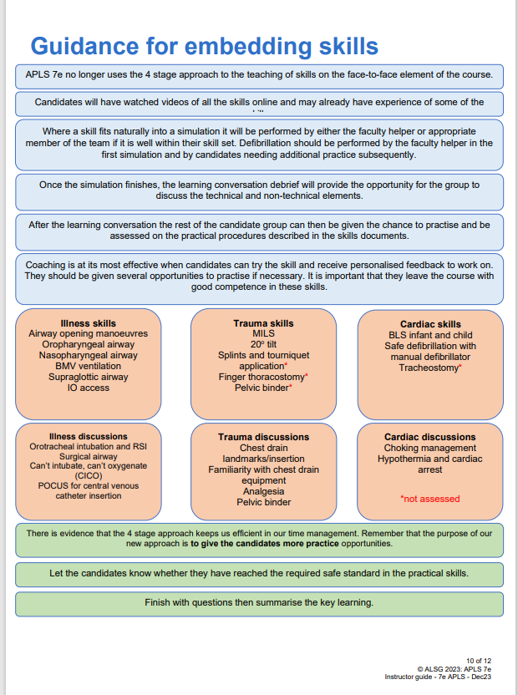
Instructor guide for APLS 7e
Notes:
Remind instructors that ALSG embrace the principles of equality, diversity and inclusion in all our training. Please uphold these principles while teaching and meeting the different needs of learners.
Consider for example encouraging speaking clearly, listening attentively and closing the communication loop during the learning conversations.
Recognise our individual differences including those of the learners and ensure that opportunities to contribute are offered to all.

Slide 6
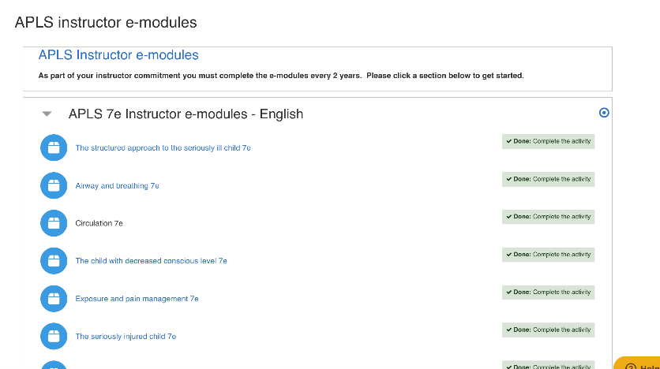
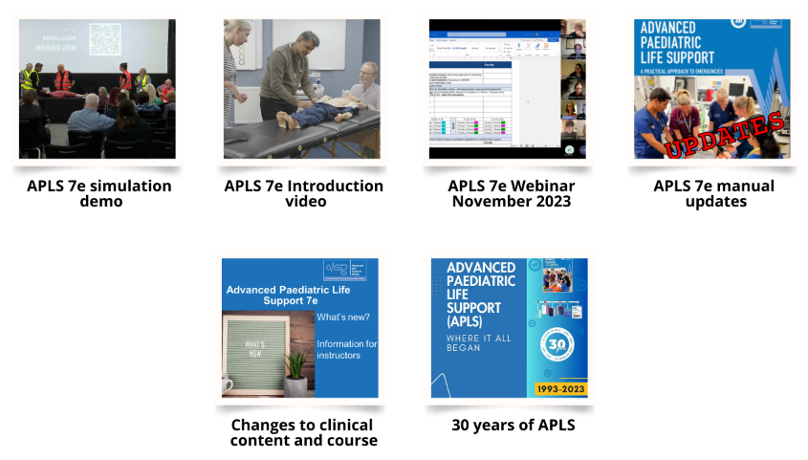
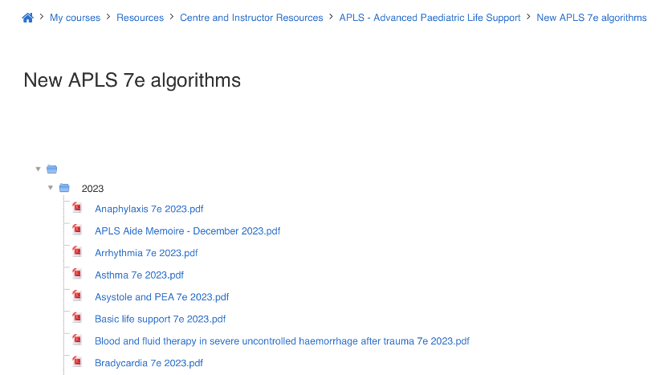
Other resources

Slide 7
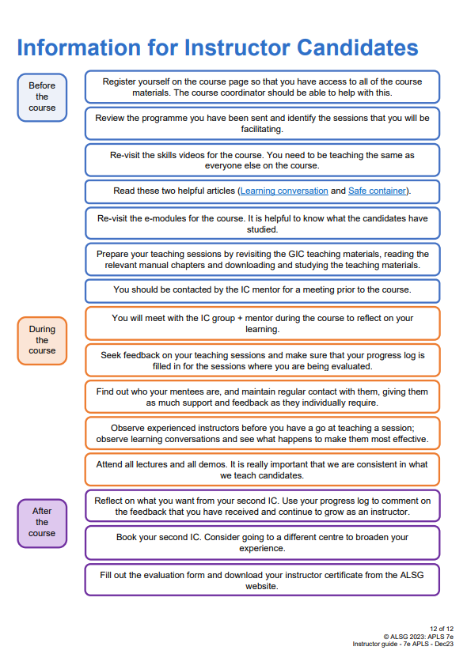
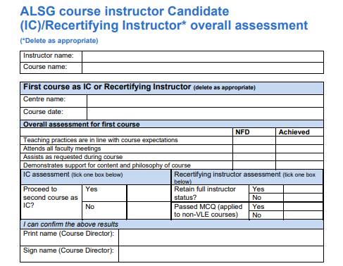
Instructor Candidates - ICs
  Don’t participate in demos or give lectures
  Need to watch all lectures and demos
  Recommend first ICs don’t take role of Lead Instructor/Faculty Helper in illness simulations
  Assessed on:
    1 x skills coaching – usually in the illness simulations
    2 x Lead instructor role with Learning Conversation
    2 x Faculty helper

Slide 8
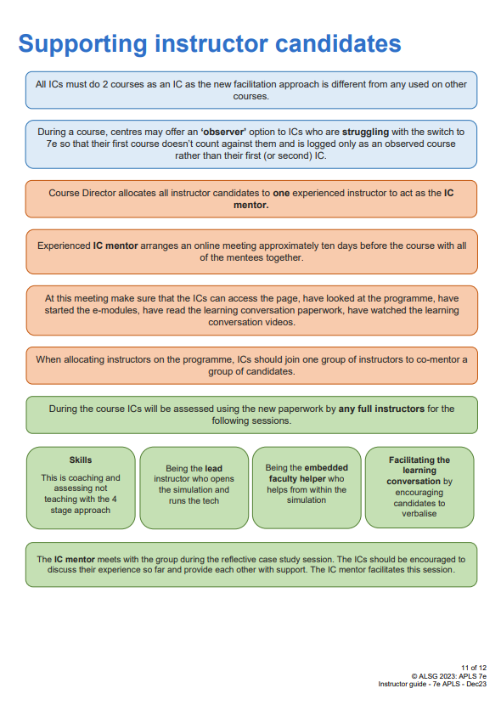
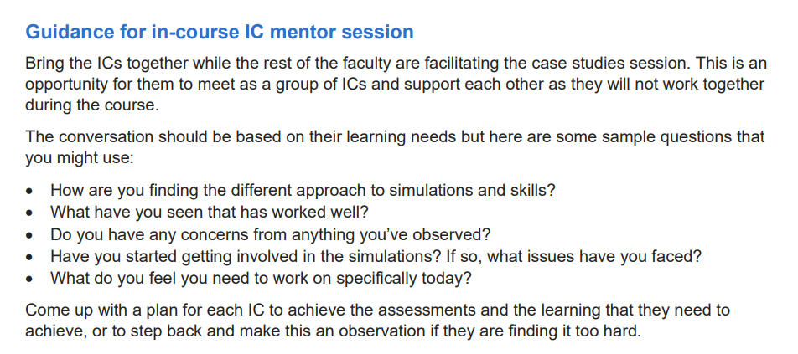
IC mentor
  Recommend one IC Mentor – to oversee all ICs throughout course
  Can also have individual IC mentors for each IC
  Ideally meet/talk before the course
  Facilitates mentor meeting on morning of day 2
  Guide for role and meeting in the instructor guide

Slide 9
Instructor roles
Lead instructor (outside sim)
Introduces session / briefs the candidate team leader then steps back
Controls manikin, monitors etc
Sends in other candidates to assist
Facilitates learning conversation
Faculty Helper (inside sim)
Participates in sim as a member of the team (rather than from the outside)
Source of information from within the simulation
Prompts only if required – examples provided
Demonstration of skill if required (delegation to suitable candidate)
Observer
Safety – including equipment troubleshooting
Join the simulation if needed e.g. anaesthetist/surgeon
Receive SBAR handover
Notes:
FH role – not same as ETC

Slide 10
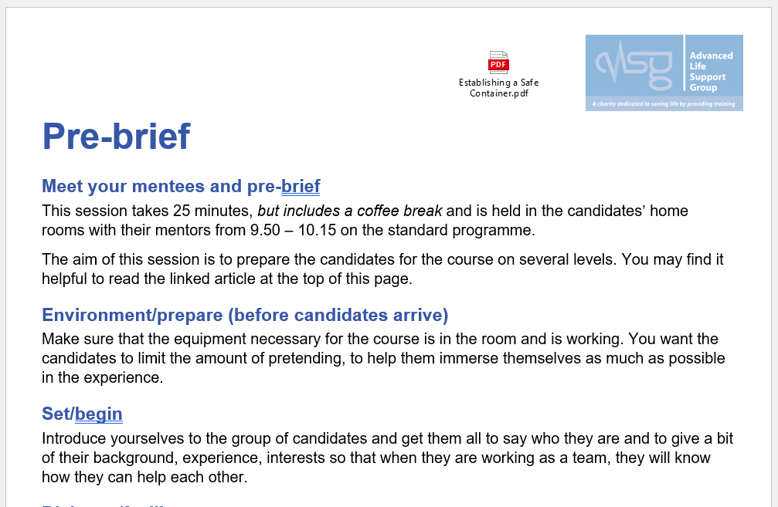
What’s new in the programme?
Pre course online faculty meeting
Day 1
  Pre-brief
  Learning partner conversation after sim demos
Day 2
  Reflective session
  Final bank of simulations – new options
Notes:
Pre brief
make sure candidates understand their role in sims whether team lead or team member
make sure candidates understand role of FH

Slide 11
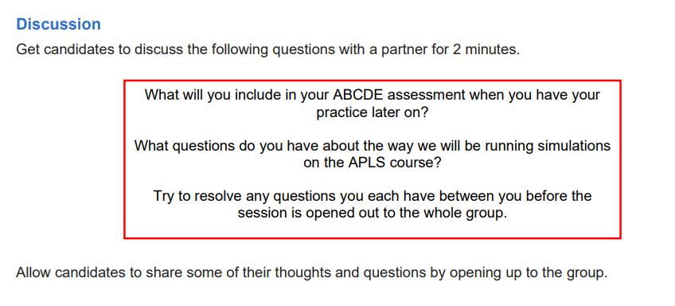
Demo simulations
  Should be coached and practised by team during the lecture
  Do not debrief the demo simulation
  Use the questions provided to facilitate learning partner conversation amongst the candidates

Slide 12
Embedded skills
  No skill stations - skills embedded into simulations
  Demonstrated in situ in real time during simulation by faculty helper (old stage 1)
  Candidates practise and are coached/assessed at the end of the simulation after the learning conversation (old stage 4)
  Resist the urge to teach – coach where needed
  Ensure at least 10 min is left for this skills practice
  50 min - 20 min per sim and 10 min for the skills
  Weaker candidates may need to have more practice in later simulations e.g. BMV/defibrillation

Slide 13
Core assessed skills
Illness
Airway opening manoeuvres
Oropharyngeal and Nasopharyngeal airway
BVM ventilation
Supraglottic airway
IO access
Trauma
MILS
Trauma - 20º tilt
(all other trauma skills are for discussion, or optional practice)
Cardiac
BLS infant and child
Safe defibrillation with manual defibrillator
Needle thoracocentesis

Slide 14
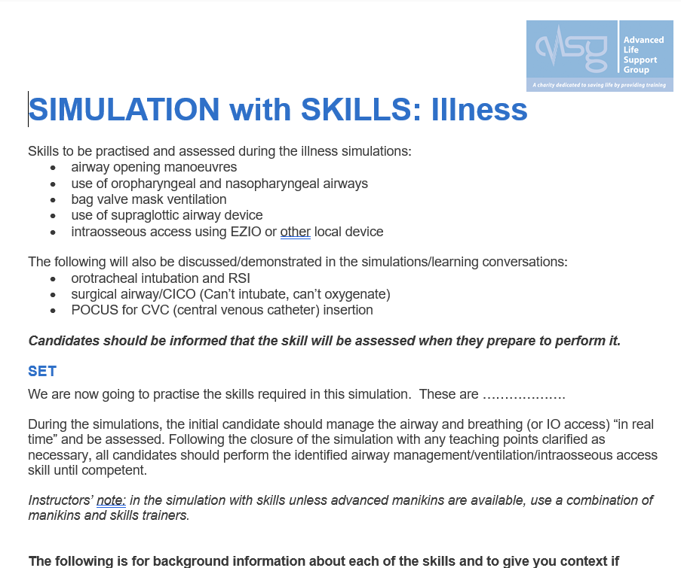
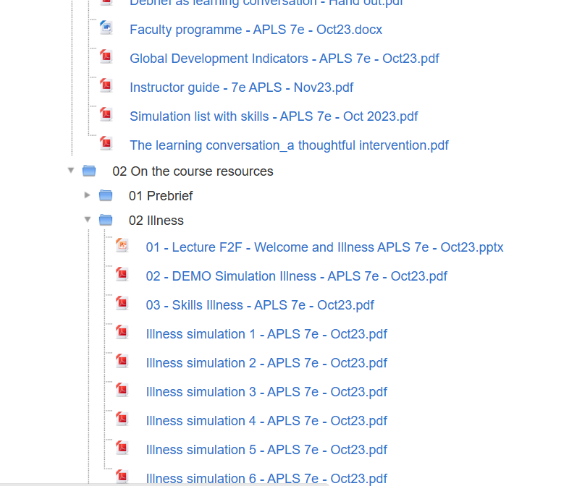
Notes:
3 skills documents (illness, trauma and cardiac) cover all the teaching and assessment information from 7e manual for the embedded skills

Slide 15
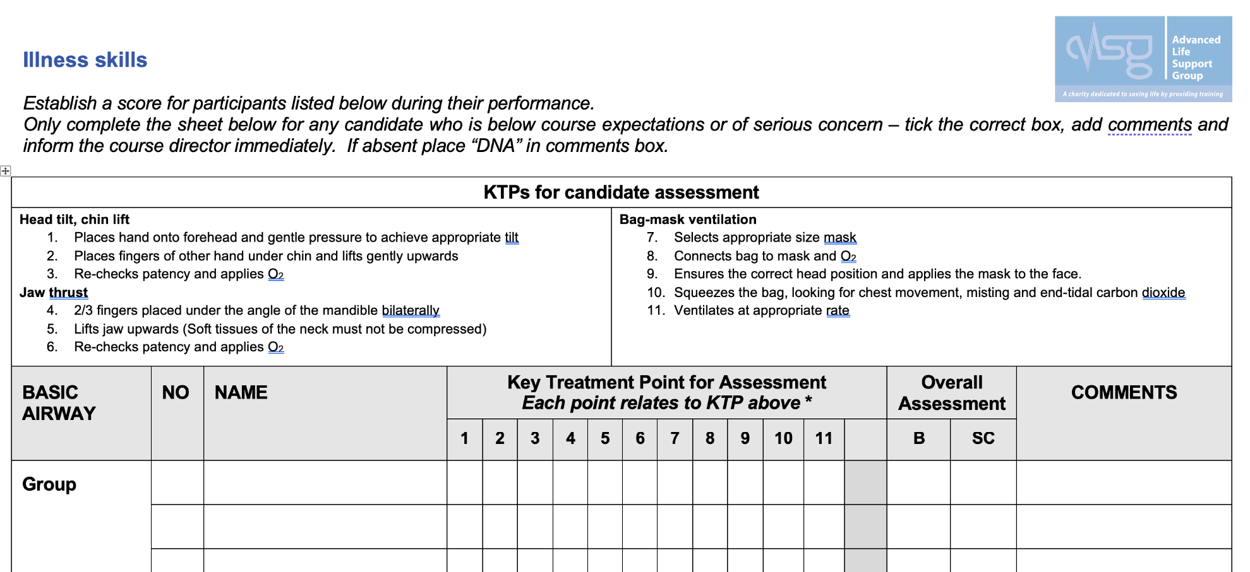
Recording ‘struggling’ candidate - skills
Notes:
Only document those who do not achieve the skill assessment

Slide 16
Reflective session
Whole group brought together in the lecture room with experienced instructor to facilitate
Sit them in their groups
Candidates pair up with someone from the same group
Facilitator asks candidates 3 questions, one at a time (approx. 4 min per question)
After each question – instructor pulls the group back together briefly to gather some of their responses
One instructor facilitates but others might enjoy hearing what candidates say, especially in response to what they want to try out.
Instructors must not get involved in the candidates’ discussions; the idea is to give them space to verbalise their learning.
Notes:
Get candidates to sit in their groups
Using these questions
What is the most significant thing that you learnt yesterday?
Describe to your partner something that another person in your group did yesterday that you thought was particularly good and explain why
What do you plan to try today – is there a specific way in which you want to push yourself a bit?
Pull group together for a few minutes after each question and then summarise at the end of the session

Slide 17
Simulations
  6 simulations per set
  Illness, trauma, cardiac and final bank
  Paired sims – ‘with’ and ‘without’ an embedded skill
  30 min (with skill), 20 min (without skill)
  Illness 1&2 has 60 min and cardiac 1&2 has 75 min
  Demonstrate defib safety and course defibrillators before cardiac 1&2
  Have ED and ward ‘stories’

Slide 18
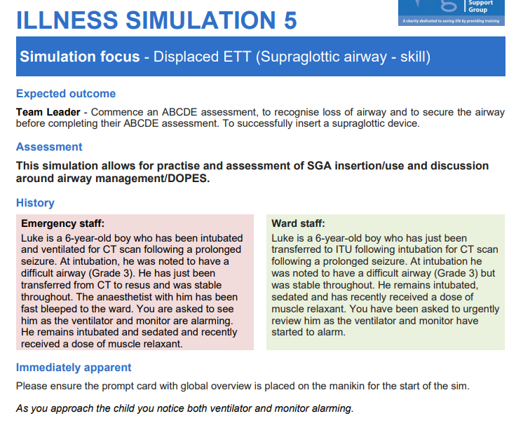
Notes:
Example of simulation – ward and ED stories

Slide 19
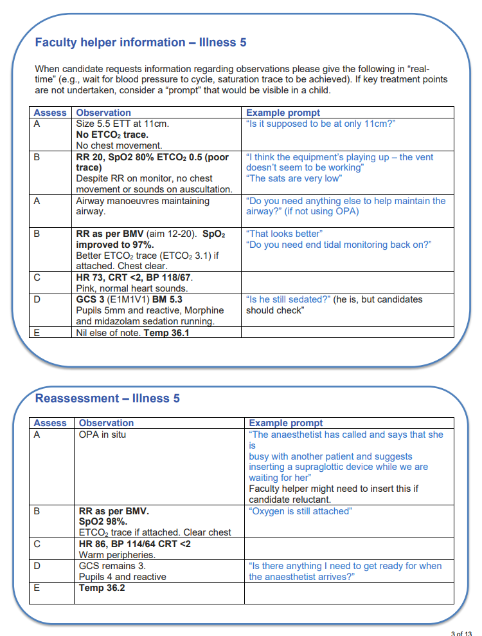
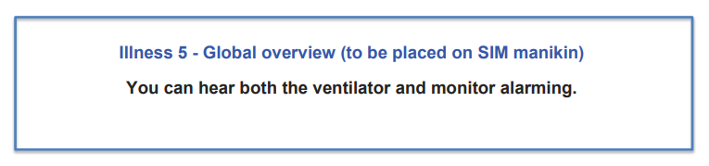
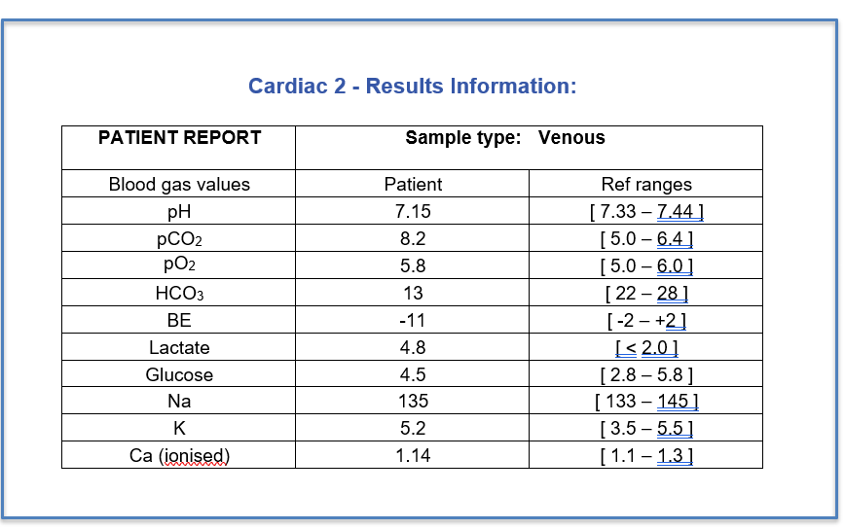
Notes:
Overview card, gas and prompt cards – FH will use these

Slide 20
Illness simulation set up
LI
FH
3rd I
Ca
TL
Ca
Ca
Ca
Ca
Notes:
Shows the position of the FH and other instructors with regards to the candidate group and the simulation
Don’t forget to bring in other candidates – especially in illness sim to do tasks such as fluids/drugs/cannulation/BP/airway support etc. once initial ABCDE is done

Slide 21
Trauma and cardiac simulation set up
LI
Ca
3rd I
Ca
FH
Ca
Ca
TL
Ca
Notes:
Shows the position of the FH and other instructors with regards to the candidate group and the simulation
Don’t forget to bring in other candidates:
In trauma you may want to start with a full trauma team
In cardiac you will need at least 2 people (plus TL) to do BLS initially but bring in more to assist as an arrest team

Slide 22
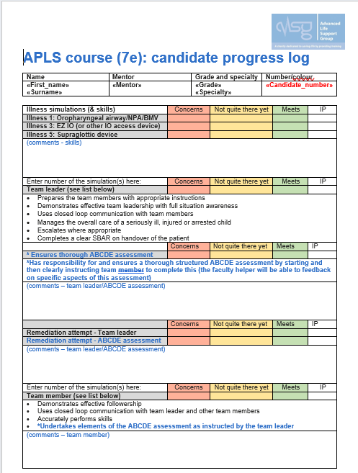
Simulations
Updated progress log
  Space for remediation
  Clearer assessment criteria
What are we assessing?
  Core skills
  ABCDE assessment
  KTPs
  Leadership and teamwork

Slide 23
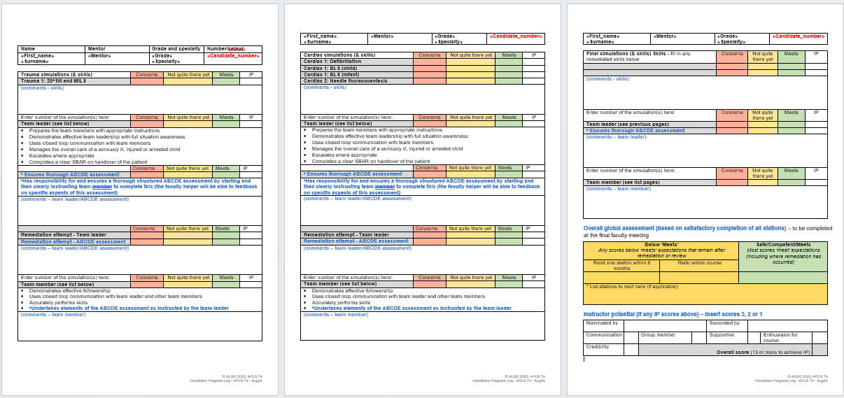

Slide 24
What are we assessing?
Illness
Team leader (TL) does/is assessed on ABCDE assessment
Can delegate tasks to FH
Must ask for specific assessments and interpret findings
FH provides clinical info and initially assists
Other candidates join later to assist with tasks and to prevent boredom!
Trauma
TL assessed on directing trauma team
Can be hands off
Interprets findings and makes decisions
FH ‘offers’ to do primary survey under TL direction and provides clinical info
Start with FULL trauma team (preparation and communication)
Candidate TL will make decisions based on findings
Notes:
TL can handover lead to another candidate after initial assessment – e.g. junior candidate/nurse
TL can ask FH to auscultate chest etc if not part of their role e.g. nurse

Slide 25
What are we assessing?
Cardiac
TL assessed on directing the team
Start with FH and 2 other candidates (to do effective BLS)
Cardiac 1 – FH does the defibrillation
Candidates assessed on defib and BLS at the end of cardiac 1
Cardiac 3 – candidates to do defibrillation in the simulation
Cardiac 5 – FH to do cardioversion in the simulation
ABCDE assessment can be remediated here for a struggling candidate after ROSC

Slide 26
What are we assessing?
Final simulations
Complex team sim or Remediation sim
Not all candidates have to lead a simulation
Remediation - can be used for retest if required
Use the complex to push a well performing candidate or group and add extra learning, not to test them (let them know this)
Notes:
You must do all 6 sims from the final set

Slide 27
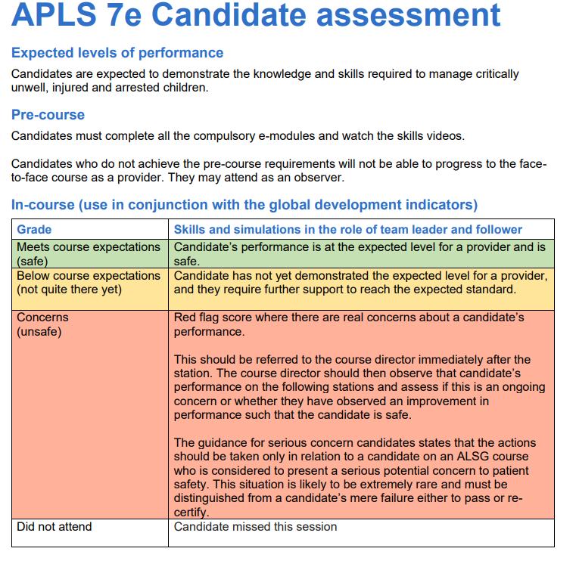

Slide 28
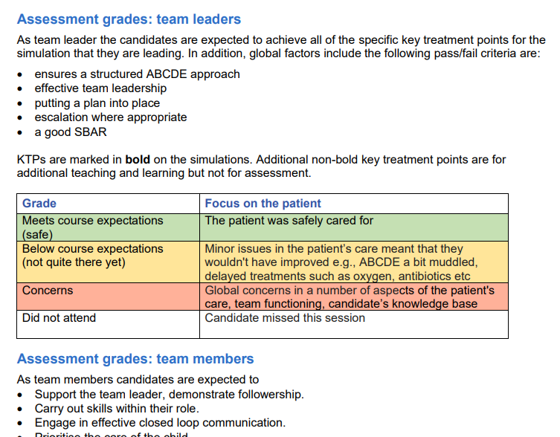

Slide 29
The struggling candidate
Constructive, kind but ‘real’ feedback after skill or simulation
Ensure they know they have or have not ‘met’ the required standard and what they have failed on as soon as possible after the simulation
Mentoring – in groups
Support and coaching throughout
Communication with CD is key
Detailed documentation – what they have failed on and communication
Can have remedial teaching or have component tested in another scenario
Can use final bank of sims to remediate skill or simulation
Notes:
There are new documents to help you document concerns with a struggling candidate:
Candidate feedback form – use during the course
Candidate incomplete attendance form – missed sessions
Candidate unsuccessful resit one element form
Candidate unsuccessful redo whole course form
And for serious concerns please use the ‘Regulations – Managing a Candidate who raises serious concern form’.

Slide 30

Advanced Paediatric Life Support
Online pre course faculty meeting

Slide 31
Summary
Prepare
Prepare
Prepare
See you soon!
Notes:
Add in local housekeeping re faculty meal, hotel, parking etc

