Slide 1

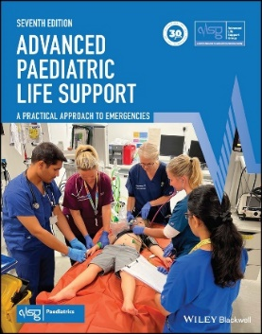
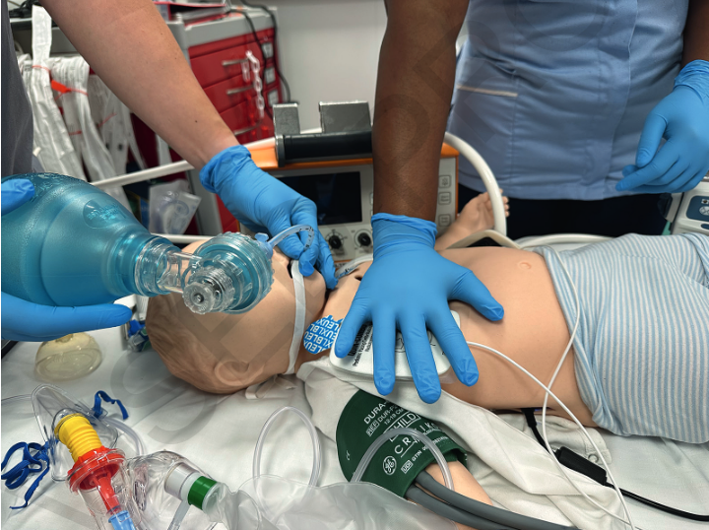
Advanced Paediatric Life Support
RCC – veranderingen in de 7e editie
Notes:
DON’T FORGET TO READ THE NOTES UNDER THE SLIDES!
Remember the lectures are here to refresh the content for the candidates rather than teach it. The notes are provided are to assist you and should not be used as a script.
These slides are an attempt to summarise key changes in the 7th Edition of APLS. They are not all inclusive and instructors are advised to update on the VLE, as well as with other key documents on course organisation. As always constructive comments and queries are welcome and should be directed via ALSG.
The demo simulation follows this lecture.
The lecturer is responsible for leading into this at the end of the lecture and for facilitating the ‘partner discussion’ at the end of the sim demo.
Please use the slide provided at the end of the lecture (after the questions and summary slides) to show the candidates the questions they need to discuss.

Slide 2




Samenvatting van de belangrijkste veranderingen
  ILCOR 2021 (2025)
  Evidence based medicine
  Richtlijnen van andere bronnen
Notes:
In 2021 International Liaison Committee on Resuscitation (ILCOR) recommended updates for paediatric resuscitation. The information is to assist you whilst preparing for and attending APLS and PLS courses in the interim period while the 7th edition manual is being produced.
The information reflects the changes in health service provision and evidence based medical knowledge and practice. It also reflects the latest guidelines for resuscitation of the deteriorating child or the child in cardiac arrest in alignment with ILCOR 2021.
2025 is in deze lecture door ons aangepast….

Slide 3
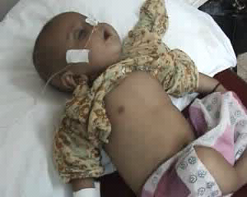
1. Herkenning en opvang van ernstig zieke kinderen

Slide 4
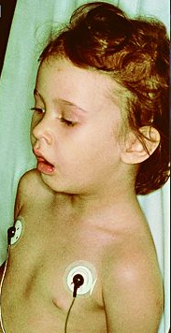
Respiratoir
SpO₂ titreren 94-98 %, dus actief afbouwen > 98%!
  Oxy trial: 88/92-94%
HFNZ/nCPAP/NIV als er nog voldoende kracht is
Anders overgaan op balloneren
Notes:
In the seriously ill infant/child aim for saturations 94-98% with as little supplemented oxygen as possible.
Sustained saturations of 100% should be avoided.
Do not give pre-emptive oxygen to infants/children without signs of immediate risk of hypoxemia or shock.
For infants/children with hypoxia and not responding to low flow oxygen (but with adequate respiratory effort) competent providers should consider HFNC oxygen or CPAP/NIV support.

Slide 5
Respiratoir
  Denk aan LMA (of intubatie) als balloneren onvoldoende effect heeft
  Intubatie max. 2 pogingen (3e alleen als levensreddend)
  Na LMA/intubatie capnografie voor vroege detectie van foutieve/verplaatste tube
  Moeilijke luchtweg
    Zorg voor een goed algoritme/plan van aanpak
    FONA (front of neck access), chirurgische luchtweg
Notes:
Failed intubation algorithms
CICO (can’t intubate can’t oxygenate) situation - changes to difficult airways – FONA (front of neck access), surgical airways – chapter 19
1. Needle techniques have a low success rate in adults (and are likely to be easier in adults than children)
2. It is not possible to feel the cricothyroid membrane in younger children, therefore using this landmark might not be relevant.
The steer is open techniques are preferred over needle techniques (ie more likely to be successful) and the cricothyroid membrane landmark is only relevant when it is palpable (older children/ adults).

Slide 6
Circulatoir
Bolus 10 ml/kg gebalanceerde crystalloiden, bv PlasmaLyte/Hartmann
  niet beschikbaar? NaCl 0.9% (opgelet hyperchloremische acidose)
Regelmatig bloedgas/lactaat bepalen voor evaluatie behandeling
Overweeg in een vroeg stadium inotrope ondersteuning
Bij vermoeden hartfalen: bolus van 5 ml/kg
Opgelet:
Geen tekenen van shock/ circulatoir falen → geen vocht
Notes:
Fluid boluses should not be given routinely and only when there are signs of circulatory insufficiency or shock. There are many circumstances where fluids may be harmful, including in febrile children where there is no immediate intensive care.
Crystalloids remain first choice, but in trauma, blood should be given sooner.
Crystalloids – Not large volume of 0.9 % saline to avoid acidosis
The importance of reassessment, review of blood gases and lactate to guide treatment are crucial.

Slide 7
Circulatoir
Tachy-aritmie met shock:
  3 synchrone shocks met adequate analgesie
  1 J/kg → 2 J/kg
  Overweeg 4 J/kg (na overleg expert)
Corrigeer hypoglycemie (<50 mg/dL of 2.8mmol/L) met 2 ml/kg bolus glucose 10% gevolgd door onderhoudsinfuus
Notes:
Resuscitation 161 (2021) page 333 - European Resuscitation Council Guidelines 2021: Paediatric Life Support
“Unstable primary tachycardia: In children with decompensated circulatory failure due to either supraventricular (SVT) or ventricular tachycardia (VT), the first choice for treatment is immediate synchronised electrical cardioversion at a starting energy of 1 J/kg body weight. Double the energy for each subsequent attempt up to a maximum of 4 J/ kg. If possible, this should be guided by expert help. For children who are not yet unconscious, use adequate analgosedation according to local protocol. Check for signs of life after each attempt.”
Resuscitation 161 (2021) page 334 - European Resuscitation Council Guidelines 2021: Paediatric Life Support
“Severe paediatric hypoglycaemia (< 50 mg/dl (2.8 mmol/L) with neuroglycopenic symptoms) demands:
IV glucose 0.3 g/kg bolus; preferably as 10% (100 mg/ml; 3 ml/ kg)”………
“Retest blood glucose 10 min after treatment and repeat treatment if the response is inadequate. Reasonable targets are an increase of at least 50 mg/dl (2.8 mmol/L) and/or a target glycaemia of 100 mg/dL (5.6 mmol/L).”

Slide 8
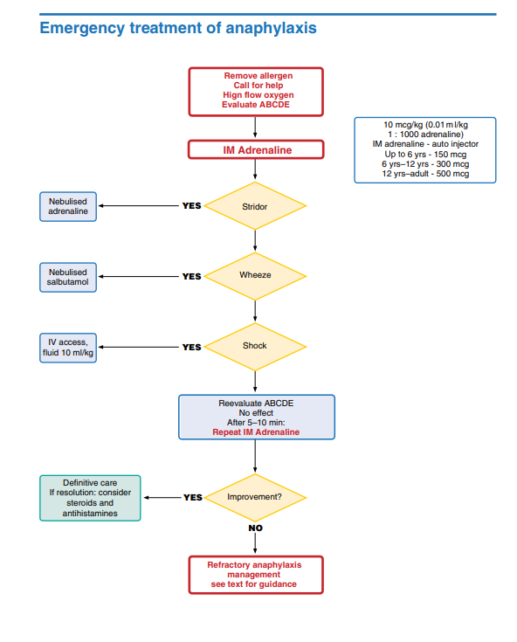
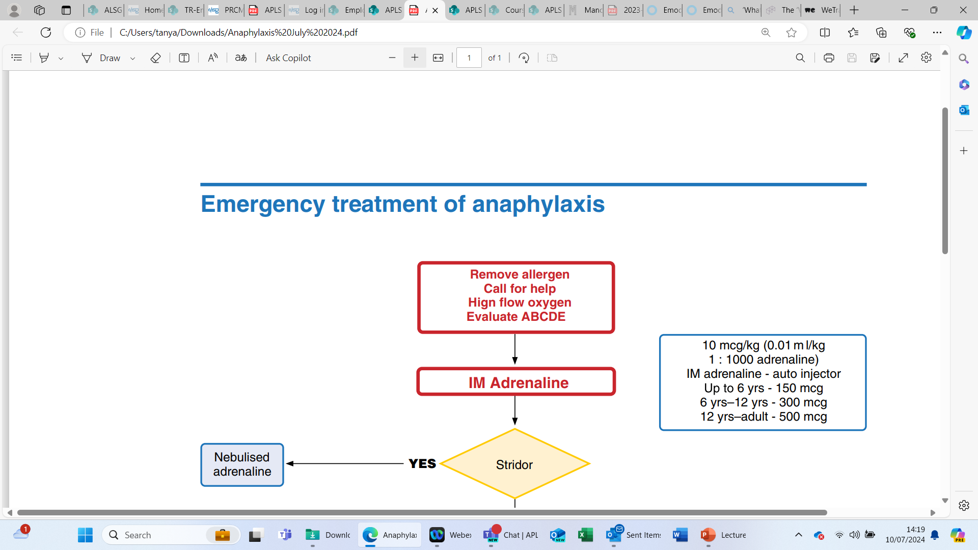
Anafylaxis

Slide 9
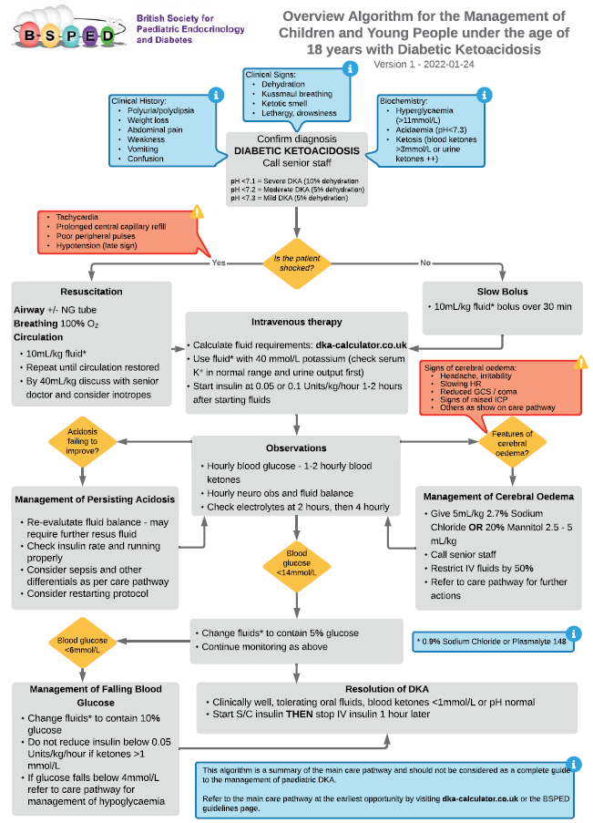

DKA
Notes:
Voorbeeld, volg vooral je eigen richtlijnen (cfr NVK)

Slide 10
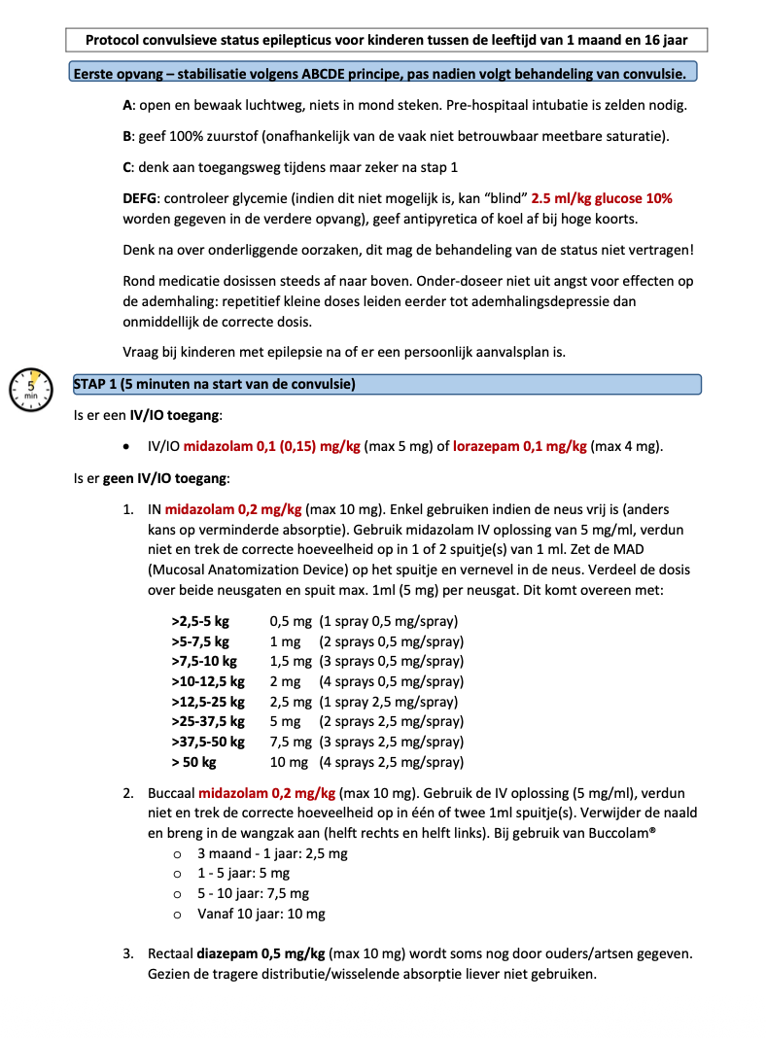
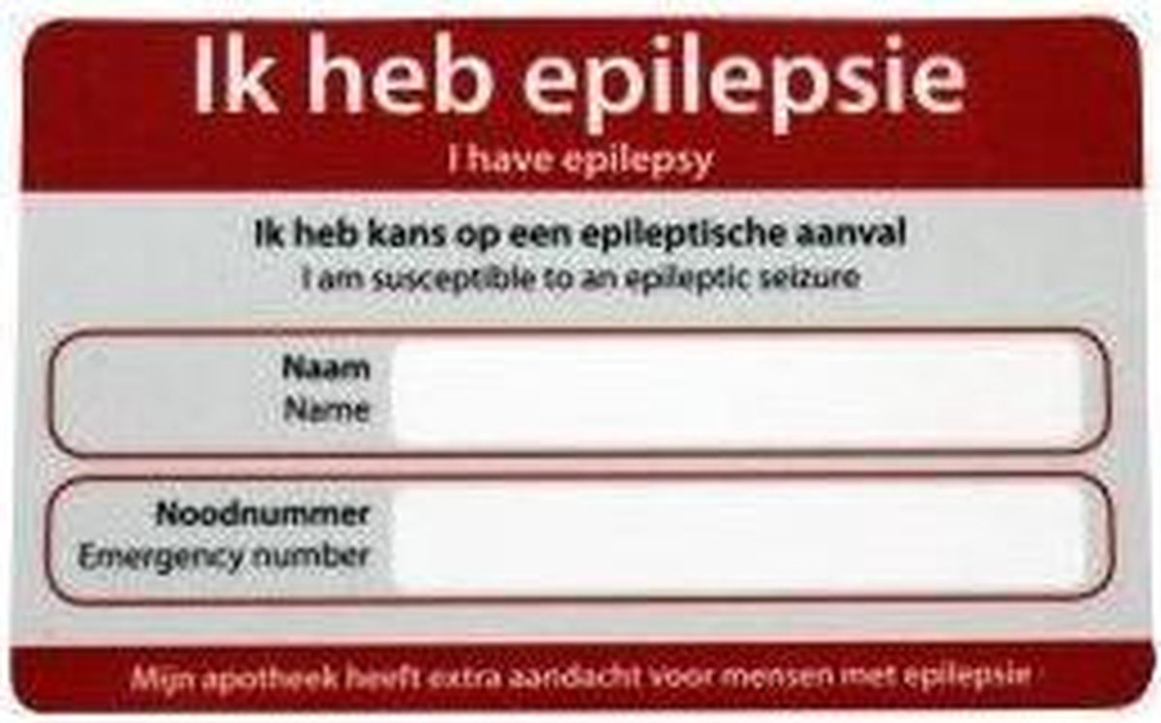
Neurologie: status epilepticus
Status epilepticus
  Starten met 2 x benzodiazepine
  Tweede lijn: voorkeur levetiracteam!
  Bij 40 minuten overweeg PICU-medicatie
Notes:
STATUS EPILEPTICUS
- De behandeling van status epilepticus kan wisselen per land en per centrum, maar start in alle gevallen met 2 x een benzodiazepinedoses. Voor het vervolg verwijzen we naar lokale protocollen.
- Na uitblijven werking na twee doses benzodiazepines sterke aanbeveling op medicament uit tweede lijn (vb levetiracetam, phenytoïne, valproaat), als werking nog uitblijft kan “ander” medicament uit zelfde groep overwogen worden.
Na max 40 minuten overwegen van “anesthesie” indien ervaring beschikbaar (midazolam continu, ketamine, propofol, …)
Opgelet: ook dit is een voorbeeld. Checl ook altijd of er een individueel noodplan is

Slide 11
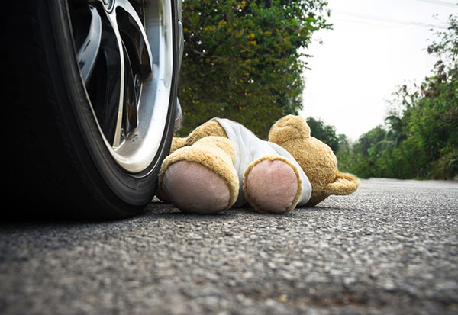
2. Herkenning en opvang van zwaargewonde kinderen

Slide 12

Trauma
Primaire opvang en _{c}A_{c}BCDE resuscitatie zijn prioritair!
Teammanagement en teamcontrole zijn essentieel
Secundaire opvang waar nodig
Notes:
Team working is important not just for trauma, but in managing cardiac arrest and illness.
Systematic primary survey looking for catastrophic bleeding or haemorrhage, airway and breathing problems, problems with circulation such as shock, disability (neurological dysfunction)
To identify essential things that need to be done to start to reverse the effects of injury and prevent further deterioration or secondary injury to brain, heart and other vital organs because these contribute to later death or disability from organ failure.
Highlight importance of team with clear leadership and members who understand and can carry out their roles.
Team composition may vary by setting but fundamentals are the same:
Conduct a primary survey and carry out any immediate life- or limb- saving interventions to stabilise the patient so that they can get safely to definitive care.
Skills needed in team:
advanced airway skills
be able to carry out chest procedures
manage haemorrhage and shock
assess neurological function
assess pain
be able to give emergency room treatment.
A trauma team leader who is able to stand back and have situational awareness so that they can direct the team with clear instructions towards a clear goal is a really important part of a well-functioning trauma team.

Slide 13
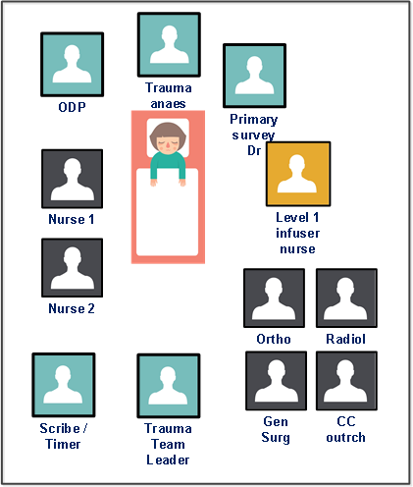
Trauma
Trauma level
Trauma team voorbereiding
  antwoord ~ centrum, principes niet.
Team allocaties en pre-briefing
Duidelijke hand-over - ATMIST
Age
Time of injury
Mechanism
Injuries
Signs
Treatment
Notes:
There is now more stress on the importance of team preparation, equipment preparation and effective handovers, such as that provided by ATMIST:
ATMIST = Age, Time of injury, Mechanism, Injuries, Signs, Treatment
Highlight importance of team with clear leadership and members who understand and can carry out their roles.
Team composition may vary by setting but fundamentals are the same:
Conduct a primary survey and carry out any immediate life- or limb- saving interventions to stabilise the patient so that they can get safely to definitive care.
Skills needed in team:
advanced airway skills
be able to carry out chest procedures
manage haemorrhage and shock
assess neurological function
assess pain
be able to give emergency room treatment.
A trauma team leader who is able to stand back and have situational awareness so that they can direct the team with clear instructions towards a clear goal is a really important part of a well-functioning trauma team.

Slide 14
Trauma - Initiële beoordeling en opvang
_{C} ontrole catastrofale bloedingen
Airway – open luchtweg
_{C} bescherming (cervicale) wervelkolom
Breathing (ademhaling)
Circulatie
Disability (neurologie)
Exposure (uitwendig) inclusief extremiteiten / Environment (omgeving)
Notes:
Reinforce Primary Survey structured approach:
Emphasise the first <c>.
<c>
Mention haemorrhage control – direct pressure, splints and tourniquets
A (+CS)
Identify at risk airway (e.g. low GCS or inhalational burns) and what level of intervention is needed immediately
Remember if risk of spinal injury to protect spine with immobilisation and restriction of movement.
B
Breathing assessment includes inspection of the chest for signs of injury and paradoxical movement, listening to the percussion note and listening for breath sounds and air entry as well as measuring oxygen saturations. This might suggest pneumothorax, haemothorax or a flail chest.
C
Not all traumatic bleeding is obvious. Look for signs of shock such as tachycardia, prolonged capillary refill, reduced consciousness.
Low blood pressure or absent pulses in a child are very late signs of shock and require immediate fluid resuscitation.
Think about where blood may be lost “blood on the floor and five more” - chest, abdomen, pelvis, long bones such as femur. In small infants with open head sutures a significant amount of blood can also be lost into the scalp and skull.
D
AVPU/GCS, pupils and posture. This is often best done by the person managing the airway as they can talk to the patient and look in the eyes.
E
The patient should be examined fully for signs of injury. This will include perineal examination to look for signs of pelvic injury.
The back should be examined especially in penetrating injury. The patient will need to be log-rolled for this if there is concern for spinal injury.
The patient’s extremities should be assessed for injury, especially for open fractures. Obvious deformities may need to be splinted or manipulated if there are signs of critical skin or poor perfusion distally.

Slide 15
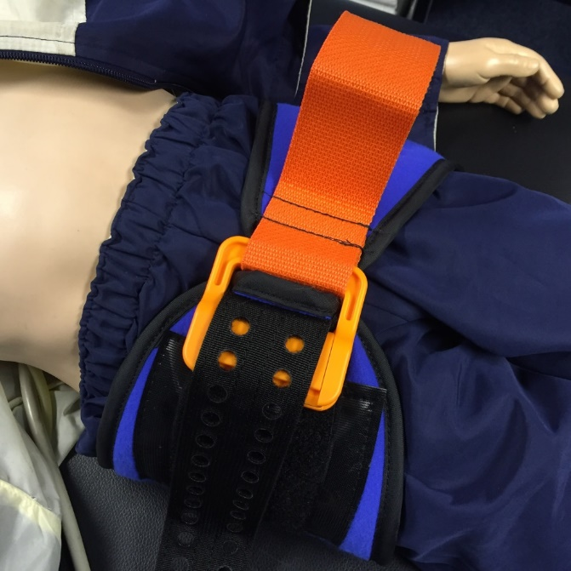
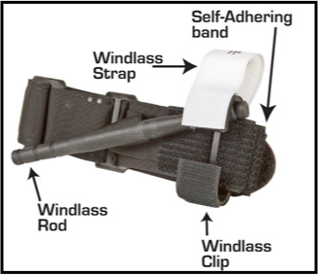
Trauma – controle bloedingen
Tranexaminezuur
MTP en vocht – 10ml/kg
Minimale belasting – ‘first clot’
Directe lokale druk
20º tilt – geen log-roll
Ketamine & rocuronium - RSI
Bekkensling
Spalken
Tourniquets
Notes:
Quick all round check for massive haemorrhage and trigger for massive transfusion protocol:
Massive haemorrhage protocol: Note that for the volumes for the alternating doses of blood products in a 1:1 ratio vary between different protocols, usually either 5ml/kg or 10ml/kg per dose. The evidence for either dose in children is not available and candidates should check their local major haemorrhage protocol. Also note that platelets take longer to prepare by blood bank than either RBCs or FFP.
2 x IV access
Warmed fluids.
An essential part of Damage Control Resuscitation is preventing further blood loss through the use of tranexamic acid, splinting, packing, administering blood in preference to saline.
Ketamine + rocuronium are good as induction agents.

Slide 16
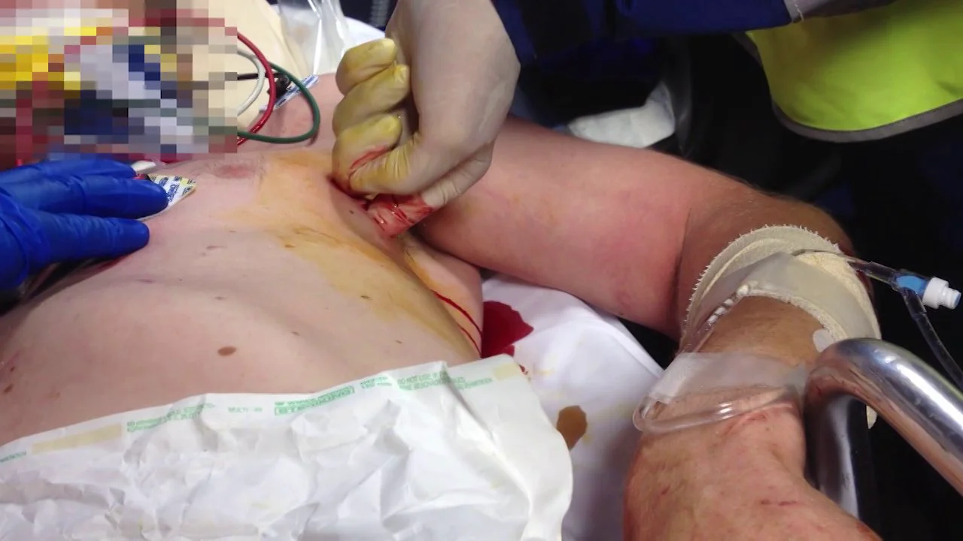
Trauma – thoraxletsel
Naaldthoracocentese (vooral non-trauma)
Vinger-thoracostomie bij trauma
Notes:
Discuss move towards thoracostomies rather than needle thoracocentesis
Bij arrest
- Bilateraal vinger of tube thoracostomie eerder dan thoracocentese. Naaldthoracocentese acceptabel alternatief bij kinderen.
- Bij penetrerend trauma kan bilaterale thoracotomie overwogen worden op spoed (zelden op straat)
mits expertise

Slide 17
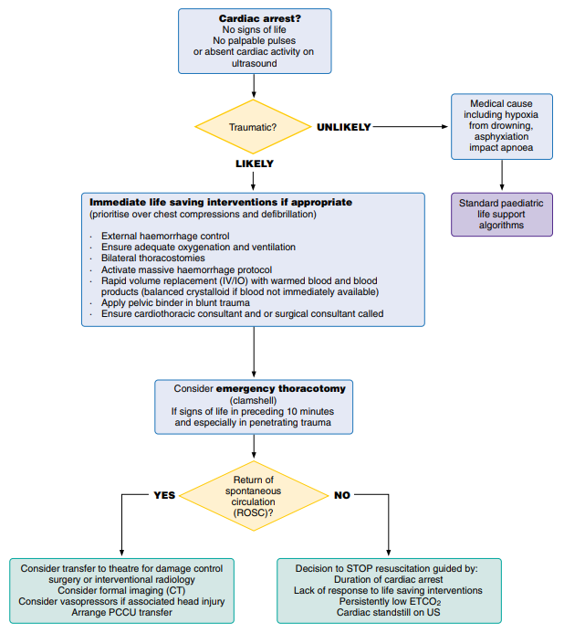
Hartstilstand bij kinderen met trauma
Notes:
How do we do this differently?
Why do we do this differently?

Slide 18
HOTT principe
Handelingen die onmiddellijk levensreddend zijn (‘prioriteit’ boven hartmassage en defibrillatie)
Hypovolemie (Stelpen externe bloedingen, bekkensling, snel vocht, MTP)
Oxygenatie tekort
Tensie pneumonthorax (Bilaterale) thoracostomie
Tamponade
Notes:
Immediate life saving interventions if appropriate – name HOTT principles - (prioritise over chest compressions and defibrillation)
· External haemorrhage control · Ensure adequate oxygenation and ventilation
· Bilateral thoracostomies
· Activate massive haemorrhage protocol
· Rapid volume replacement (IV/IO) with warmed blood and blood products (balanced crystalloid if blood not immediately available)
· Apply pelvic binder in blunt trauma
· Ensure cardiothoracic consultant and or surgical consultant called
The HOTT principle in trauma is
a mnemonic for addressing the four most common, potentially reversible causes of traumatic cardiac arrest (TCA): Hypovolemia (hemorrhage), Oxygenation impairment, Tension pneumothorax, and Tamponade (cardiac tamponade). It emphasizes identifying and correcting these issues simultaneously before continuing or initiating chest compressions in a trauma patien

Slide 19
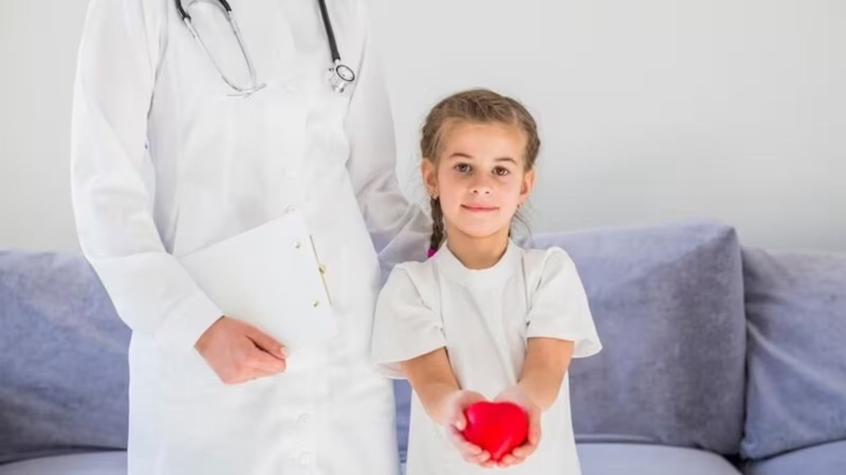
2. Aanpak van hartstilstand
Notes:
DON’T FORGET TO READ THE NOTES UNDER THE SLIDES!

Slide 20
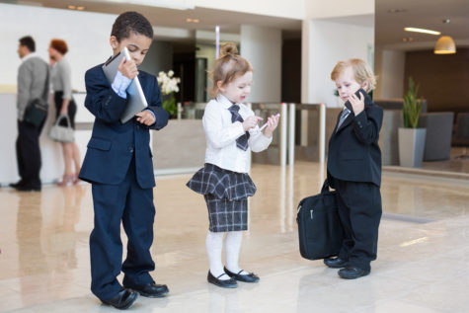
Definitie pasgeborene, zuigeling en kind
Pasgeborene | Net na geboorte (‘nat’)
Zuigeling | < 1 jaar
Kind/adolescent | 1 -18 jaar (België: 15j)
Als jij denkt dat het een kind is, mag je de richtlijnen voor kinderen toepassen.
Notes:
The above table replaces the line “A somewhat artificial line is drawn between infant (less than 1 year old) and children (between 1 year and puberty)”

Slide 21
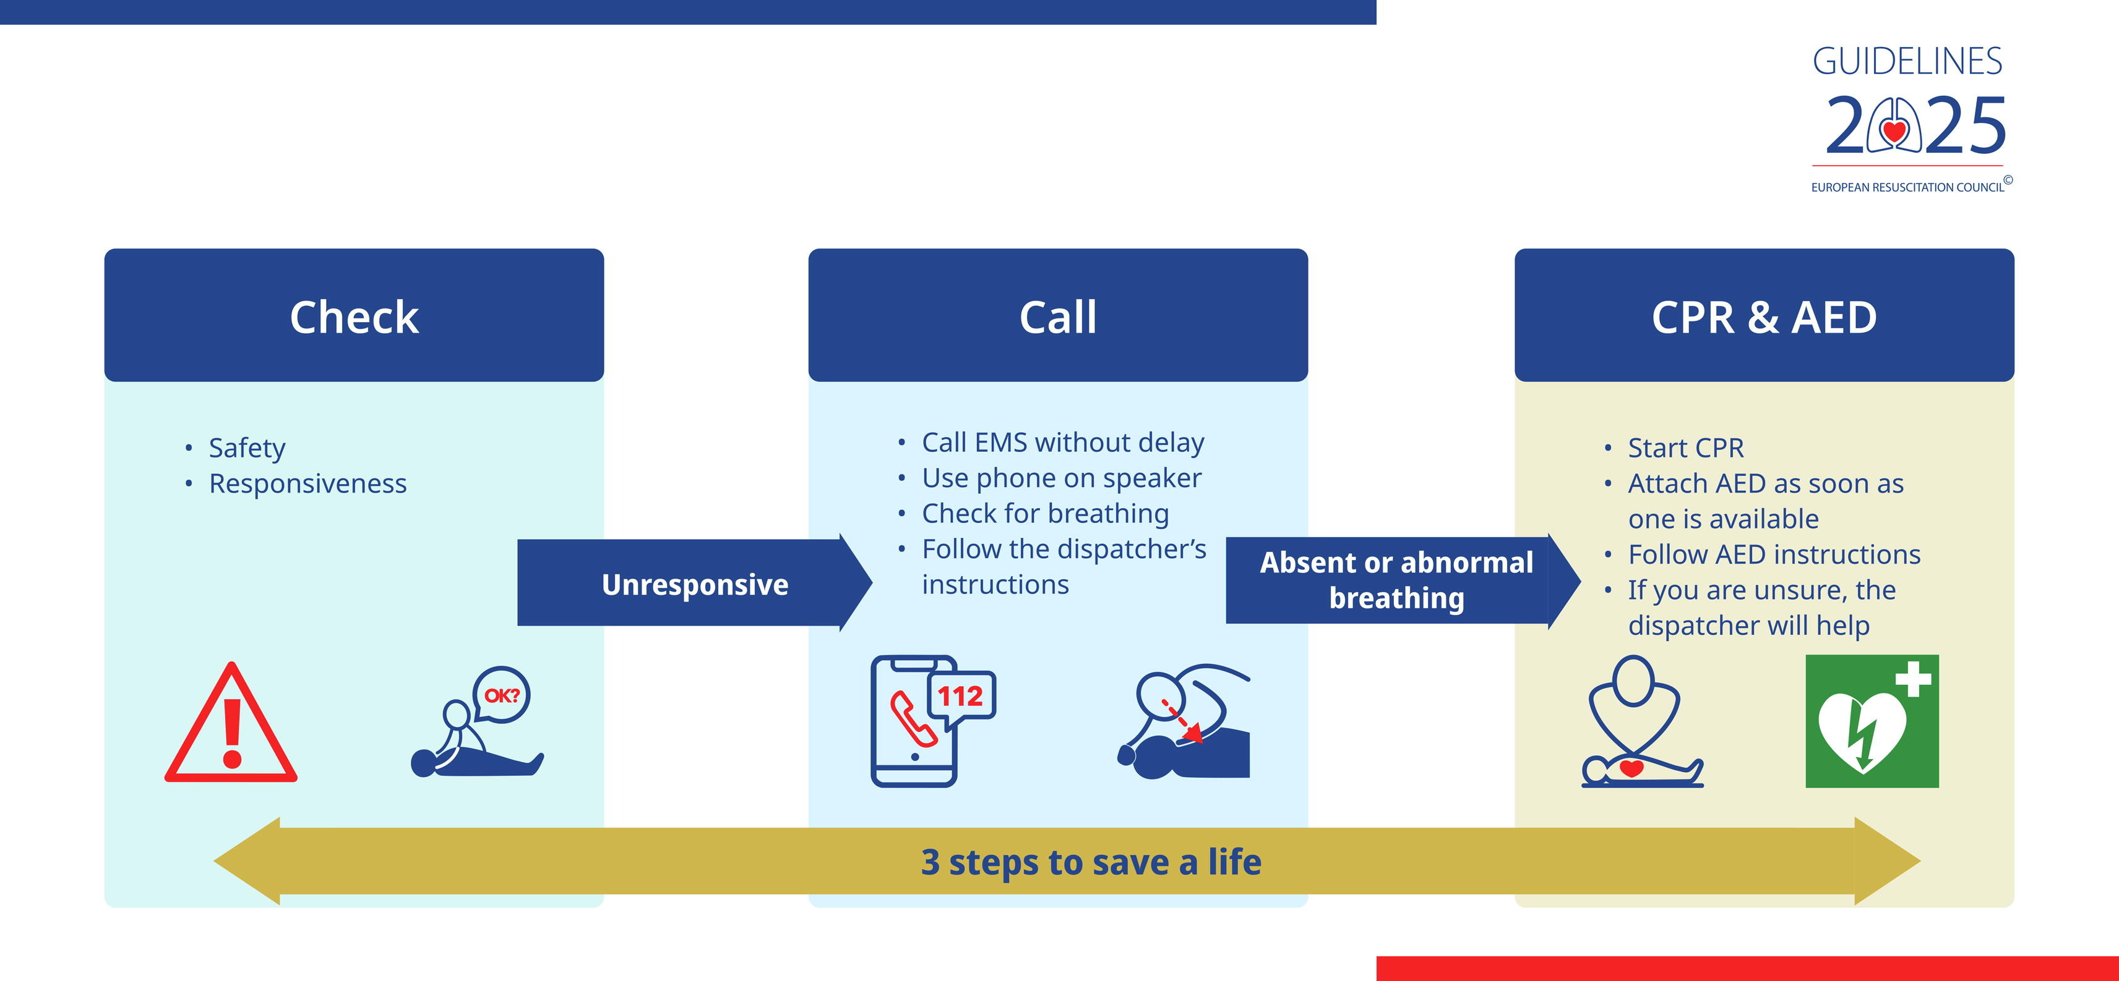
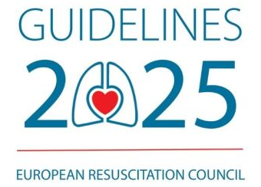

Slide 22
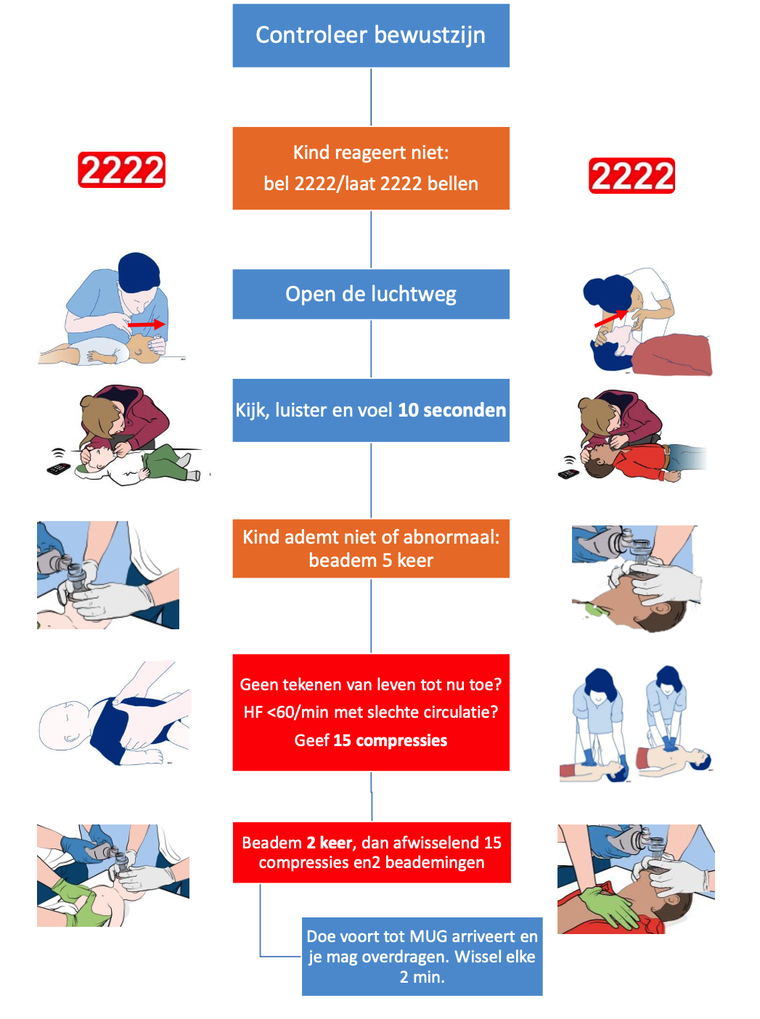
Notes:
Wijs op sneller hulp activeren en op alleen omcirkelen

Slide 23
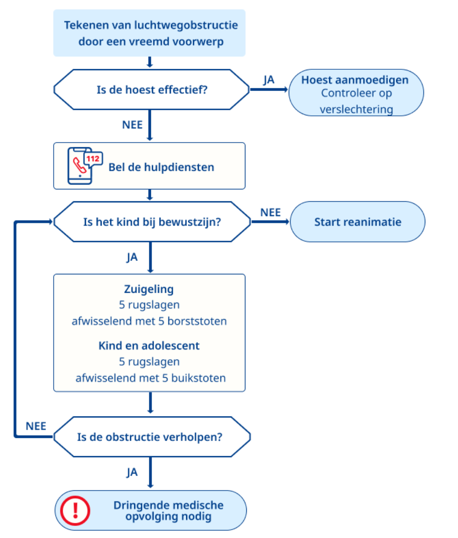
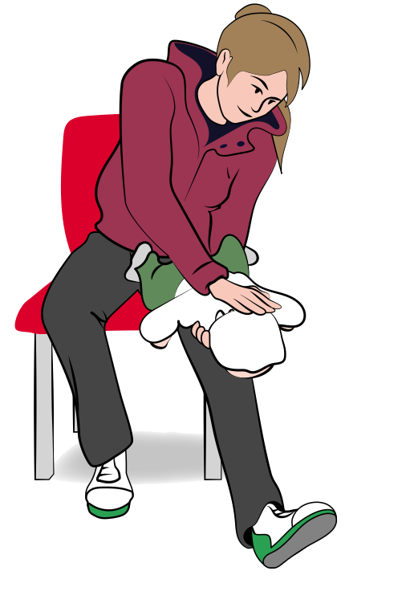
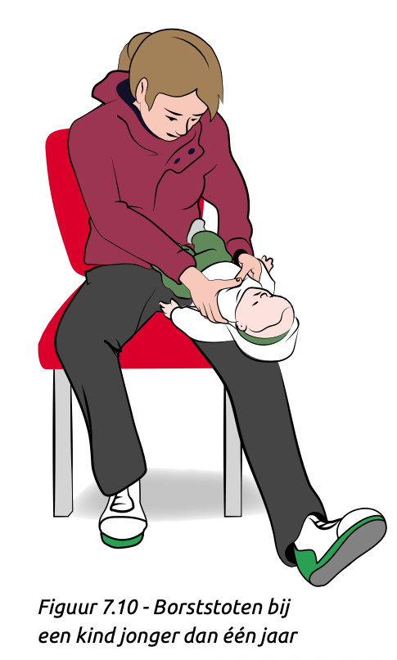
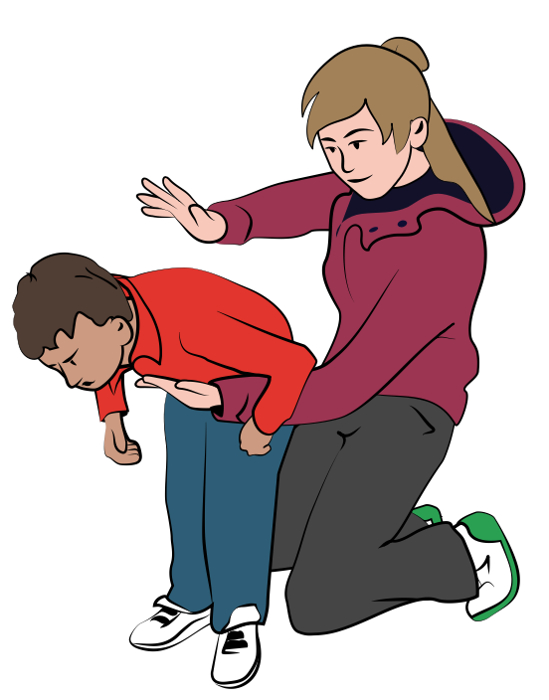
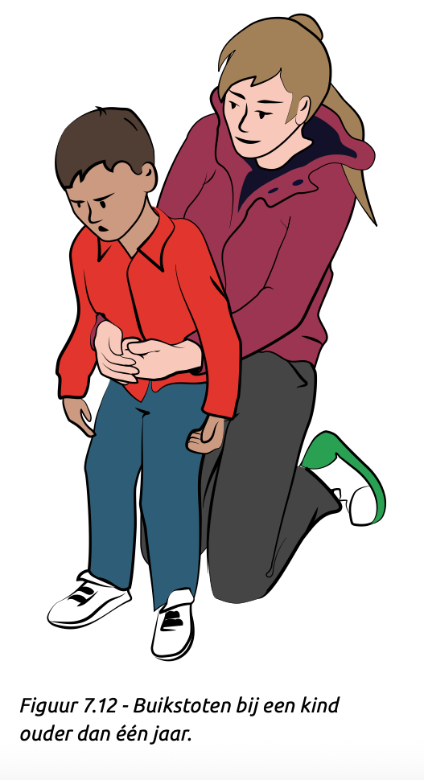
Notes:
Ook hier nu deze techniek voor de babies

Slide 24
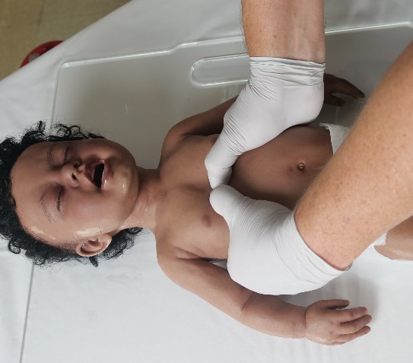
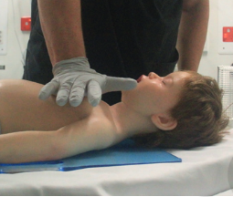
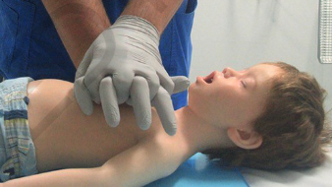
EFFECTIEVE BLS REDT LEVENS
15:2
100-120 per minuut
Duw hard, minstens 1/3e diep
Notes:
If still no signs of life observed during the previous steps, then start chest compressions.
Signs of life
• breathing or abnormal breathing (agonal breathing)
• movement
• cough/gag in response to breaths
Compress the lower half of the sternum at least one third of the depth of the child’s/infant’s chest.
Infant - Using two-thumb encircling technique over the lower half of the sternum – at least 4cm
Child - Using the heel of one hand (or two) over the lower half of the sternum – at least 5 cm
Thanks to Children’s Health Queensland for images

Slide 25
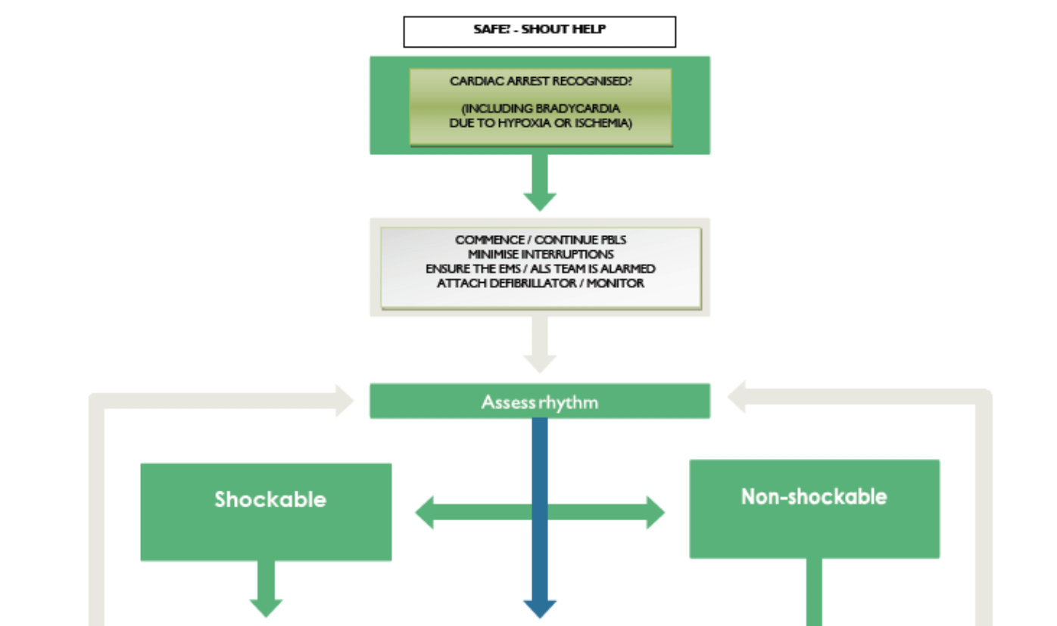
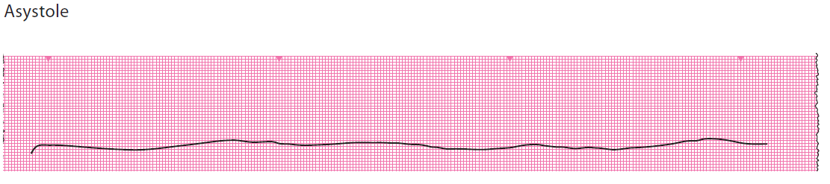
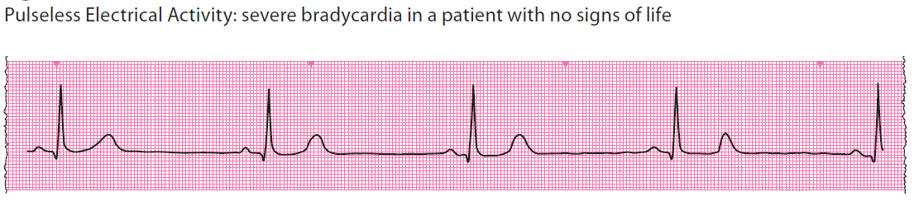
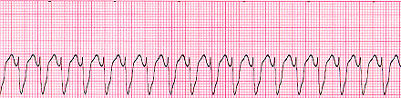
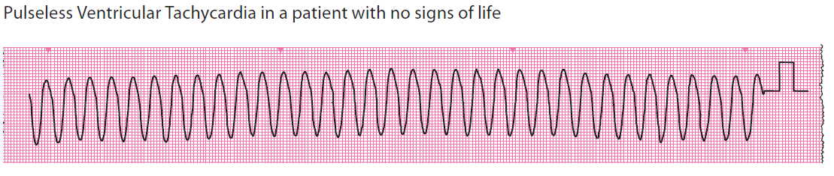
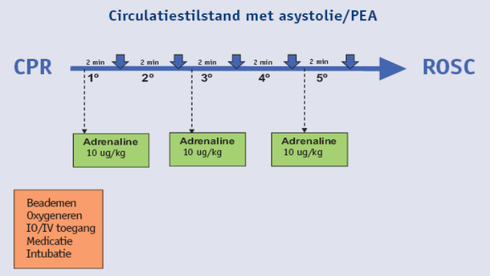
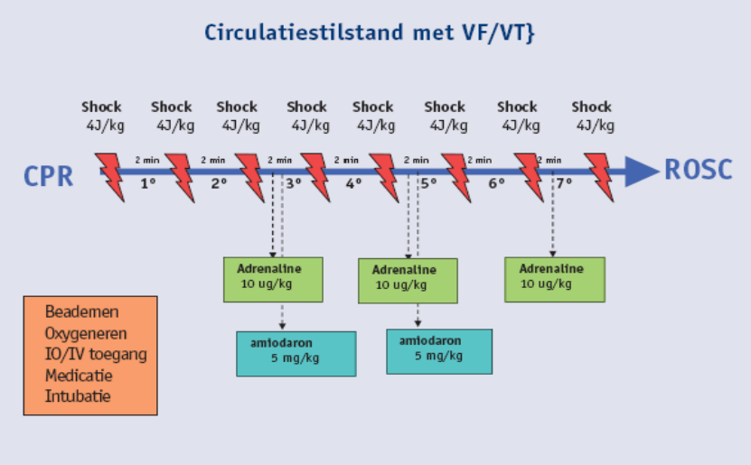
8J/kg
8J/kg
8J/kg
8J/kg
Notes:
Geen veranderingen non shockable
Bijna geen veranderingeen tenzij overwegen hogere dosis (*j/kg) vanaf 5e shock maar niet meer dan 360 J/shock

Slide 26
Defibrillatie
Single shocks
Manuele defibrillator
  4 J/kg voor iedereen
AED
  Liefst aangepaste set tussen 1-8 jaar.
  Ouder dan 8: volwassen shock
Nog steeds in aritmie na 4 shocks
  Overweeg andere plaatsing van andere pads
  Overweeg ophogen dosis tot 8 J/kg
Notes:
For the infant of less than one year a manual defibrillator which can adjusted to give the correct shock is recommended. However, if an AED is the only defibrillator available, it use should be considered, preferably with paediatric attenuation pads. The order of decreasing preference for defibrillation in the under ones is as follows:
Manual defibrillator
AED with dose attenuator
AED without dose attenuator
From Resuscitation 161 (2021) page 338 - European Resuscitation Council Guidelines 2021: Paediatric Life Support :
“Use 4 J/kg as the standard energy dose for shocks. It seems reasonable not to use doses above those suggested for adults (120-200 J, depending on the type of defibrillator). Consider escalating doses -stepwise increasing up to 8 J/Kg and max. 360 J- for refractory VF/pVT (i.e. more than 5 shocks needed).”

Slide 27

Advanced Paediatric Life Support Recertificatiecursus

Slide 28

Samenvatting
We bespraken vele aspecten van de resuscitatie, maar deze korte verkenning is niet volledig.
Volg updates
  via de VLE
  Via de manual (7e , 8e, 9e,….)
  Via andere kanalen: bv. app ERC of lokale/nationale richtlijnen.

Slide 29
Simulatie demonstratie
Vragen die je onderling na de demonstratie bespreekt:
Hoe heeft de teamleider de niet-technische aspecten van de simulatie aangepakt?
Als jij een team leidt, hoe zorg je er dan voor dat er goede beslissingen worden genomen?
Wat zijn onderdelen van een effectieve communicatie?
Probeer deze vragen onderling op te lossen, nadien volgt nog een korte nabespreking met de hele groep.
Notes:
Discussion
Get candidates to discuss the following questions with a learning partner for 2 minutes for each question. In between each question open out to the group. This will ensure that all of them are fully engaged.
Leadership and communication
During the learning partner conversation ensure the following aspects of leadership and communication are discussed.
Team leadership involves directing and coordinating the activities of the team members, encouraging them to work together, assessing performance, assigning tasks appropriately dependent on skills, creating a positive atmosphere and ensuring the care of the child.
Specifically the group need to raise the following as important issues for effective leadership:
Position of the leader in the room
Situation awareness
Leader sharing their mental model
Leader asking the team to share information and asking the team for their opinions
Leader using their own and the team’s knowledge of appropriate algorithms and/or checklists
Pausing (10 seconds for 10 minutes) if appropriate
Verbalising
Using closed loop communication
Using people’s names
Performing a succinct SBAR
Please add anything that would be useful to talk about in terms of clinical team leadership.

